Slide 1
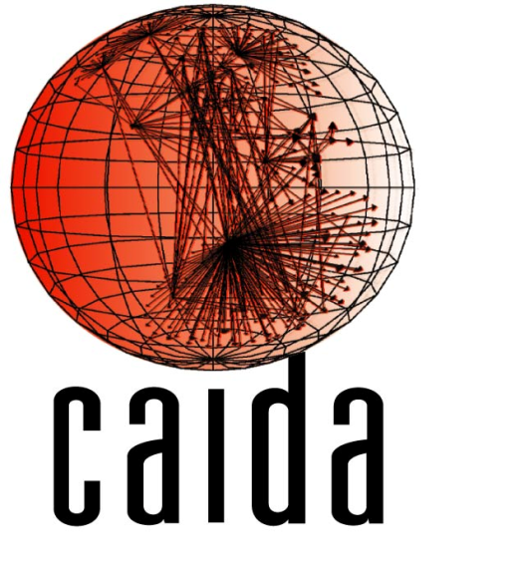
CAIDA’s AS-rank: measuring the influence of ASes on Internet Routing
Matthew Luckie
Bradley Huffaker Amogh Dhamdhere
Vasileios Giotsas
k claffy
http://as-rank.caida.org/

Slide 2
Overview
Inferring AS relationships using publicly available BGP paths
views of ~400 ASes at Route Views and RIPE RIS
Inferring the influence of ASes based on their “customer cone”
Traffic in your customer cone stays on-net and is the most profitable (when it reaches you)
http://as-rank.caida.org/

Slide 3
AS Relationships – Validation Summary
CAIDA: 2,370
2010 – 2012 83% p2p
Most submitted via web form, some via email
RPSL: 6,065
April 2012 100% p2c
RIPE whois database, two-way handshake
BGP Communities: 39,838
April 2012 59% p2c
Dictionary of operator-published community meanings assembled by Vasileios Giotsas (UCL)
Overall: 47,881 GT relationships, 63% p2c, 37% p2p
~38% of the publicly available graph.

Slide 4
AS Relationships - Validation
 | p2c PPV |  | p2p PPV
CAIDA | 99.6% | 1/250 | 98.4% | 1/63
UCLA | 99.0% | 1/100 | 90.9% | 1/12
Isolario | 90.3% | 1/10 | 96.0% | 1/25
Xia + Gao | 90.6% | 1/10 | 95.6% | 1/23
Gao | 84.7% | 1/6.5 | 99.5% | 1/200
SARK
CSP
ND-ToR
Take home: difficult to be accurate at inferring both types of relationships

Slide 5
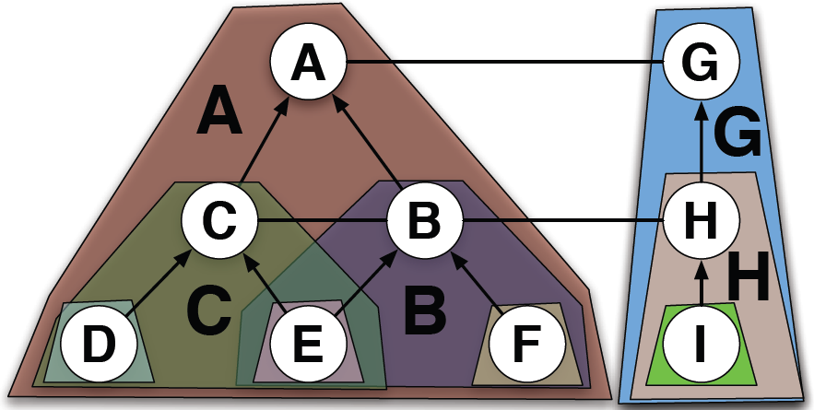
Definition – Customer Cones
A’s customer cone: A, B, C, D, E, F
B’s customer cone: B, E, F
C’s customer cone: C, D, E

Slide 6
Customer Cone Computation
AS relationships are complex: two ASes may have a c2p relationship in one location, but p2p elsewhere
Define customer cone based on provider/peer observed view of an AS
A sees D and E as indirect customers via B, so B’s customer cone only includes D, E from C.
Might suffer from limited visibility
A
Region Y: “Europe”
B
Region X: USA
B
C
NOT inferred to be part of B’s.
C
F G H
D
E

Slide 7
Caveats
AS Relationship ecosystem is complex
Different relationships in different regions
Can’t differentiate between paid-peers and settlement-free peers (financial difference, not routing)
Don’t know about traffic
Don’t have much visibility into peering
BGP paths are messy (poisoning, leaking)
NOT a clear metric of market power

Slide 8
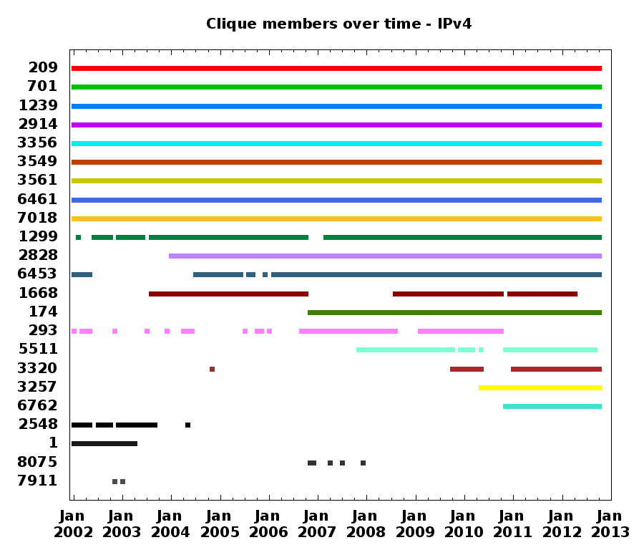
CL – Qwest
Verizon
Sprint
NTT
Level3
Level3 - GBLX
CL – Savvis
AboveNet
AT&T
TeliaSonera
XO
TATA
AOL
Cogent
ESNet
France Tel.
Deutsche Tel.
Inteliquent
Tel. Italia
WorldCom BBN/Genuity
Microsoft
Will. Comms.

Slide 9
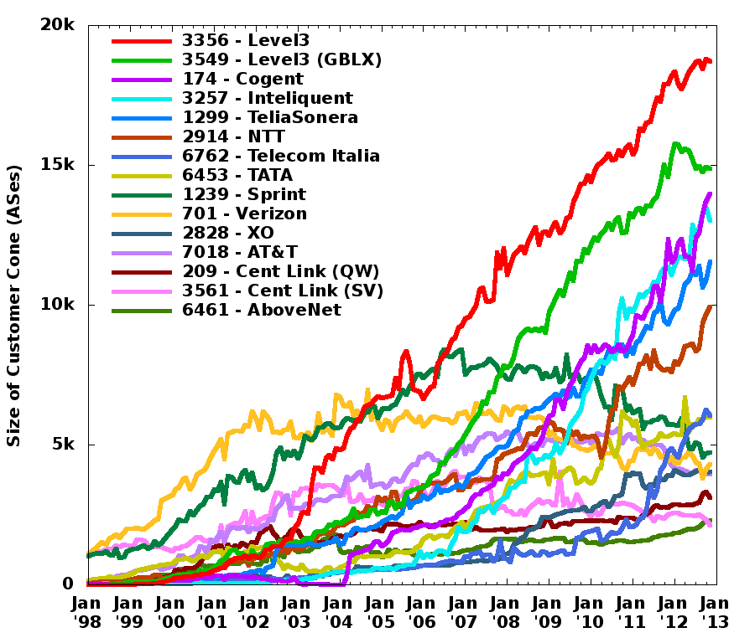
Level3
44%
Level3 + GBLX
Level3 (GBLX)
Cogent
Inteliquent
TeliaSon.
NTT
Level3 + Genuity
Tel. Italia
TATA
Sprint Verizon XO
AT&T CL (QW) AboveNet
CL (SV)
Verizon Sprint MCI

Slide 10
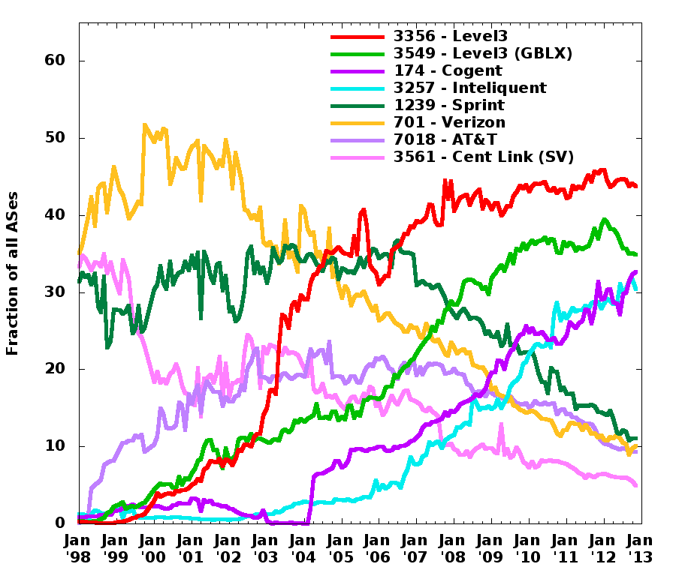
Level3
Level3 (GBLX)
Cogent
Inteliquent
Sprint Verizon AT&T
(MCI/CL)

Slide 11
Customer cone as a metric
Fraction: 0.75
TP
Fraction: 0.25
P₁
P₂
VP
A
B
C
D
What fraction of ASes in a customer cone are reached via the top provider?

Slide 12
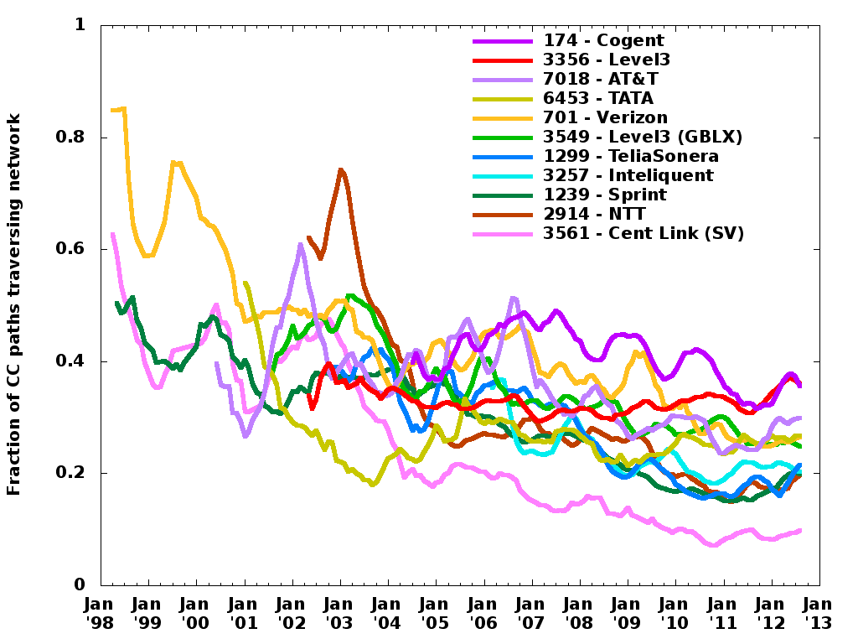

Slide 13
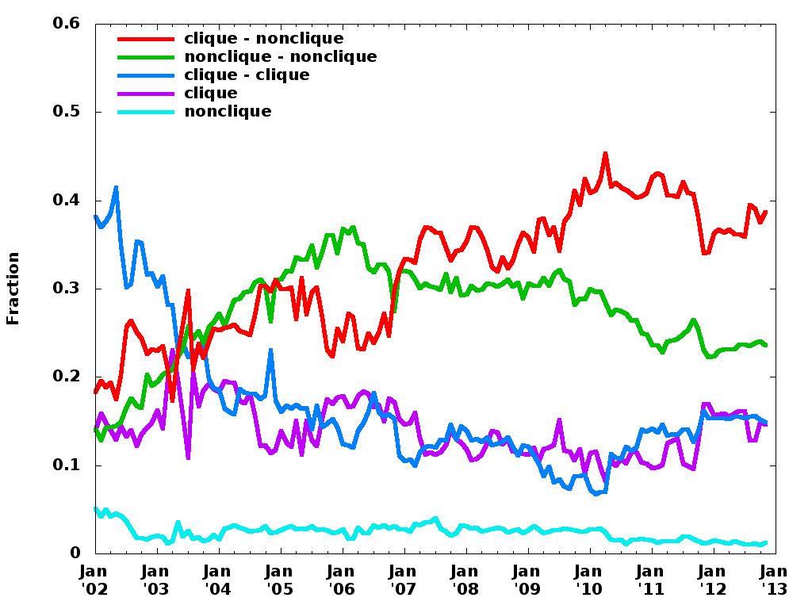

Slide 14
Data Sharing
On publication:
97% of Validation Data (not directly reported)
15 years of AS relationship inferences
15 years of customer cone inferences

