Slide 1
Physics and geometry of networks
Dmitri Krioukov UCSD/CAIDA Northeastern University, February 2013

Slide 2
Physics, geometry, networks
Canonical physics
Least action principle
Lagrangian $L\left(q,\dot{q},t\right)$
Hamiltonian $H=p\dot{q}−L, p=\frac{∂L}{∂\dot{q}}$
Action $$𝒮=∫L dt$$
Hamilton equations
$$\dot{q}=\frac{∂H}{∂p}; \dot{p}=−\frac{∂H}{∂q}$$
Least action $$δ𝒮=0$$
Euler-Lagrange equations (ELE) $$\frac{d}{dt}\frac{∂L}{∂\dot{q}}−\frac{∂L}{∂q}=0$$

Slide 3
Physics, geometry, networks
Canonical physics
Least action principle
(Hidden) geometry
Classical mechanics:
Space  time $S×T= 𝔼^{3}×ℝ$ Group $G=E\left(3\right)×T\left(1\right)$ Euclidean group $E\left(3\right)=T(3)⋊O\left(3\right)$
$G$ is a group of symmetries or isometries of (hidden) space $S$
$$q^{′}=A\left(q+a\right) \\ q,q^{′}∈𝔼^{3}; a∈T\left(3\right)=ℝ^{3}; A∈O(3)$$
Coordinate transformations $G:q↦q′$
Free particle $L=\frac{m{\dot{q}}^{2}}{2}$
$L$ is invariant under $G$
Time translations $T\left(1\right)$: energy’s conserved Space translations $T\left(3\right)$: momentum
Space rotations $O\left(3\right)$: angular momentum
Conservation law (Noether’s theorem)

Slide 4
Physics, geometry, networks
Canonical physics
ELE = Newton’s law $F=ma$
Least action principle
(Hidden) geometry
Examples
Classical mechanics
Relativistic mechanics
General relativity
Quantum mechanics
Space  time $S×T= 𝔼^{3}×ℝ$ Group $G=T\left(1\right)×T(3)⋊O\left(3\right)$
Free particle action $𝒮=m∫dl$
Particle in $U\left(q,t\right)$: $L=\frac{m{\dot{q}}^{2}}{2}−U\left(q,t\right)$
Spacetime $S=𝕄^{3,1}$ Group $G=T(3,1)⋊O\left(3,1\right)$ Free particle action $𝒮=−mc∫ds$
Universe’s spacetime $S≈{d𝕊}^{3,1}$ Group $G=SO\left(4,1\right)$ Free action $𝒮∼∫R\sqrt{−g} d^{4}x$
ELE = Einstein’s equations

Slide 5
Physics, geometry, networks
ELE = Maxwell’s equations
(Nonequilibrium) dynamics
Canonical physics
Least action principle
(Hidden) geometry
Examples
Classical mechanics
Relativistic mechanics
General relativity
Quantum mechanics
Quantum field theory
Statistical mechanics
Electrodynamics Hidden space $S=𝕊^{1}$ Group $G=U\left(1\right)$
Expected value of observable $𝒪$
$$\left\langle 𝒪\right\rangle =\frac{1}{Z}\int{𝒪 e^{− \frac{𝒮\left[φ\right]}{h}}} 𝒟φ$$
$$Z=\int{e^{− \frac{𝒮\left[φ\right]}{h}}} 𝒟φ$$
Electroweak interactions
Group $G=SU\left(2\right)×U\left(1\right)$ $$SU\left(2\right)∼𝕊^{3}$$
(Thermal) equilibrium
Expected value of observable $𝒪$
$$\left\langle 𝒪\right\rangle =\frac{1}{Z}\sum_{φ}{𝒪 e^{− \frac{H\left[φ\right]}{k_{B}T}}}$$
$$Z=\sum_{φ}{e^{− \frac{H\left[φ\right]}{k_{B}T}}}$$
Strong interactions
Group $G=SU\left(3\right)$ $SU\left(3\right)∼𝕊^{3}$-fiber bundle of $𝕊^{5}$

Slide 6
Physics, geometry, networks
Canonical physics
Least action principle
(Hidden) geometry
Examples
Classical mechanics
Relativistic mechanics
General relativity
Quantum mechanics
Quantum field theory
Statistical mechanics
Almost “all physics”
All fundamental interactions

Slide 7
Physics, geometry, networks
Canonical physics
Physics of networks
Least action principle
Check & revise principle
Lagrangian $L\left(q,\dot{q},t\right)$
Hamiltonian $H=p\dot{q}−L, p=\frac{∂L}{∂\dot{q}}$
Collect some data
Action $$𝒮=∫L dt$$
Measure some properties
Hamilton equations
$$\dot{q}=\frac{∂H}{∂p}; \dot{p}=−\frac{∂H}{∂q}$$
Least action $$δ𝒮=0$$
Some modeling and analysis
Euler-Lagrange equations (ELE) $$\frac{d}{dt}\frac{∂L}{∂\dot{q}}−\frac{∂L}{∂q}=0$$
Try to predict something

Slide 8
Physics, geometry, networks
Old and mature
Elegance post-factum
New and young Similar to early physics
Canonical physics
Physics of networks
Least action principle
Check & revise principle
Lagrangian $L\left(q,\dot{q},t\right)$
Hamiltonian $H=p\dot{q}−L, p=\frac{∂L}{∂\dot{q}}$
Collect some data
Action $$𝒮=∫L dt$$
Measure some properties
Hamilton equations
$$\dot{q}=\frac{∂H}{∂p}; \dot{p}=−\frac{∂H}{∂q}$$
Least action $$δ𝒮=0$$
Some modeling and analysis
Euler-Lagrange equations (ELE) $$\frac{d}{dt}\frac{∂L}{∂\dot{q}}−\frac{∂L}{∂q}=0$$
Try to predict something

Slide 9
Physics, geometry, networks
Old and mature
Elegance post-factum
New and young Similar to early physics
Canonical physics
Physics of networks
Main question: Does the canonical picture apply to networks?
Least action principle
Check & revise principle
Lagrangian $L\left(q,\dot{q},t\right)$
Hamiltonian $H=p\dot{q}−L, p=\frac{∂L}{∂\dot{q}}$
Collect some data
Action $$𝒮=∫L dt$$
Measure some properties
Hamilton equations
$$\dot{q}=\frac{∂H}{∂p}; \dot{p}=−\frac{∂H}{∂q}$$
Least action $$δ𝒮=0$$
Some modeling and analysis
Euler-Lagrange equations (ELE) $$\frac{d}{dt}\frac{∂L}{∂\dot{q}}−\frac{∂L}{∂q}=0$$
Try to predict something

Slide 10
Properties
Processes
Self-similarity (conformal invariance)
Maximum navigability
Exponential random graphs
(Fermi gas)
Popularity  similarity optimization
Classical random graphs
Random geometric graphs
in hidden hyperbolic spaces
Preferential attachment
Configuration model
Quantum gravity (causal sets)
Equilibrium-nonequilibrium duality

Slide 11
Properties
Processes
Self-similarity (conformal invariance)
Maximum navigability
Exponential random graphs
(Fermi gas)
Popularity  similarity optimization
Classical random graphs
Random geometric graphs
in hidden hyperbolic spaces
Preferential attachment
Configuration model
Quantum gravity (causal sets)
Equilibrium-nonequilibrium duality

Slide 12
Properties
Processes
Self-similarity (conformal invariance)
Maximum navigability
Exponential random graphs
(Fermi gas)
Popularity  similarity optimization
Classical random graphs
Random geometric graphs
in hidden hyperbolic spaces
Preferential attachment
Configuration model
Quantum gravity (causal sets)
Equilibrium-nonequilibrium duality

Slide 13
Properties
Processes
Self-similarity (conformal invariance)
Maximum navigability
Exponential random graphs
(Fermi gas)
Popularity  similarity optimization
Classical random graphs
Random geometric graphs
in hidden hyperbolic spaces
Preferential attachment
Configuration model
Quantum gravity (causal sets)
Equilibrium-nonequilibrium duality

Slide 14
Properties
Processes
Self-similarity (conformal invariance)
Maximum navigability
Exponential random graphs
(Fermi gas)
Popularity  similarity optimization
Classical random graphs
Random geometric graphs
in hidden hyperbolic spaces
Preferential attachment
Configuration model
Quantum gravity (causal sets)
Equilibrium-nonequilibrium duality

Slide 15
Properties
Processes
Self-similarity (conformal invariance)
Maximum navigability
Exponential random graphs
(Fermi gas)
Popularity  similarity optimization
Classical random graphs
Random geometric graphs
in hidden hyperbolic spaces
Preferential attachment
Configuration model
Quantum gravity (causal sets)
Equilibrium-nonequilibrium duality

Slide 16
Properties
Processes
Self-similarity (conformal invariance)
Maximum navigability
Exponential random graphs
(Fermi gas)
Popularity  similarity optimization
Classical random graphs
Random geometric graphs
in hidden hyperbolic spaces
Preferential attachment
Configuration model
Quantum gravity (causal sets)
Equilibrium-nonequilibrium duality

Slide 17
Properties
Processes
Self-similarity (conformal invariance)
Maximum navigability
Exponential random graphs
(Fermi gas)
Popularity  similarity optimization
Classical random graphs
Random geometric graphs
in hidden hyperbolic spaces
Preferential attachment
Configuration model
Quantum gravity (causal sets)
Equilibrium-nonequilibrium duality

Slide 18
Properties
Processes
Self-similarity (conformal invariance)
Maximum navigability
Exponential random graphs
(Fermi gas)
Popularity  similarity optimization
Classical random graphs
Random geometric graphs
in hidden hyperbolic spaces
Preferential attachment
Configuration model
Quantum gravity (causal sets)
Equilibrium-nonequilibrium duality

Slide 19
Properties
Processes
Self-similarity (conformal invariance)
Maximum navigability
Exponential random graphs
(Fermi gas)
Popularity  similarity optimization
Classical random graphs
Random geometric graphs
in hidden hyperbolic spaces
Preferential attachment
Configuration model
Quantum gravity (causal sets)
Equilibrium-nonequilibrium duality

Slide 20
Random graphs with hidden variables
Given N nodes
Assign to each node a random variable  drawn from distribution ()
Connect each node pair with probability p(,)
$$κ$$
$$κ′$$
$$p(κ,κ^{′})$$

Slide 21
Example: Classical random graphs
Given N nodes
Hidden variables: None
Connection probability: $p\left(κ,κ^{′}\right)=p$
Results:
Degree distribution: Poisson ($λ=pN$)
Clustering: Weak
$$κ$$
$$κ′$$
$$p$$

Slide 22
Example: Soft configuration model
Given N nodes
Hidden variables: Expected degrees $κ$ $ρ\left(κ\right) \sim κ^{−γ}$
Connection probability: $p\left(κ,κ^{′}\right)=\frac{κκ^{′}}{\overline{k}N}$
Results:
Degree distribution: Power law ($P\left(k\right) \sim k^{−γ}$)
Clustering: Weak
$$κ$$
$$κ′$$
$$p\left(κ,κ^{′}\right) \sim κκ′$$

Slide 23
Example: Random geometric graphs
Given N nodes
Hidden variables: Node coordinates $\vec{κ}$ in a space $ρ\left(\vec{κ}\right)$: uniform in the space
Connection probability: $p\left(\vec{κ},{\vec{κ}}^{′}\right)=Θ\left(R−d\left(\vec{κ},{\vec{κ}}^{′}\right)\right)$
Results:
Clustering: Strong
Degree distribution:
Euclidean or spherical space: Poisson
Hyperbolic space: Power law
$$\vec{κ}$$
$$\vec{κ}′$$
$$d\left(\vec{κ},{\vec{κ}}^{′}\right)<R$$

Slide 24
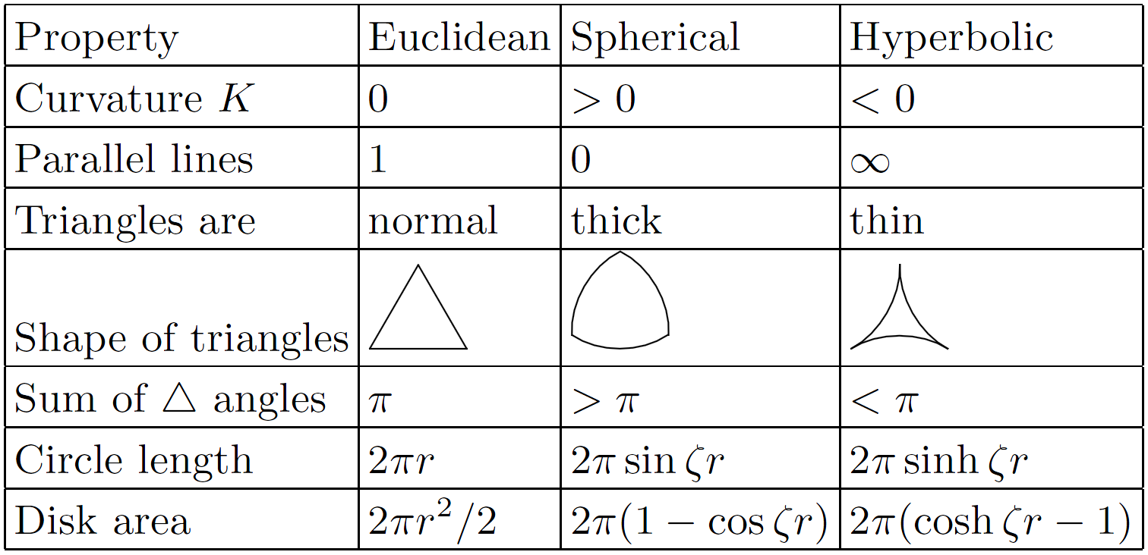
Taxonomy of spaces

Slide 25
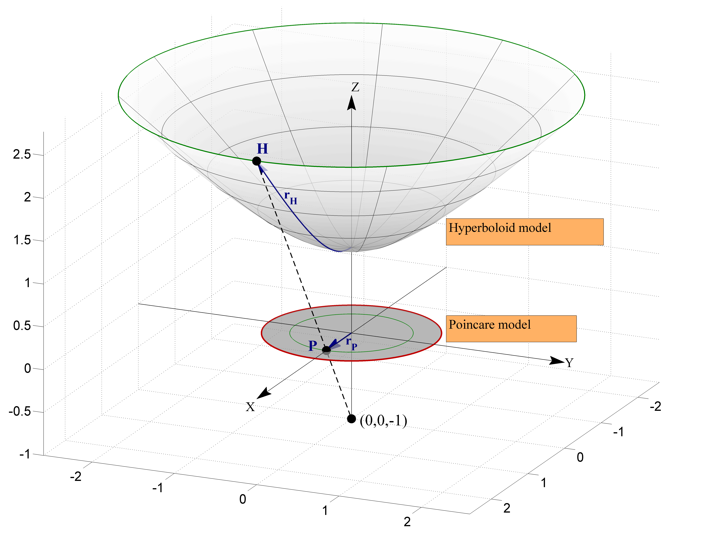
$${ds}^{2}={dx}^{2}+{dy}^{2}−{dz}^{2}$$
$$r_{P}=\tanh{\frac{r_{H}}{2}}$$
$$x^{2}+y^{2}−z^{2}=−1$$
$$x^{2}+y^{2}<1$$
$${ds}^{2}={dx}^{2}+{dy}^{2}+{dz}^{2}$$
$$r_{E}=−iE\left(ir_{H},2\right)$$

Slide 26
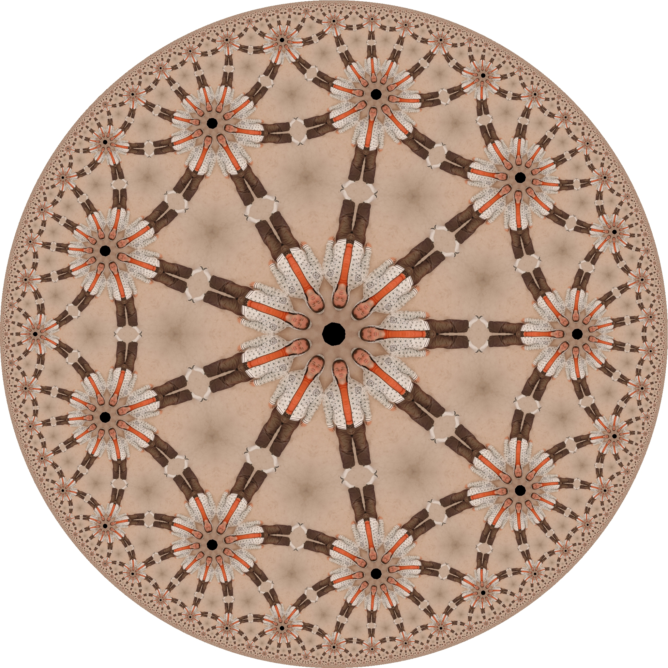

Slide 29
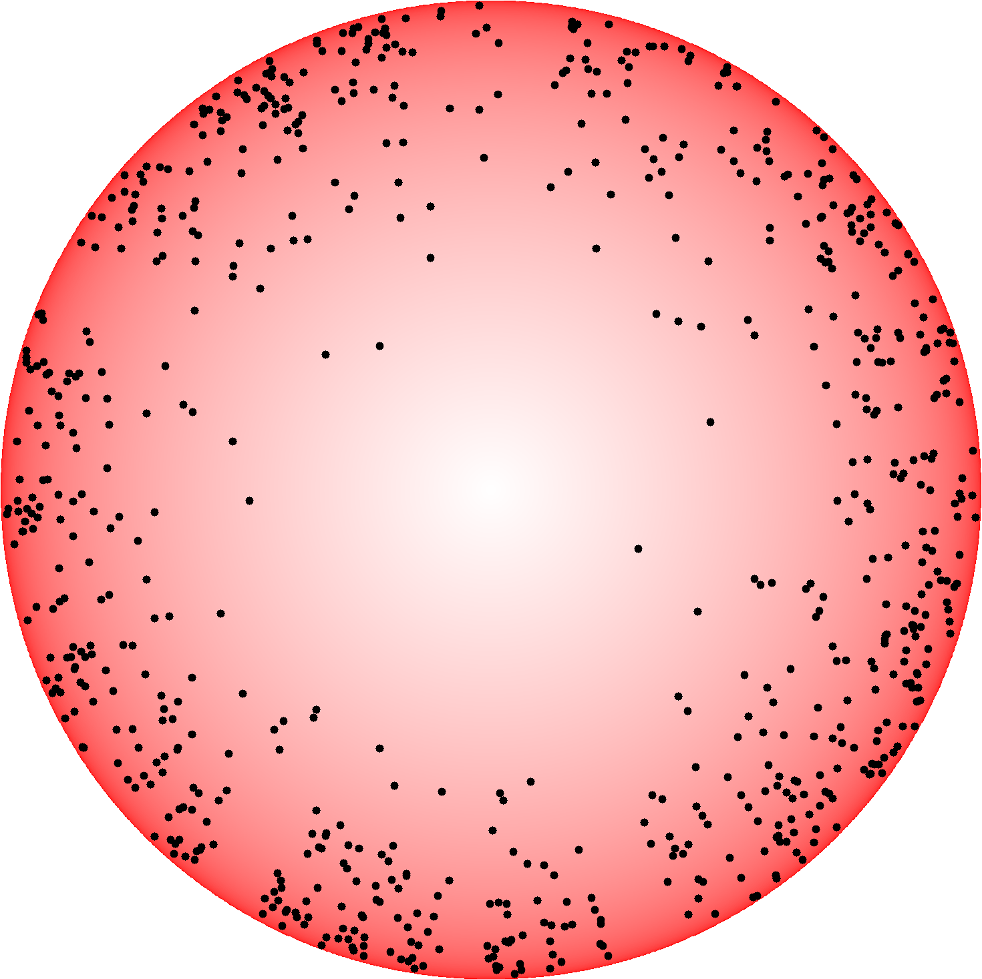

Slide 31
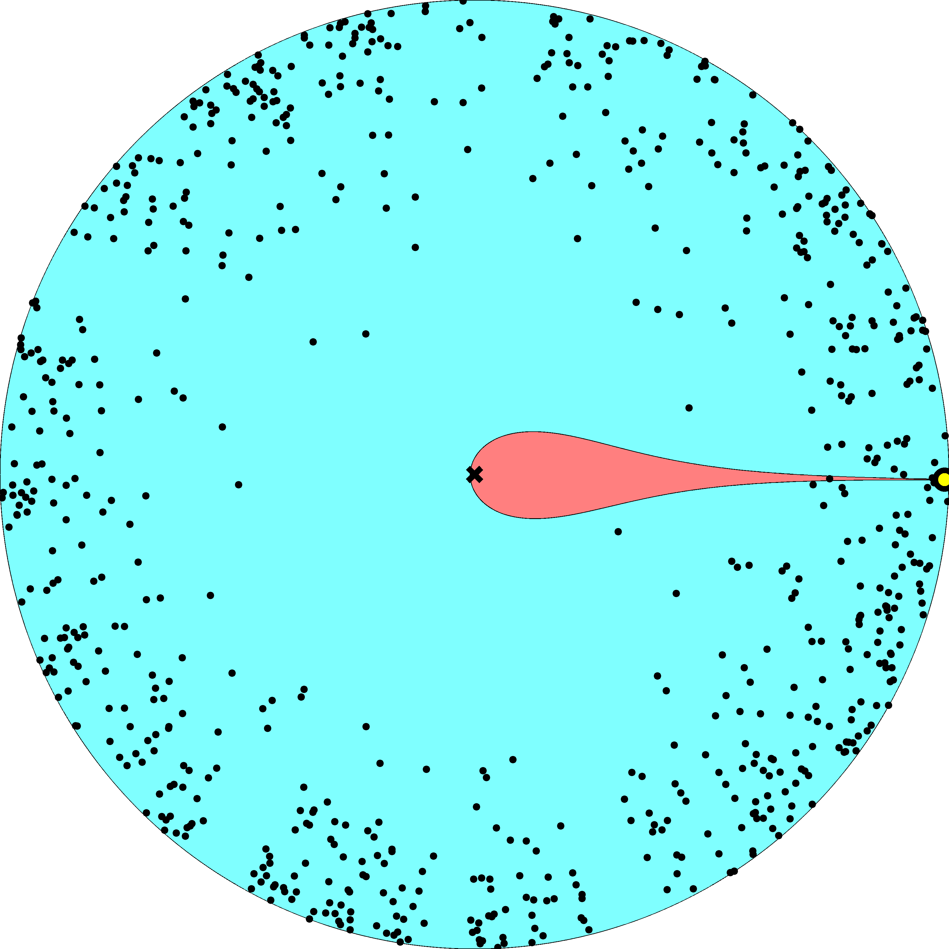

Slide 32
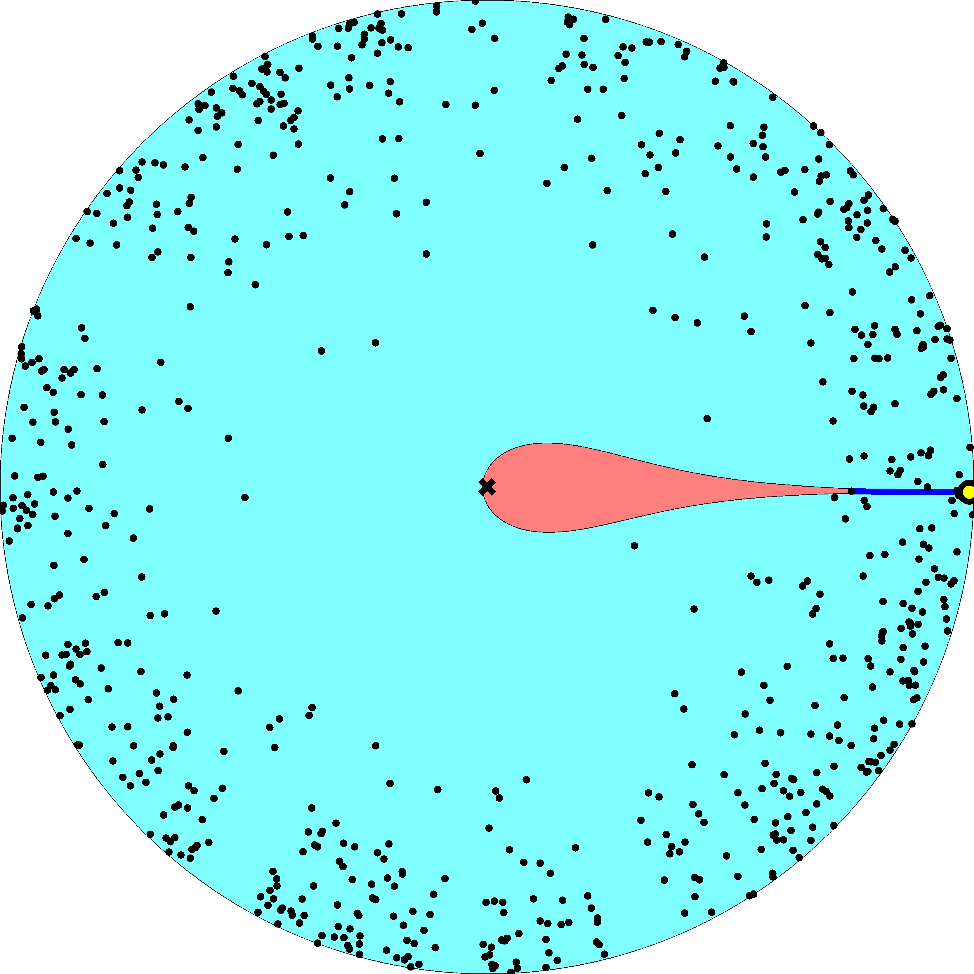

Slide 33
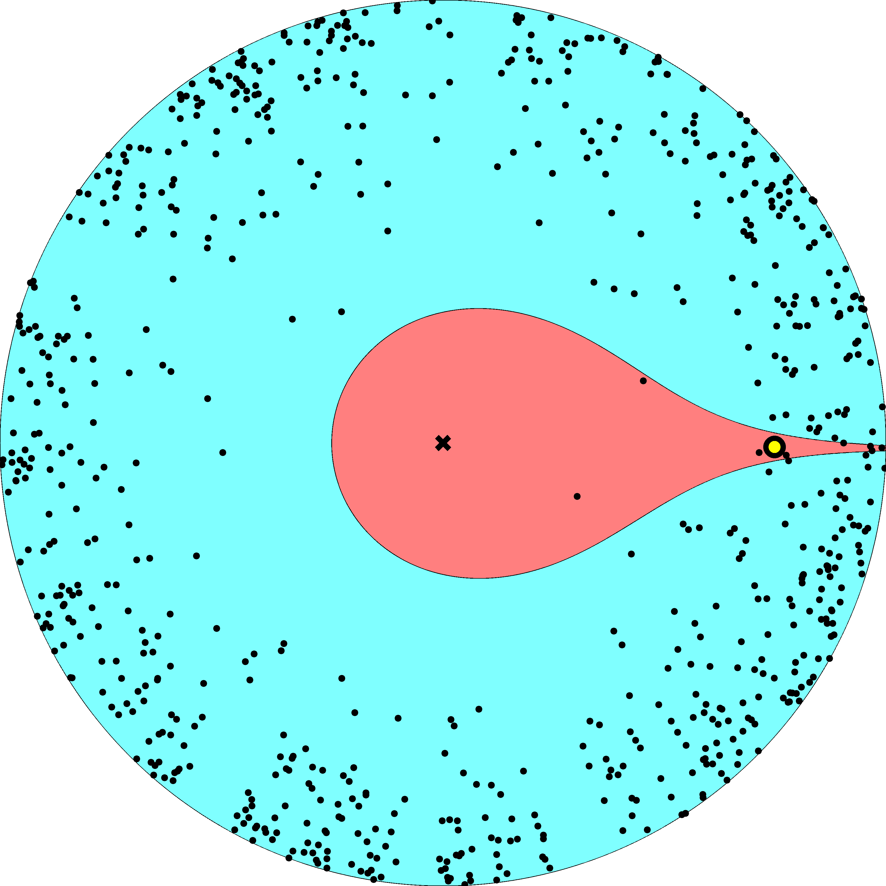

Slide 34
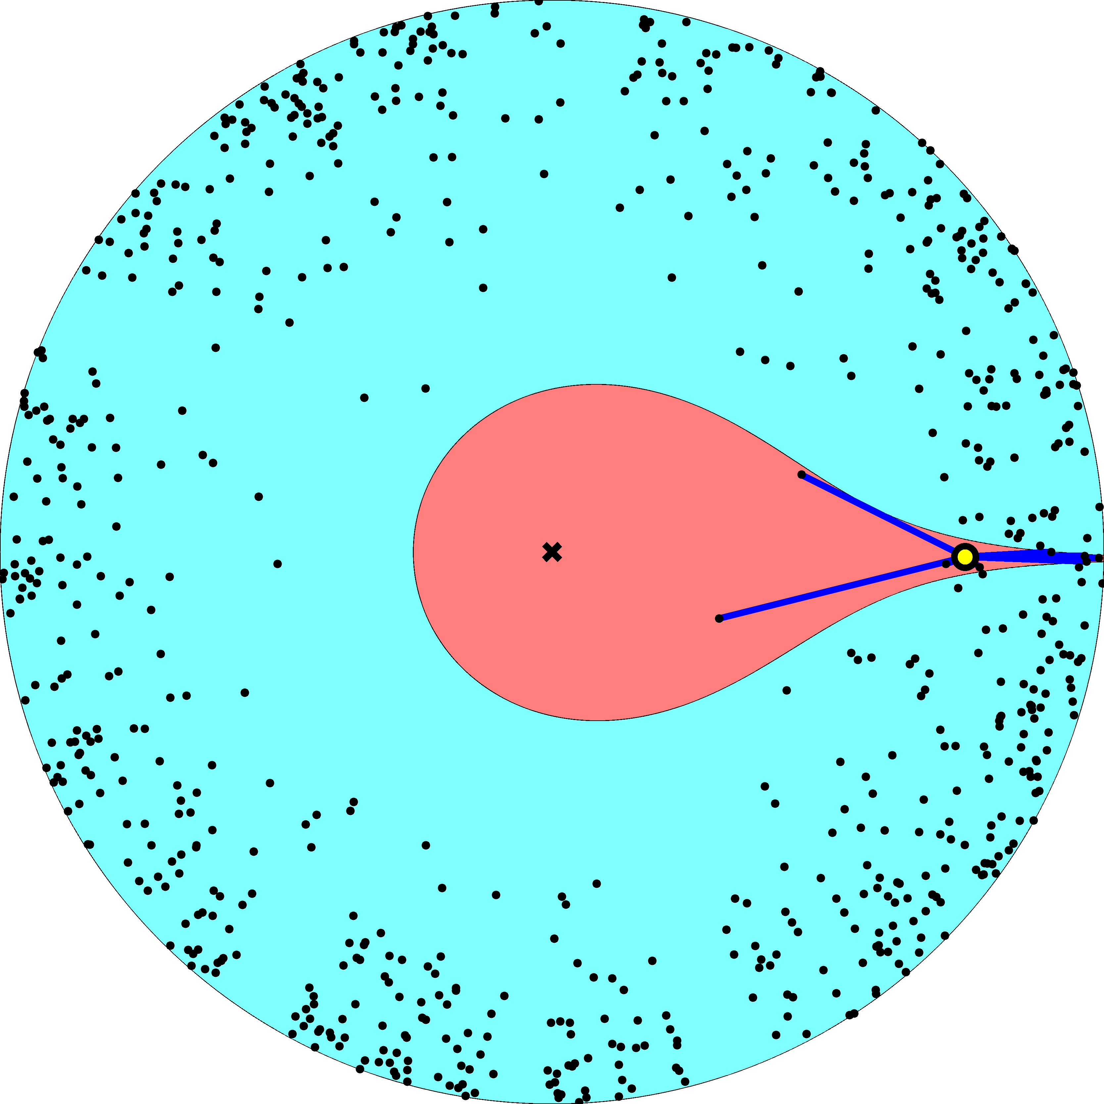

Slide 35
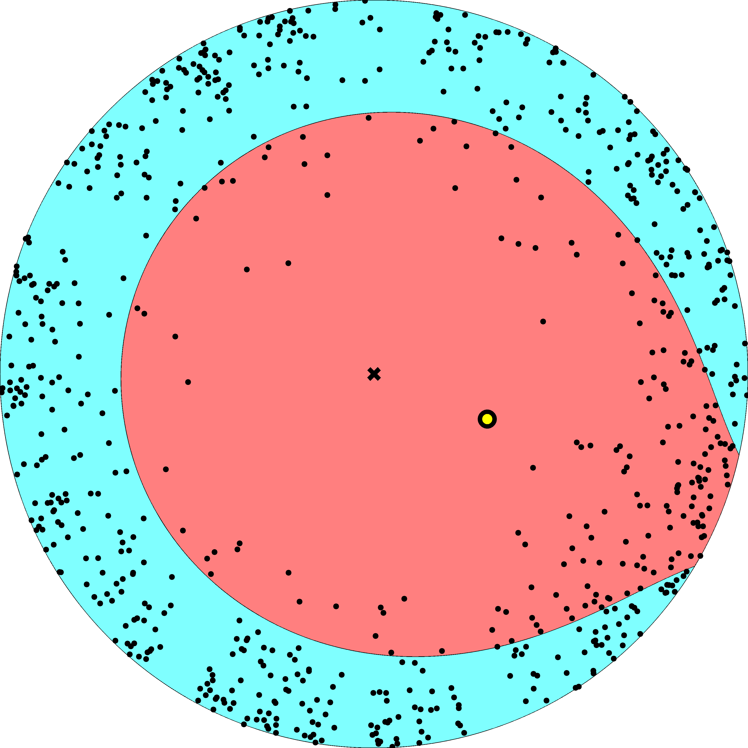

Slide 36
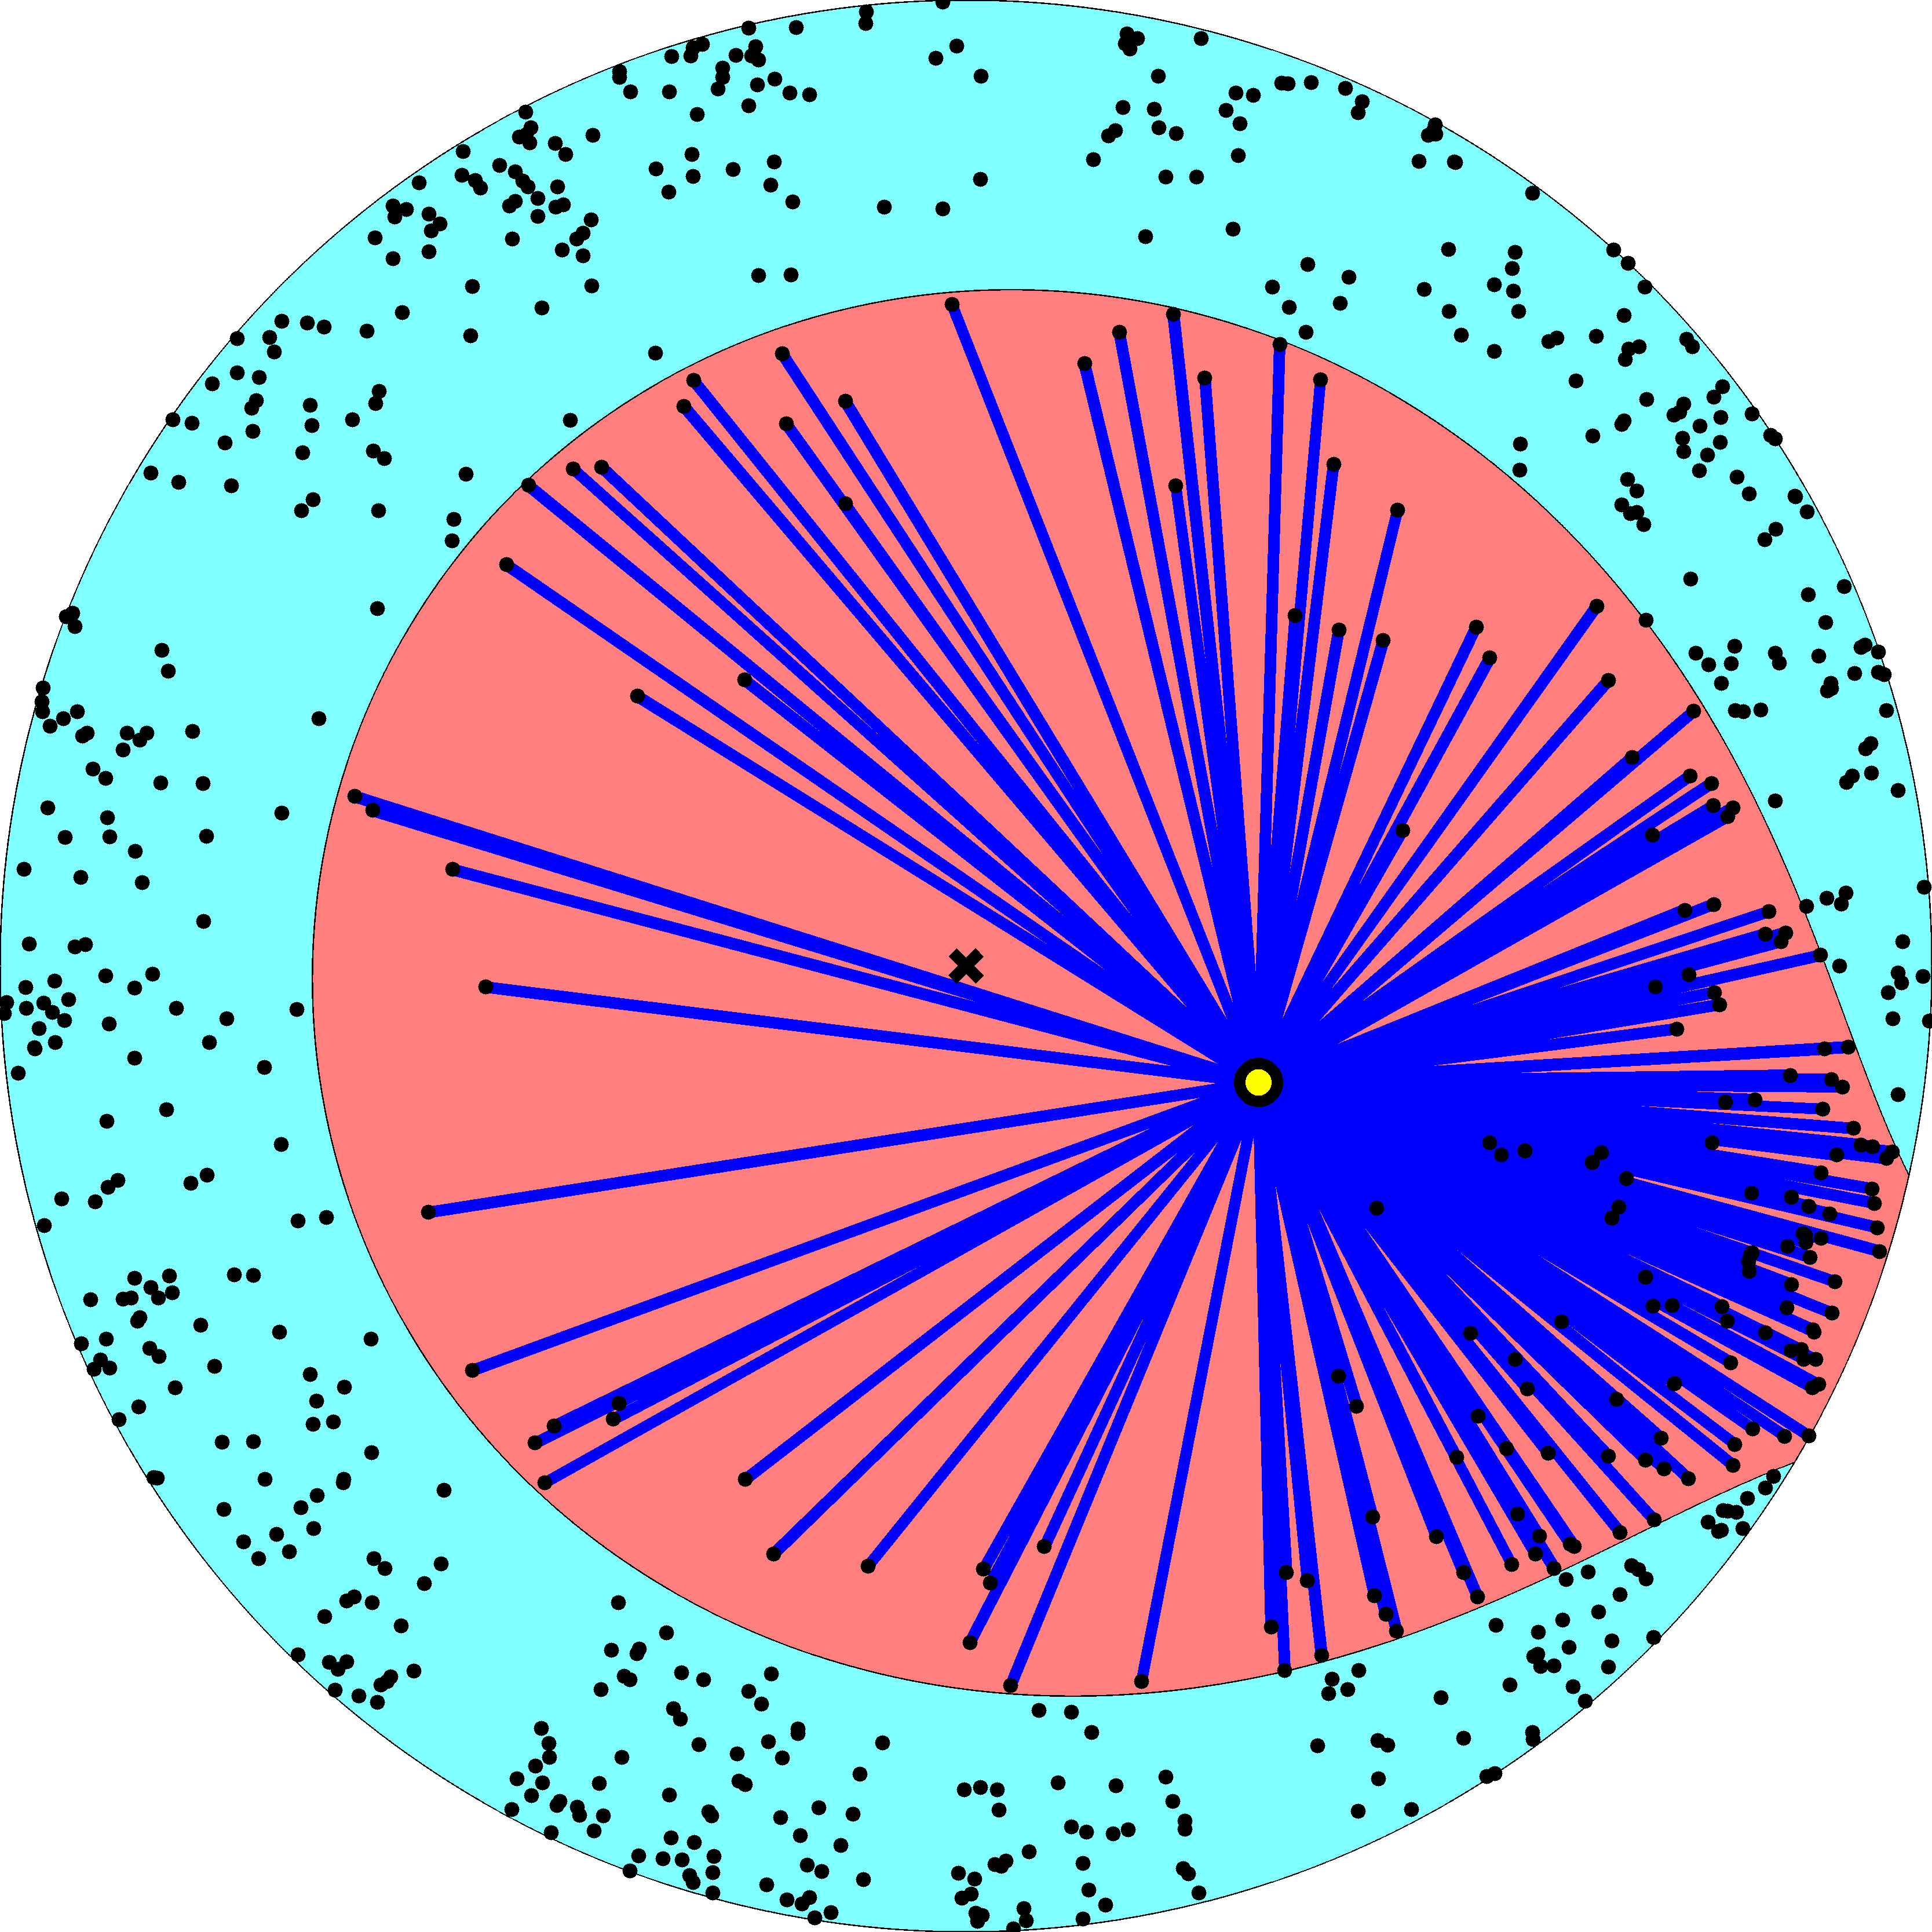

Slide 37
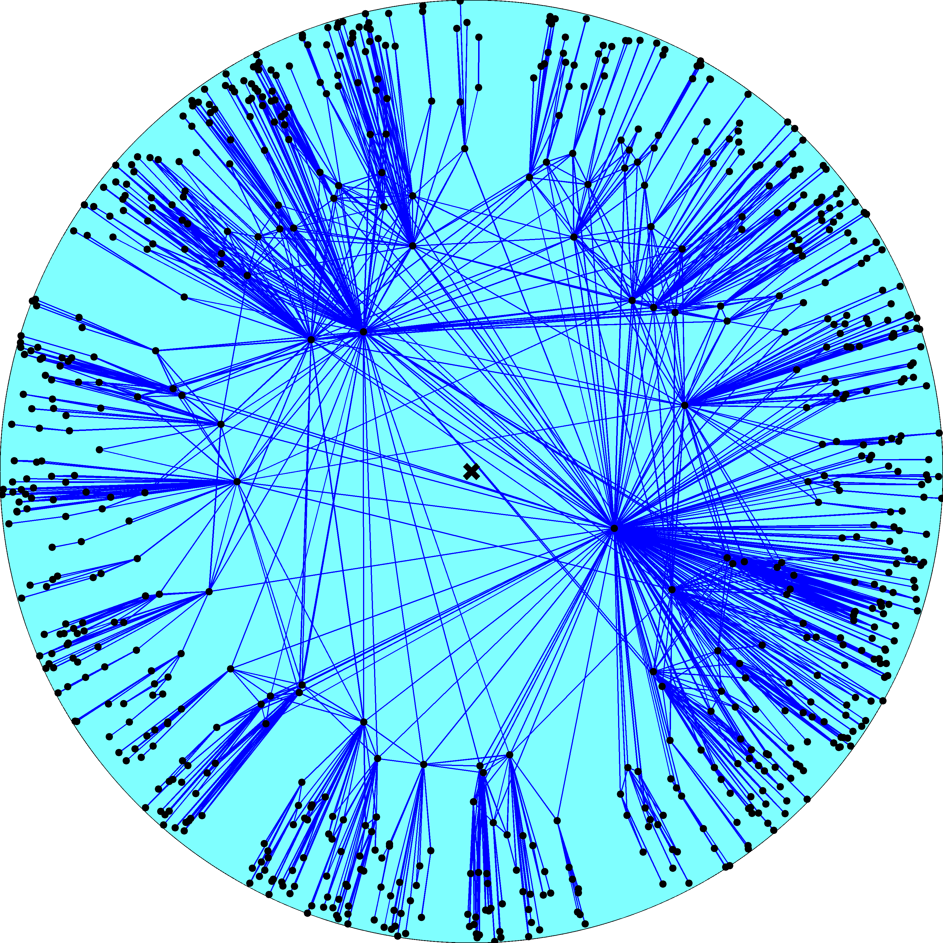
Degree distribution
$$P\left(k\right)∼k^{−γ} \\ γ=k_{B}+1 \\ k_{B}=\frac{2}{\sqrt{−K}}$$
Clustering
$$\overline{c}\left(k\right)∼k^{−1}$$ maximized

Slide 38
Fermi-Dirac connection probability
connection probability p(x) – Fermi-Dirac distribution
hyperbolic distance x – energy of links/fermions
disk radius R ~ log N – chemical potential
curvature radius k_{B} = 2/|K| – Boltzmann constant
parameter T – temperature
chemical potential R diverges at T  1 (phase transition)
clustering decreases from max at T = 0, to 0 at T  1
clustering is zero at T > 1

Slide 39
Exponential random graphs
Intuition:
Maximum-entropy graphs under the constraints that expected values of some graph observables are equal to given values
Definition:
Set of graphs G with probability measure $P\left(G\right)= \frac{e^{− \frac{H(G)}{k_{B}T}}}{Z}$ where the partition function $Z=\sum_{G}{e^{− \frac{H(G)}{k_{B}T}}}$ and $H\left(G\right)=\sum_{i}{ω_{i}𝒪_{i}\left(G\right)}$ is the graph Hamiltonian with Lagrange multipliers $ω_{i}$ maximizing the Gibbs entropy $S=−\sum_{G}{P\left(G\right)\ln{P\left(G\right)}}$ under constraints $\sum_{G}{P\left(G\right)𝒪_{i}\left(G\right)=\left\langle 𝒪_{i}\right\rangle }$

Slide 40
Examples
Hamiltonian can often be written using G’s adjacency matrix $A_{ij}$ as $H\left(G\right)=\sum_{i<j}{ω_{ij}A_{ij}}$
Free energy $F=−\ln{Z}$ yields connection probability $p_{ij}=\frac{∂F}{∂ω_{ij}}$
Graph models | $$ω_{ij}$$ | $$p_{ij}$$
Classical random graphs | $$ω_{ij}=ω$$ | $$p=\frac{1}{e^{ω}+1}$$
Configuration model | $$ω_{ij}=ω_{i}+ω_{j}$$ | $$p_{ij}=\frac{1}{e^{ω_{i}+ω_{j}}+1} \sim κ_{i}κ_{j}$$
Random hyperbolic graphs | $$ω_{ij}=x_{ij}−R$$ | $$p_{ij}=\frac{1}{e^{\frac{ω_{ij}}{k_{B}T}}+1} \sim {\left(\frac{κ_{i}κ_{j}}{θ_{ij}}\right)}^{\frac{1}{T}}$$

Slide 41
Examples
Hamiltonian can often be written using G’s adjacency matrix $A_{ij}$ as $H\left(G\right)=\sum_{i<j}{ω_{ij}A_{ij}}$
Free energy $F=−\ln{Z}$ yields connection probability $p_{ij}=\frac{∂F}{∂ω_{ij}}$
$$T→∞ \\ k_{B}→0 \\ k_{B}T=γ−1$$
$$T→∞$$
Graph models | $$ω_{ij}$$ | $$p_{ij}$$
Classical random graphs | $$ω_{ij}=ω$$ | $$p=\frac{1}{e^{ω}+1}$$
Configuration model | $$ω_{ij}=ω_{i}+ω_{j}$$ | $$p_{ij}=\frac{1}{e^{ω_{i}+ω_{j}}+1} \sim κ_{i}κ_{j}$$
Random hyperbolic graphs | $$ω_{ij}=x_{ij}−R$$ | $$p_{ij}=\frac{1}{e^{\frac{ω_{ij}}{k_{B}T}}+1} \sim {\left(\frac{κ_{i}κ_{j}}{θ_{ij}}\right)}^{\frac{1}{T}}$$

Slide 42
Examples
Random hyperbolic graphs are
an equilibrium ensemble of graphs
$P\left[G\right]=\frac{1}{Z}e^{− \frac{H\left[G\right]}{k_{B}T}}$ Boltzmann distribution
$$Z=\sum_{G}{e^{− \frac{H\left[G\right]}{k_{B}T}}}$$
$$\left\langle 𝒪\right\rangle =\frac{1}{Z}\sum_{G}{𝒪 P\left[G\right]}$$ $p_{ij}=\frac{1}{e^{\frac{x_{ij}−R}{k_{B}T}}+1}$ Fermi-Dirac distribution
Hamiltonian can often be written using G’s adjacency matrix $A_{ij}$ as $H\left(G\right)=\sum_{i<j}{ω_{ij}A_{ij}}$
Free energy $F=−\ln{Z}$ yields connection probability $p_{ij}=\frac{∂F}{∂ω_{ij}}$
Graph models | $$ω_{ij}$$ | $$p_{ij}$$
Classical random graphs | $$ω_{ij}=ω$$ | $$p=\frac{1}{e^{ω}+1}$$
Configuration model | $$ω_{ij}=ω_{i}+ω_{j}$$ | $$p_{ij}=\frac{1}{e^{ω_{i}+ω_{j}}+1} \sim κ_{i}κ_{j}$$
Random hyperbolic graphs | $$ω_{ij}=x_{ij}−R$$ | $$p_{ij}=\frac{1}{e^{\frac{ω_{ij}}{k_{B}T}}+1} \sim {\left(\frac{κ_{i}κ_{j}}{θ_{ij}}\right)}^{\frac{1}{T}}$$

Slide 43
Examples
Equilibrium ensemble of graphs
$P\left[G\right]=\frac{1}{Z}e^{− \frac{H\left[G\right]}{k_{B}T}}$ Boltzmann distribution
$$Z=\sum_{G}{e^{− \frac{H\left[G\right]}{k_{B}T}}}$$
$$\left\langle 𝒪\right\rangle =\frac{1}{Z}\sum_{G}{𝒪 P\left[G\right]}$$ $p_{ij}=\frac{1}{e^{\frac{x_{ij}−R}{k_{B}T}}+1}$ Fermi-Dirac distribution
What about dynamics?
Hamiltonian can often be written using G’s adjacency matrix $A_{ij}$ as $H\left(G\right)=\sum_{i<j}{ω_{ij}A_{ij}}$
Free energy $F=−\ln{Z}$ yields connection probability $p_{ij}=\frac{∂F}{∂ω_{ij}}$
Graph models | $$ω_{ij}$$ | $$p_{ij}$$
Classical random graphs | $$ω_{ij}=ω$$ | $$p=\frac{1}{e^{ω}+1}$$
Configuration model | $$ω_{ij}=ω_{i}+ω_{j}$$ | $$p_{ij}=\frac{1}{e^{ω_{i}+ω_{j}}+1} \sim κ_{i}κ_{j}$$
Random hyperbolic graphs | $$ω_{ij}=x_{ij}−R$$ | $$p_{ij}=\frac{1}{e^{\frac{ω_{ij}}{k_{B}T}}+1} \sim {\left(\frac{κ_{i}κ_{j}}{θ_{ij}}\right)}^{\frac{1}{T}}$$

Slide 46
Growing hyperbolic model
New nodes $t=1,2,…$ are coming one at a time
Radial coordinate $r_{t}∼log t$
Angular coordinate $θ_{t}∈U\left[0,2π\right]$
Connect to $O\left(1\right)$ hyperbolically closest existing nodes; or
Connect to all existing nodes at distance $≲r_{t}$

Slide 48
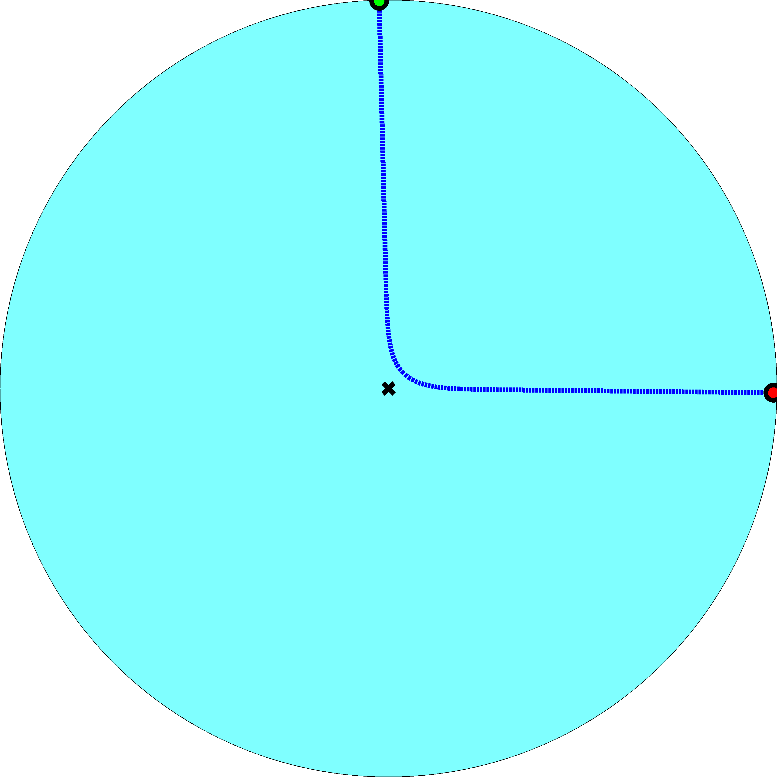
i
j
Hyperbolic distance $$x_{ij}≈r_{i}+r_{j}+k_{B}\ln{\sin{\frac{θ_{ij}}{2}}}$$

Slide 49
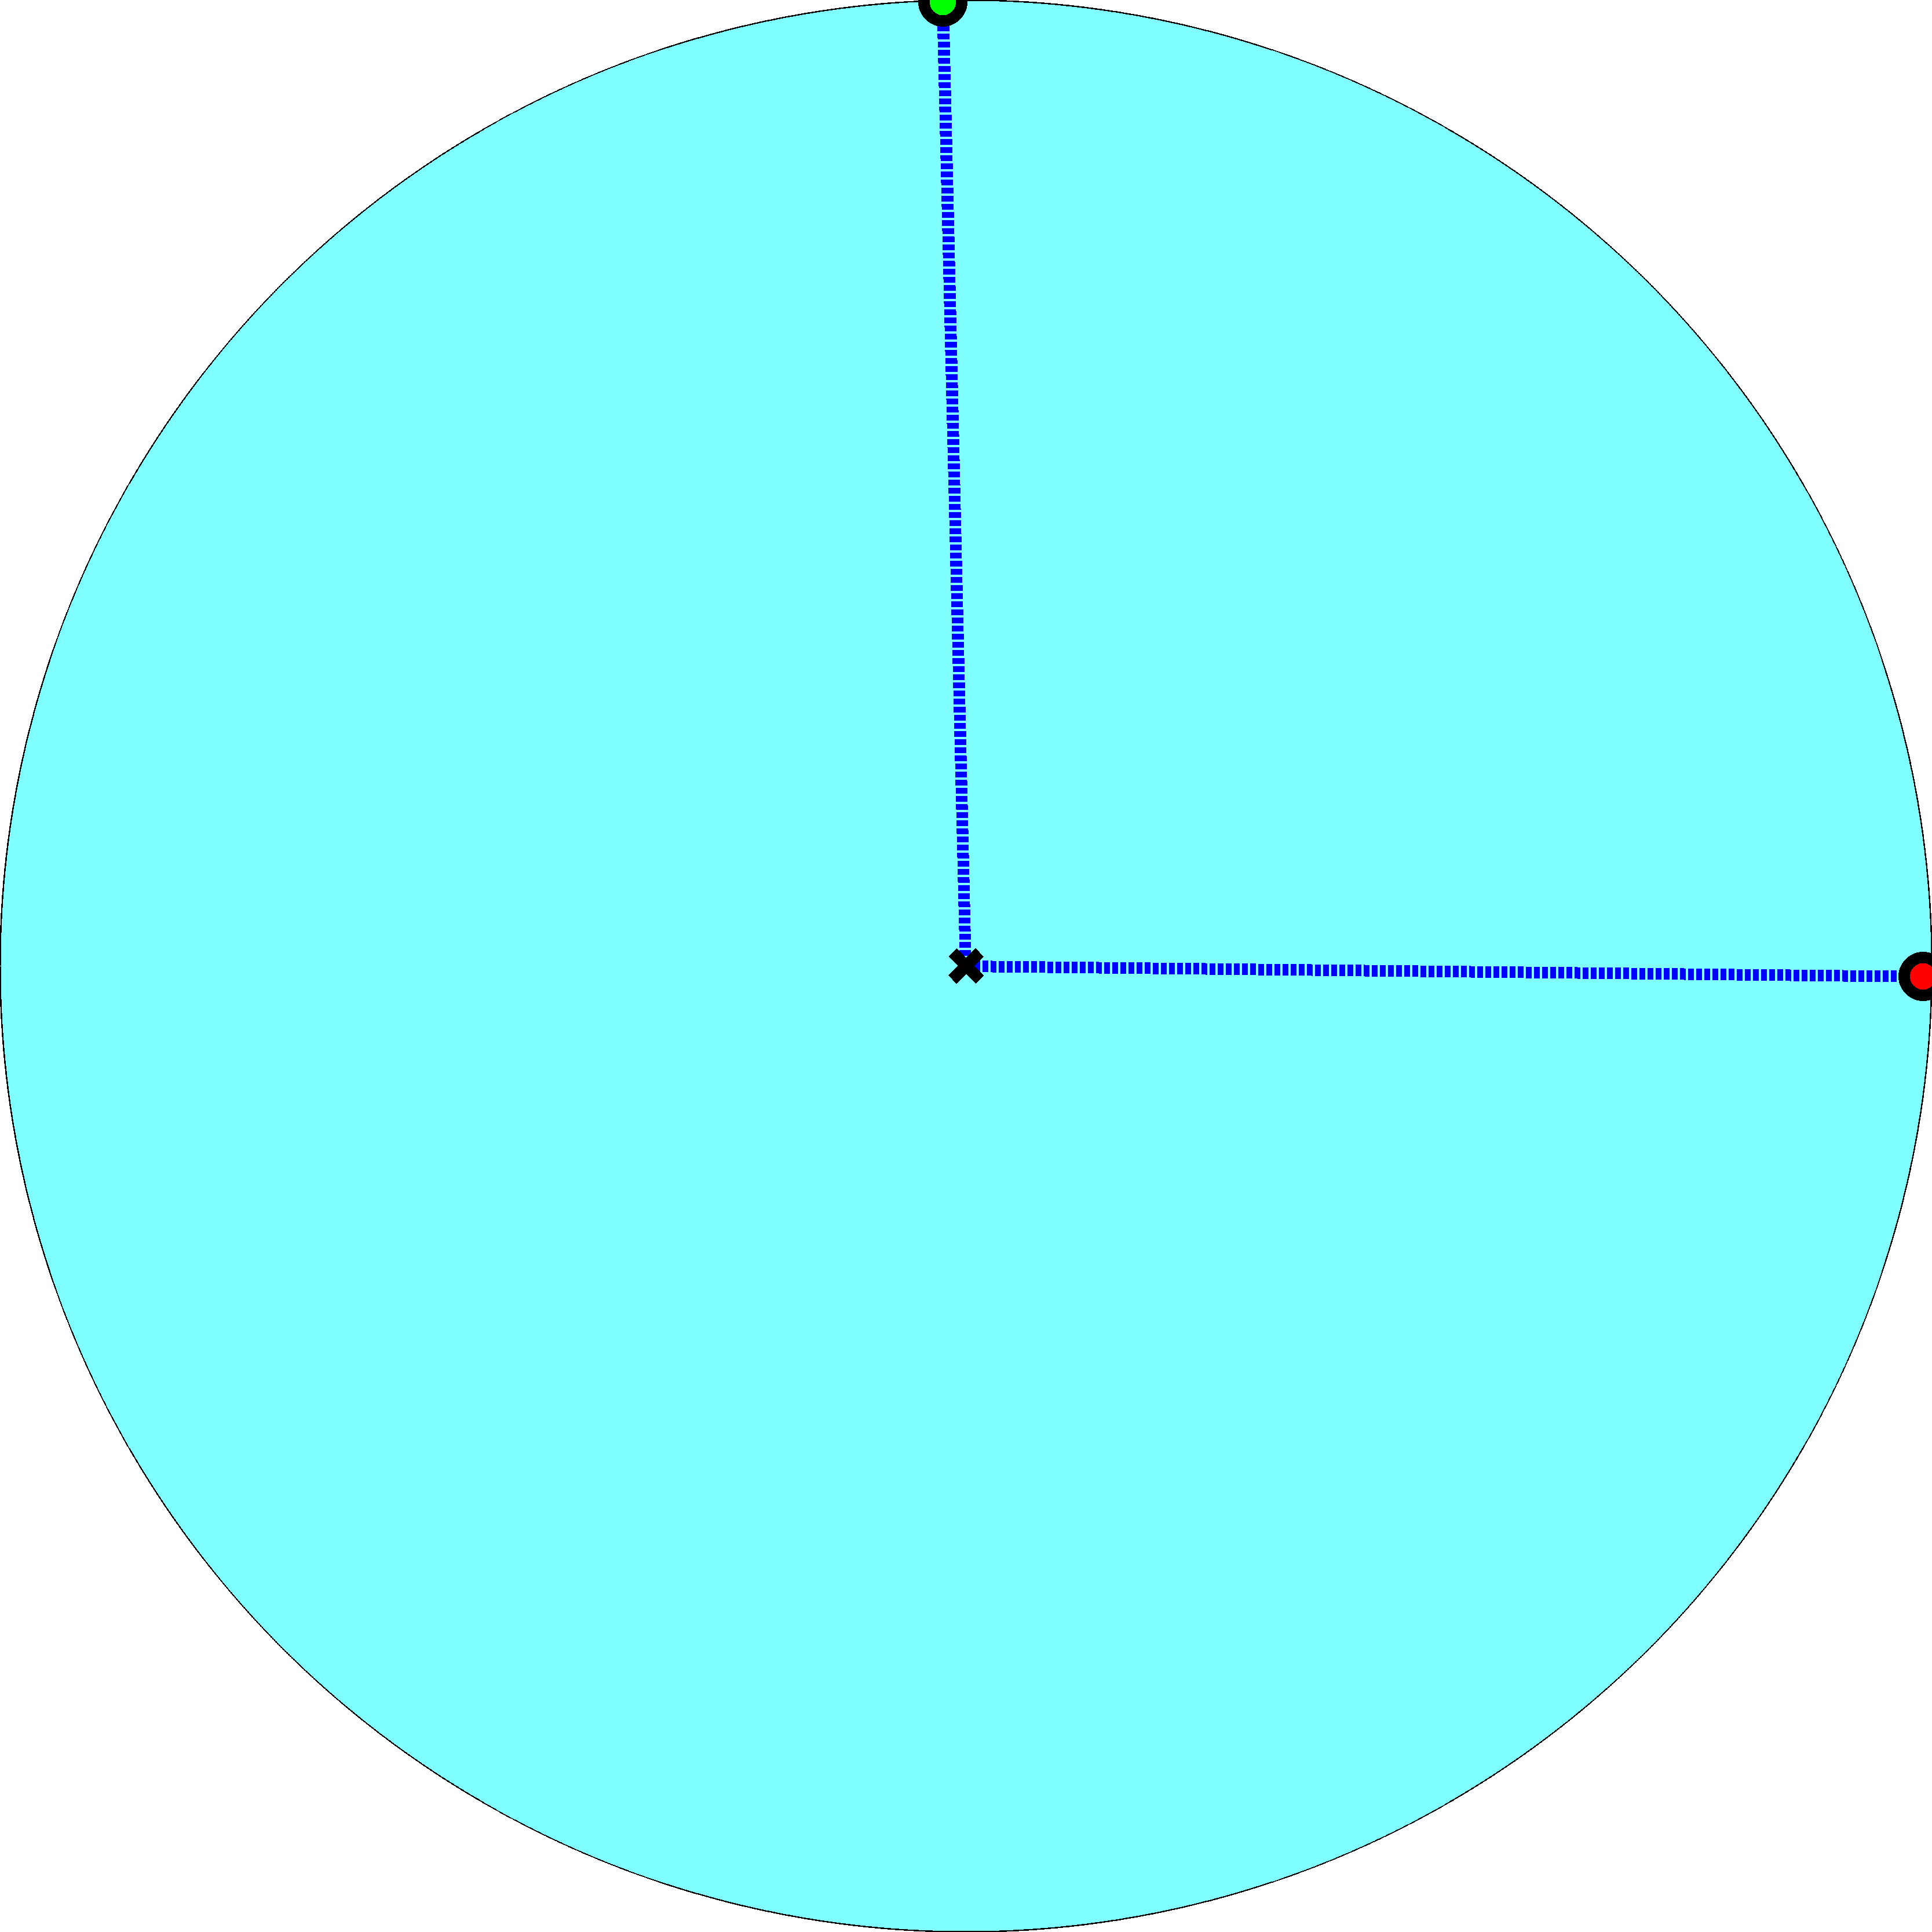
Popularity distance (not hidden)
$$d_{ij}^{(p)}=r_{i}+r_{j}∼ \\ 2R−k_{B}\ln{κ_{i}κ_{j}}$$
i
j
Hyperbolic distance $$x_{ij}≈r_{i}+r_{j}+k_{B}\ln{\sin{\frac{θ_{ij}}{2}}}$$

Slide 50
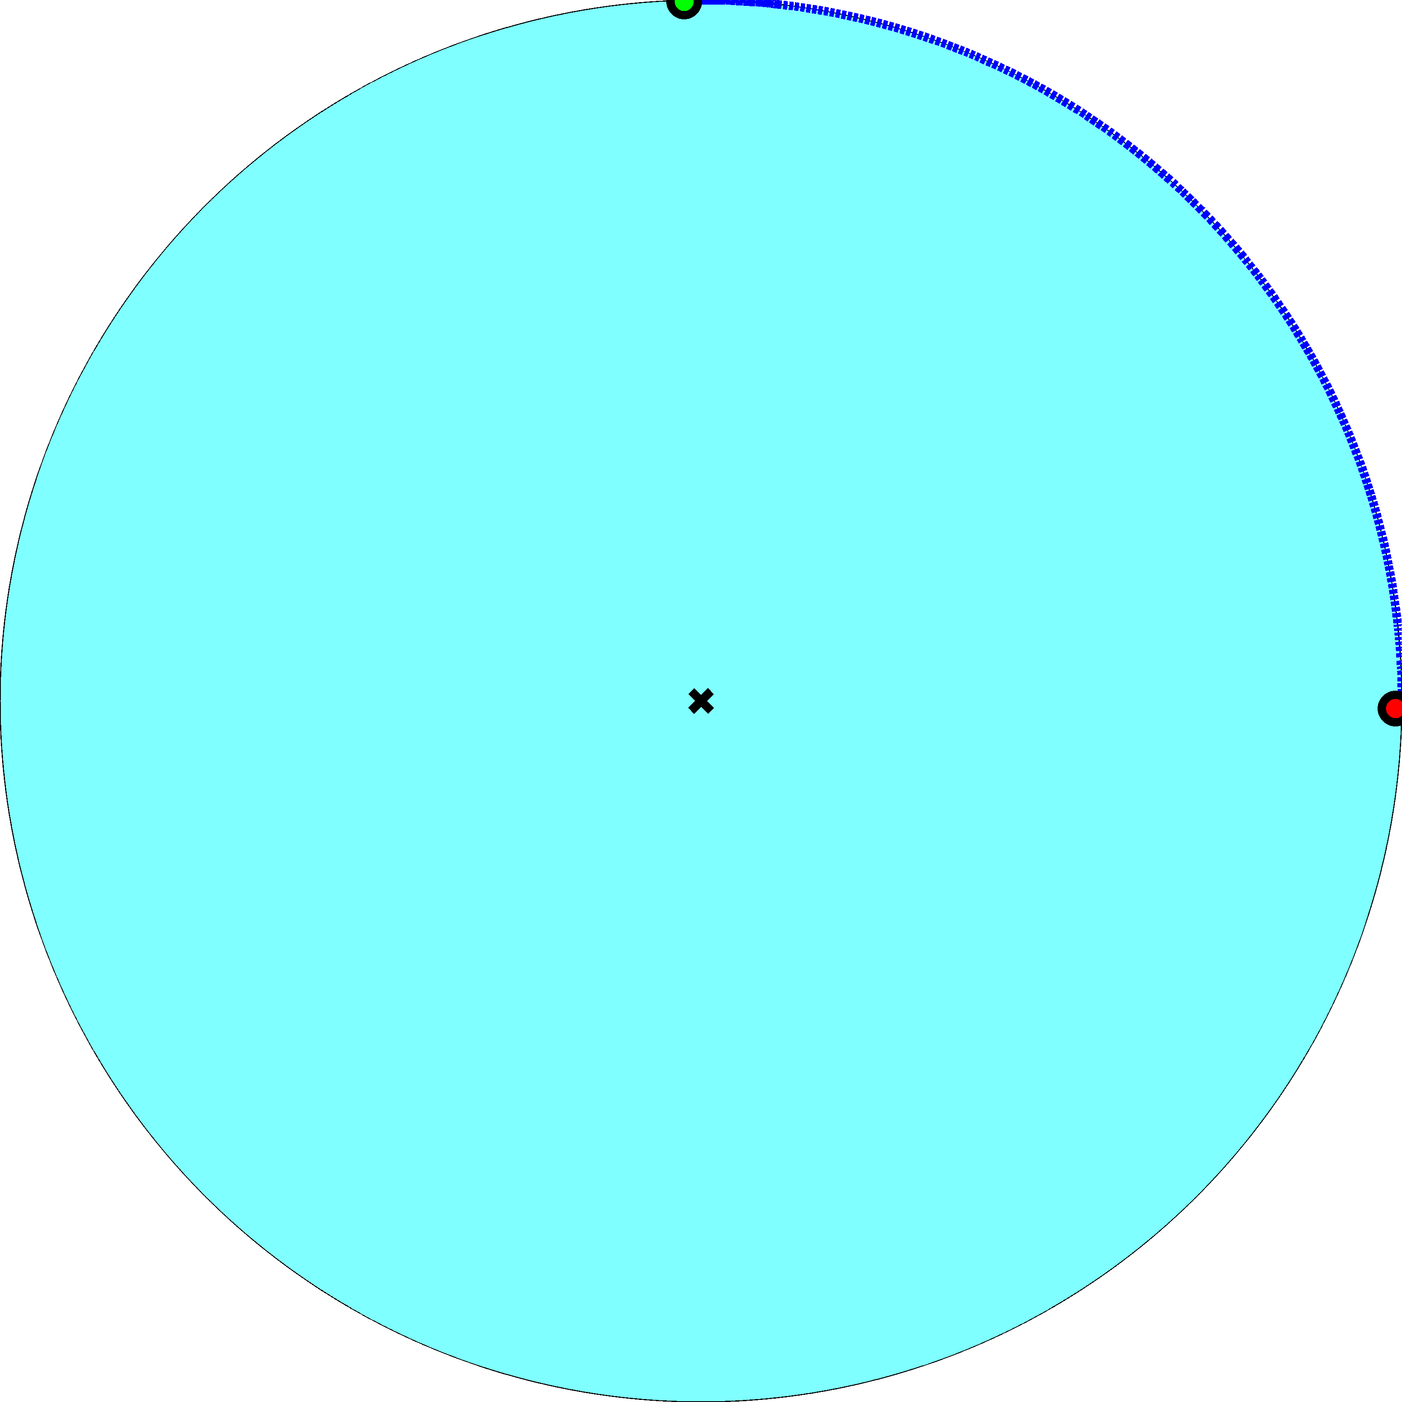
Popularity distance (not hidden)
$$d_{ij}^{(p)}=r_{i}+r_{j}∼ \\ 2R−k_{B}\ln{κ_{i}κ_{j}}$$
Similarity distance (hidden) $$d_{ij}^{(s)}=\sin{\frac{θ_{ij}}{2}}$$
i
j
Hyperbolic distance $$x_{ij}≈r_{i}+r_{j}+k_{B}\ln{\sin{\frac{θ_{ij}}{2}}}$$

Slide 51
Popularity distance (not hidden)
$$d_{ij}^{(p)}=r_{i}+r_{j}∼ \\ 2R−k_{B}\ln{κ_{i}κ_{j}}$$
Similarity distance (hidden) $$d_{ij}^{(s)}=\sin{\frac{θ_{ij}}{2}}$$
i
j
Hyperbolic distance $$x_{ij}≈r_{i}+r_{j}+k_{B}\ln{\sin{\frac{θ_{ij}}{2}}} \\ =d_{ij}^{(p)}+k_{B}\ln{d_{ij}^{(s)}}$$

Slide 52
Popularity distance (not hidden)
$$d_{ij}^{(p)}=r_{i}+r_{j}∼ \\ 2R−k_{B}\ln{κ_{i}κ_{j}}$$
Similarity distance (hidden) $$d_{ij}^{(s)}=\sin{\frac{θ_{ij}}{2}}$$
Connections to hyperbolically closest nodes optimize trade-offs between popularity and similarity
i
j
Hyperbolic distance $$x_{ij}≈r_{i}+r_{j}+k_{B}\ln{\sin{\frac{θ_{ij}}{2}}} \\ =d_{ij}^{(p)}+k_{B}\ln{d_{ij}^{(s)}}$$

Slide 53
Application to real networks
Hidden similarity coordinates are projections of properly weighted combinations of all the (hidden) factors shaping network structure and dynamics
Infer these hidden coordinates using maximum-likelihood methods
The results describe remarkably well not only the structure of some real networks, but also their dynamics
Validating not only consequences of growth dynamics, but also dynamics itself
Prediction of missing links using this approach outperforms all popular methods

Slide 54
Real networks considered
Technological (Internet)
Social (web of trust)
Biological (metabolic)
Universe’s causal set

Slide 55
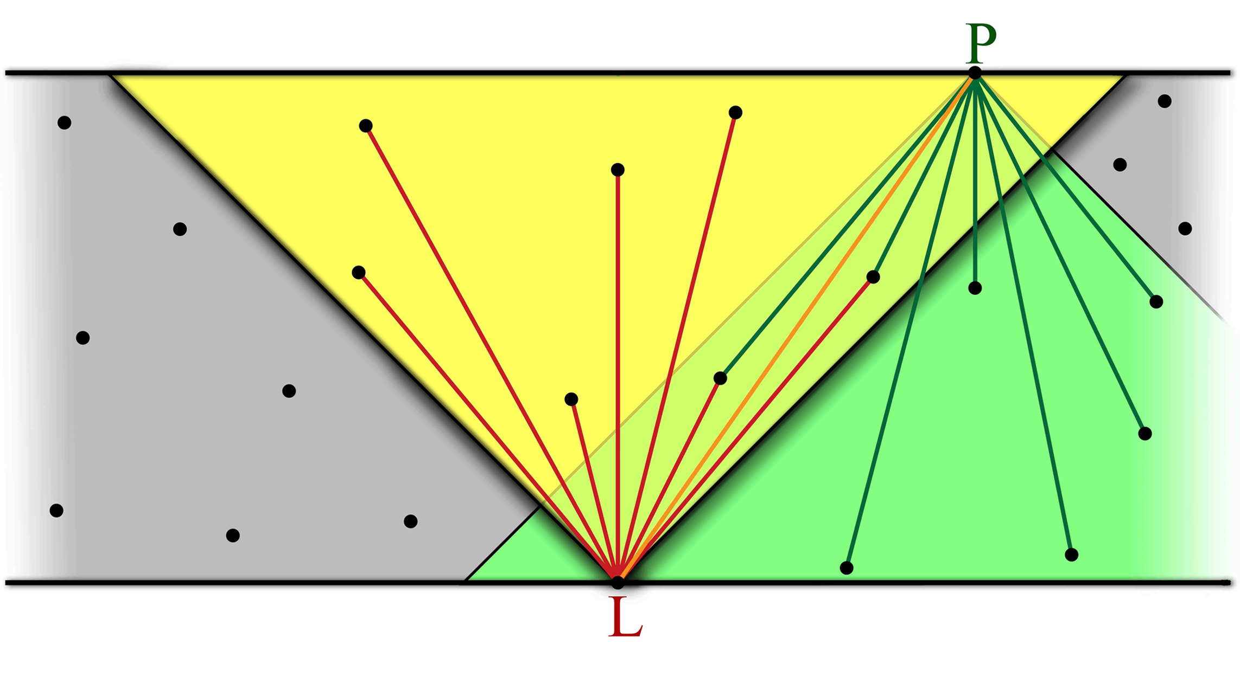
Causal sets

Slide 56
De Sitter spacetime
The universe is accelerating
Dark energy (73%) is an explanation
Remove all matter from the universe
Dark matter (23%)
Observable matter (4%)
Obtain de Sitter spacetime
Solution to Einstein’s field equations for an empty universe with positive vacuum energy (cosmological constant $Λ>0$)

Slide 57
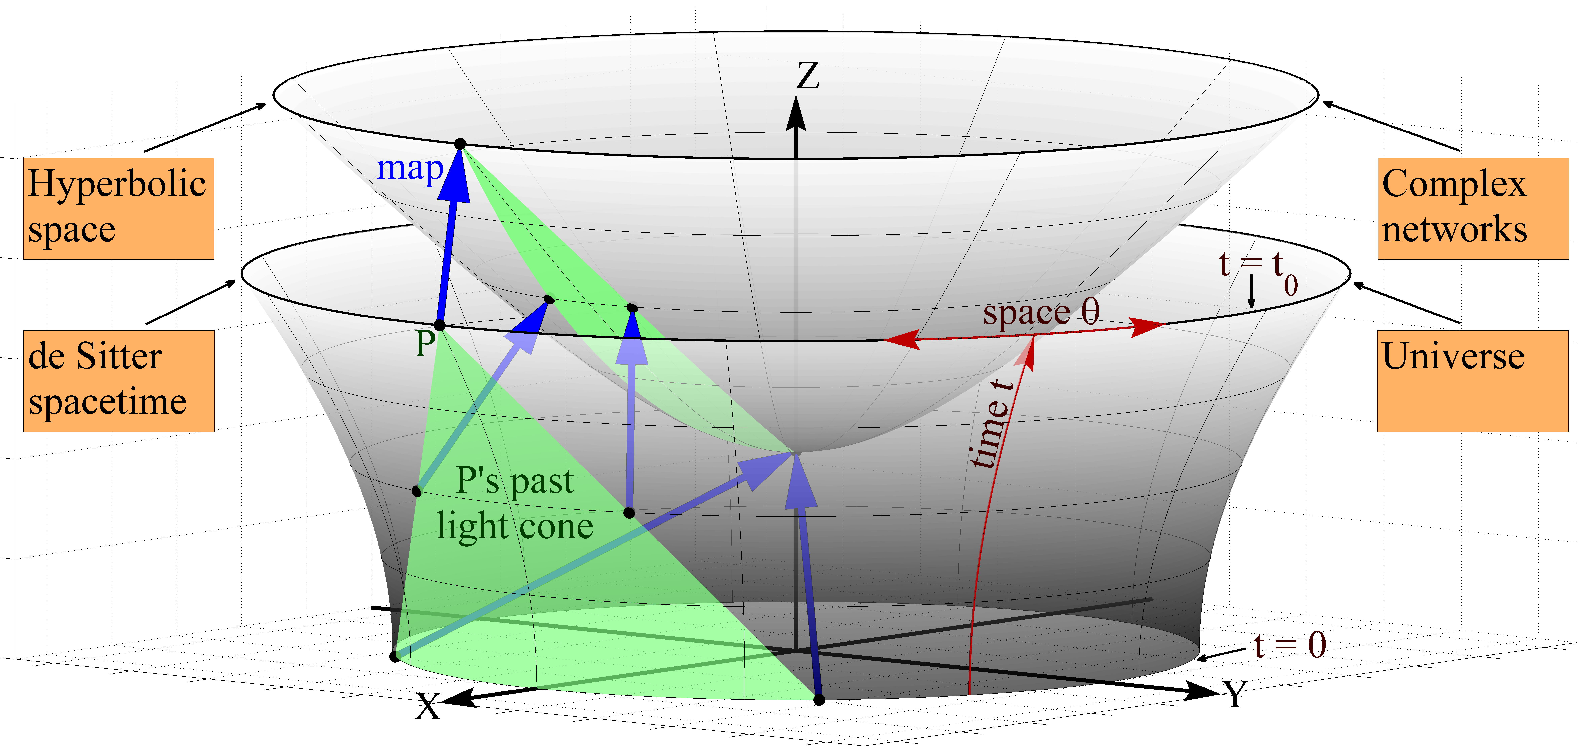
$$x^{2}+y^{2}−z^{2}=−1$$
$$x^{2}+y^{2}−z^{2}=+1$$

Slide 58
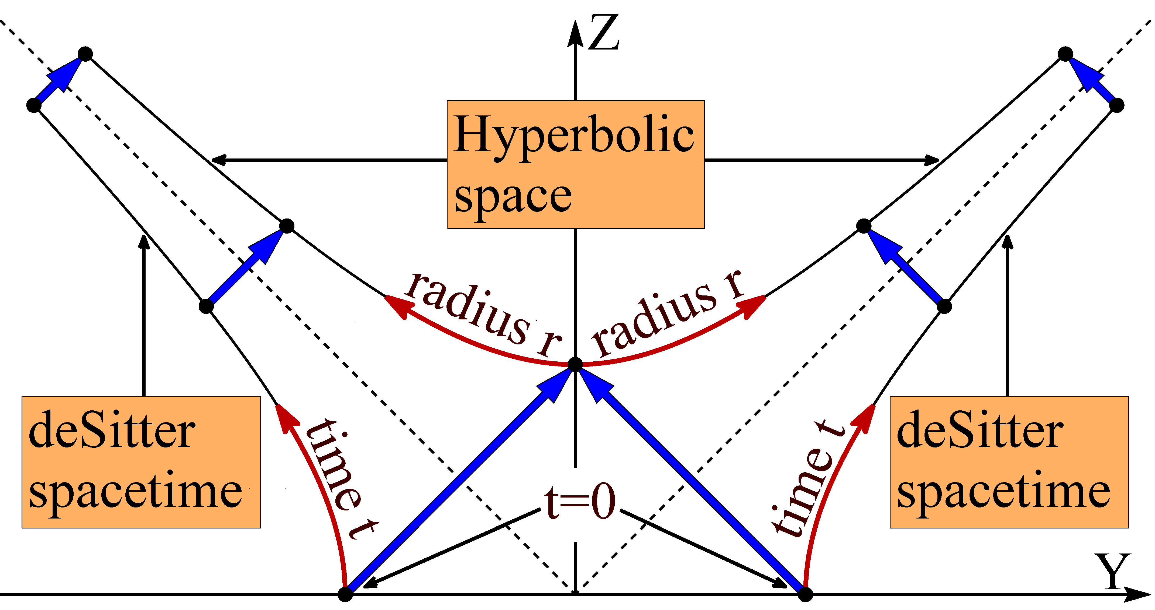

Slide 60
Are there any common fundamental laws from which Einstein’s equations (known) and complex network equations (unknown) both follow as particular cases?

Slide 61
Summary
Equilibrium (static) hyperbolic graphs
Classical picture in equilibrium statistical mechanics (ESM)
Known Hamiltonian and the connection between ESM and Euclidean path-integral QFT suggest a search direction for action invariant under the conformal (Lorentz) group
Nonequilibrium (growing) hyperbolic graphs
Optimization-driven (energy-minimization) dynamics suggests a similar least-action search direction
Causal sets in de Sitter spacetime
Identical to growing hyperbolic graphs
Self-dual: equilibrium and growing at the same time (ESM.vs.QFT)
Action has been recently found; it converges to the action in GR
Applications
Find equations of motion to predict and control
Canonical approach is a (not the) way to do that
But this is a way that works universally well in many areas of physics

Slide 62
D. Krioukov, F. Papadopoulos, A. Vahdat, and M. Boguñá, Hyperbolic Geometry of Complex Networks, Physical Review E, v.82, 036106, 2010, Physical Review E, v.80, 035101(R), 2009
F. Papadopoulos, M. Kitsak, M. Á. Serrano, M. Boguñá,, and D. Krioukov, Popularity versus Similarity in Growing Networks, Nature, v.489, p.537, 2012
D. Krioukov, M. Kitsak, R. Sinkovits, D. Rideout, D. Meyer, and M. Boguñá, Network Cosmology, Nature Scientific Reports, v.2, 793, 2012
M. Boguñá, F. Papadopoulos, and D. Krioukov, Sustaining the Internet with Hyperbolic Mapping, Nature Communications, v.1, 62, 2010
M. Boguñá, D. Krioukov, and kc claffy, Navigability of Complex Networks, Physical Review Letters, v.102, 058701, 2009 Nature Physics, v.5, p.74-80, 2009
F. Papadopoulos, D. Krioukov, M. Boguñá, and A. Vahdat, Greedy Forwarding in Scale-Free Networks Embedded in Hyperbolic Metric Spaces, INFOCOM 2010, SIGMETRICS MAMA 2009
M. Á. Serrano, M. Boguñá, and D. Krioukov, Self-Similarity of Complex Networks, Physical Review Letters, v.106, 048701, 2011 Physical Review Letters, v.100, 078701, 2008

