Slide 1



Peering Strategy Adoption by Transit Providers in the Internet: A Game Theoretic Approach
Aemen Lodhi (Georgia Tech)
Amogh Dhamdhere (CAIDA)
Constantine Dovrolis (Georgia Tech)
W-PIN 2012, June 11, 2012

Slide 2
Outline
Background and motivation
Open peering in the Internet
Results from a computational model
A simplified model
  Static game with complete information
  Dynamic game with complete information
  Static game of incomplete information

Slide 3
Background
The Internet consists of ~40,000 networks
Each independently operated and managed
  Called “Autonomous Systems” (ASes)
  Various types: transit, content, access, enterprise
Decentralized, bilateral interactions between ASes
Transit link: Customer pays provider
Settlement-free peering link: Exchange traffic for free

Slide 4
Background
The Internet Hierarchy
Tier-1 provider
Tier-1 provider
$$
Tier-1 provider
$$
Transit Provider
Transit Provider
$$
$$
Enterprise customer
Content Provider
Content Provider
Enterprise customer

Slide 5
Motivation: Existing peering environment
Increasing fraction of interdomain traffic flows over peering links*
How are transit providers responding?
Transit Provider
☺
☹
☺
☹
Content Provider/CDN
Access ISP/Eyeballs

Slide 6
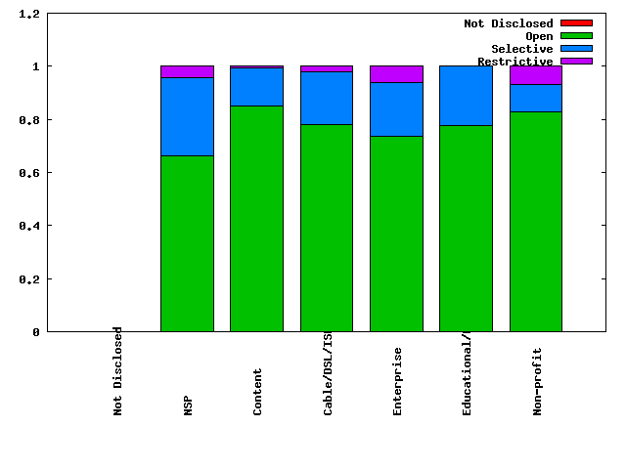
Motivation: Existing peering environment
Peering strategies of ASes in the Internet
(source: PeeringDB www.peeringdb.com)
Transit Providers peering openly ?

Slide 7
Objective
Why are so many transit providers peering openly?
What gives them the incentive to do so?
What is the impact on their economic fitness?
Which transit providers lose/gain?

Slide 8
A computational model: GENESIS*
Agent based interdomain network formation model
Incorporates
  Geographic constraints in provider/peer selection
  Interdomain traffic matrix
  Public & Private peering
  Realistic peering costs, transit costs, transit revenue

Slide 9
The model: GENESIS*
Each AS is an independent agent
  Fitness = Transit Revenue – Transit Cost – Peering cost
Objective: Maximize economic fitness
Agents act in turn, evaluate possible peering strategies, choose the strategy that maximizes fitness
  No foresight or coordination between agents
Compute strategy equilibrium

Slide 10
Peering strategies
ASes must be co-located in order to establish a peering link
Restrictive: Peer only if the internetwork would otherwise be partitioned
Selective: Peer only with ASes of “similar size”
  Use total traffic volume of potential peers as proxy for size
Open: Peer with any co-located AS

Slide 11
Strategy adoption by transit providers

Slide 12
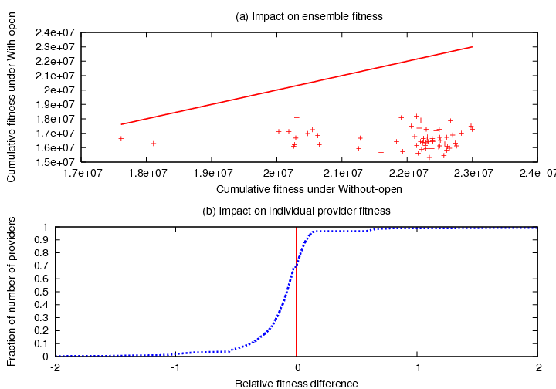
Impact of Open peering on cumulative fitness
Cumulative fitness reduced in all simulations
70% providers have lower fitness

Slide 13
The attraction to Open peering
Simplified the model by removing many real-world constraints for analytical tractability
  Linear pricing
  Simplified co-location pattern
  Considered only two transit providers that interact with each other and an intermediate transit provider
Modeled as a non-cooperative two-player game

Slide 14
Two player game
T is a tier-1 transit provider, a and b are stubs that do not peer
X and Y must choose peering strategy: restrictive, selective, or open
X, Y can peer using selective peering
With open peering X peers with b, Y peers with a
T
X
Y
a
b

Slide 15
Two player game
X, Y use restrictive peering
No peering
T
X
Y
a
b

Slide 16
Two player game
X, Y use selective peering
X, Y do not peer with each other’s customers
T
X
Y
a
b

Slide 17
Two player game
X uses selective, Y uses open
Y peers with X’s customer a
Y “steals” transit traffic away from X
T
X
Y
a
b

Slide 18
Two player game
X, Y both use open peering
Y peers with X’s customer a
X peers with Y’s customer b
X recovers transit traffic
T
X
Y
a
b

Slide 19
Static game, complete information
T
Peering cost per unit traffic: P_{P}
Transit price of X per unit traffic: P_{x}
X
Y
a
b

Slide 20
Static game, complete information
Two Nash Equilibria
Payoff-dominant equilibrium
Risk-dominant equilibrium

Slide 21
Static game, complete information
(S,S) is the payoff-dominant equilibrium, while (O,O) is the risk-dominant equilibrium
In the absence of any uncertainty about the other player’s actions, X and Y should choose strategy S, leading to the optimal equilibrium
With any uncertainty in how the other player will play, X and Y will both choose strategy O, leading to a sub-optimal equilibrium

Slide 22
Dynamic game, complete information
Apply previous model to sequential game: X plays first, then Y plays
Payoff matrix is the same as before
Use backward induction to compute best-response strategies
Each player will choose strategy S
Sequential game with complete information leads to the optimal equilibrium

Slide 23
Incomplete information
In some cases, X or Y may have additional (private) information that affects their decision
  Private information is not known to the other player
  E.g., company policy dictates peering selectively, or openly
Assume that players can be of certain types, corresponding to the peering strategy that they will use based on their private information:
  type-S uses Selective, type-O uses Open
Assume probability distribution across types
Bayesian equilibrium: choose strategy that maximizes expected payoff over probability distribution of other player’s type

Slide 24
Incomplete information
X chooses Open peering if E[π_{x}(O)] > E[π_{x}(S)]
The above simplifies to: X Chooses Open peering if P_{x} > P_{P}
As long as X’s transit price is greater than the peering price, and there is any uncertainty in what strategy Y will play, X chooses Open peering

Slide 25
Conclusions
Simplified model of interaction between two transit providers
Analyzed three game-theoretic scenarios
  Static game of complete information
  Dynamic game of complete information
  Static game of incomplete information
With complete information, the optimal equilibrium will be chosen
Open peering is risk-dominant. With any uncertainty in the strategy of the other player, a player chooses Open peering

Slide 26
Thanks!
Questions?

Slide 27
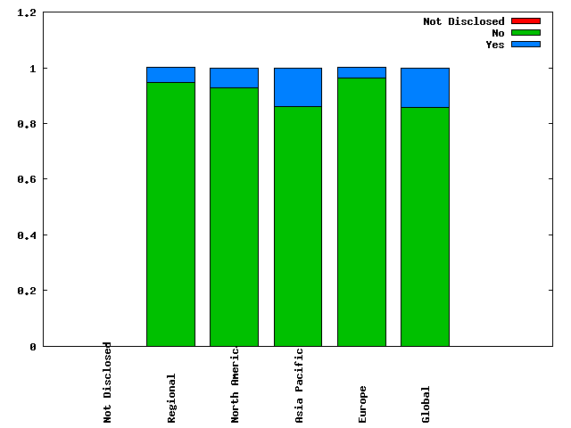
Motivation
Traffic ratio requirement for peering?
(source: PeeringDB www.peeringdb.com)

Slide 28
Traffic components
Inbound traffic
Traffic consumed in the AS
Traffic generated within the AS
Traffic transiting through the AS
Autonomous system
Outbound traffic
Transit traffic = Inbound traffic – Consumed traffic
same as
Transit traffic = Outbound traffic – Generated traffic

Slide 29
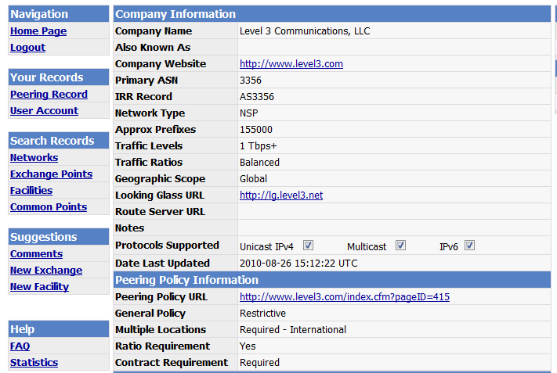
Customer-Provider traffic comparison – PeeringDB.com
Traffic carried by the AS

Slide 30
Customer-Provider traffic comparison
2500 customer-provider pairs
90% pairs: Customer traffic significantly less than provider traffic
9.5% pairs: Customer traffic larger than provider traffic (difference less than 20%)
0.05% pairs: Customer traffic significantly larger than provider traffic

Slide 31
Geographic presence & constraints
Peering link at top tier possible across regions
Geographic overlap
Link formation across geography not possible
Regions corresponding to unique IXPs

Slide 32
Logical Connectivity

Slide 33
Traffic Matrix
Traffic for ‘N’’ size network represented through an N * N matrix
Illustration of traffic matrix for a 4 AS network
Intra-domain traffic not captured in the model
Traffic sent by AS 0 to other ASes in the network
Generated traffic
Traffic received by AS 0 from other ASes in the network
Consumed traffic

