Slide 1
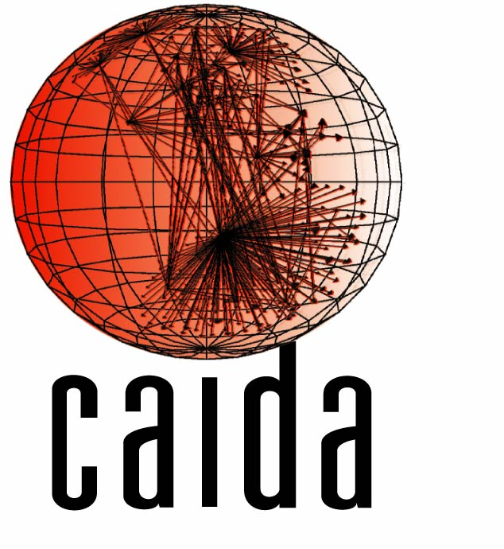


Measuring and Modeling the Adoption of IPv6
Amogh Dhamdhere, Matthew Luckie, Bradley Huffaker, Kc Claffy (CAIDA)
Ahmed Elmokashfi (Simula Research)
Emile Aben (RIPE NCC)
CAIDA-WIDE-CASFI workshop

Slide 2
Outline
Problem statement: running out of Internet addresses, replacement protocol lacks deployment incentives (classic commons problem).
How can we inform and guide the greatest architectural transition of the greatest man-made complex communications network?
Measurement and modeling to the rescue
[Insert innovative, creative approaches here]

Slide 3
Background – The Internet Numbering Architecture
The Internet is a “network of networks”
  About 40,000 networks, called Autonomous Systems (ASes)
Each host in each network needs a unique identifier, (usually) its Internet Protocol (IP) address
IANA allocates address space to Regional Internet Registries (RIRs), which allocate to organizations
The “current” IP version 4 (IPv4) provides 4 billion addresses

Slide 4
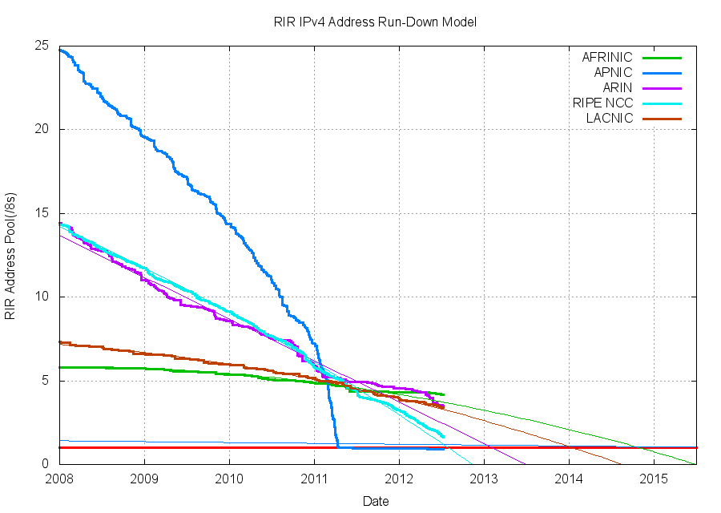
When will we run out of addresses?
IANA runout
IANA ran out of IPv4 addresses in 2011
Regional Internet Registries (RIRs) are rationing but will soon run out too
However, many underutilized IPv4 address will make their way to greater use via market mechanisms (people will sell what they don't need)
Notes:
----- Meeting Notes (7/10/12 15:05) -----
add graph from Huston
----- Meeting Notes (7/10/12 15:24) -----
take paragraph from v6 measurement prop
pitch modeling work

Slide 5
IPv6
Address runout was anticipated back in the 1990s
The “new” (15 years old) IPv6 was standardized in the late 90s
IPv6 provides much more address space than our foreseeable addressing needs
Operating systems and network hardware have supported IPv6 for many years now

Slide 6
So, What’s the Problem?
Just use IPv6, right?
The issue: IPv6 is not backwards compatible with IPv4
Hosts with an IPv4 address cannot directly communicate with hosts with IPv6 addresses
IPv6 configuration, management and troubleshooting still not well understood
Many costs, no tangible benefit!

Slide 7
Two Endgame Scenarios
IPv6 gets deployed!
  Existing measurement techniques and data will be ineffective
IPv6 languishes
  A world of large-scale NATs and poor performance
We don’t have a good idea which scenario will happen
  Scant data about IPv6 deployment, performance, traffic
    What data is available is cause for pessimism
  No model to predict future, or reveal what is needed to reach a favorable outcome

Slide 8
CAIDA’s IPv6 Efforts
Measurement
  IPv6 adoption, topology, routing, performance
  Tools and techniques for IPv6 measurement
Modeling
  Quantitative model for the IPv4-IPv6 transition
  Try to predict the outcome, or at least reveal insights into evolutionary dynamics

Slide 9
Part I – Measuring IPv6 Adoption
“IPv6 will be deployed any day now”, ACM SIGCOMM Internet Measurement Conference, 2012.

Slide 10
IPv6 growth
IPv6 is here
Notes:
----- Meeting Notes (7/10/12 15:24) -----
add color
make clear that the axes are different
two graphs: 1) one on same axis
2) different axes

Slide 11
IPv6 growth: we need to zoom in..
Linear
Exponential
Exponential
The IPv6 topology grows exponentially while the IPv4 topology now grows linearly
Notes:
----- Meeting Notes (7/10/12 15:24) -----
add color
make clear that the axes are different
two graphs: 1) one on same axis
2) different axes

Slide 12
Digging deeper
Exponential growth of IPv6 is encouraging
  shift from a “toy” network to production?
Which geographical regions and network types contribute most of the growth?
Is the business mix in IPv6 converging to that in IPv4?
Is IPv6 performance comparable to IPv4 performance?
Notes:
----- Meeting Notes (7/10/12 15:24) -----
too much text
add color
move this slide earlier?

Slide 13
Measurement Data
Topology snapshots from BGP routing datasets from 1998-present
  Routeviews and RIPE repositories
Annotated topology with business relationships on each inter-AS link
Geographical region for each AS
  ARIN: North America
  RIPE: Europe
  APNIC: Asia-Pacific
Notes:
----- Meeting Notes (7/10/12 15:24) -----
not rapidshare
amazon, rapidshare, rackspace
new slide just for classification
diagram

Slide 14
Background
AS Business Types
Large Transit Provider (LTP)
AT&T
Level3
Small Transit Provider (STP)
Verizon
$$
$$
Regional provider
Regional provider
Content/Access/Hosting Provider (CAHP)
$$
$$
UCSD
Rapidshare
Comcast
Georgia Tech
Enterprise Customer (EC)

Slide 15
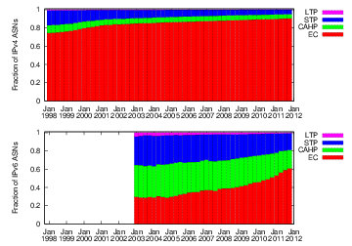
Evolution of the business mix
IPv4 network is dominated by ECs
Lower fraction of ECs in IPv6
IPv6 deployment at the edges is lagging
Hypothesis: As IPv6 matures, the business mix should become similar to that in IPv4
Notes:
----- Meeting Notes (7/10/12 15:24) -----
mention that the fractions are across different number of ASes

Slide 16
Growth trends by geographical region
IPv6: RIPE region was always ahead of ARIN
IPv4: More ASes in RIPE region than ARIN since 2009
The ARIN region is lagging in IPv6 deployment
Notes:
----- Meeting Notes (7/10/12 15:24) -----
add another slide with description of RIR regions
remove text, make graph larger. text box with arrows on circle
don't say always

Slide 17
Structure of AS-level paths
Hypothesis: As IPv6 matures, routing paths in IPv4 and IPv6 should become similar over time
Measured AS-level paths from 7 vantage points towards dual-stacked origin ASes
Focused on the fraction of identical IPv4 and IPv6 paths from each VP
Notes:
----- Meeting Notes (7/10/12 15:24) -----
reduce text on this slides

Slide 18
Identical AS-level paths
The fraction of identical paths is increasing
Currently less than 50% of IPv4 and IPv6 paths are identical
The IPv6 network is maturing, but slowly

Slide 19
IPv4 and IPv6 topology convergence
Classification: business type
Classification:
geographical region
Transit providers and content providers are mostly present in the IPv6 graph, ECs are lagging
APNIC and RIPE lead ARIN in IPv6 presence
IPv6 deployment is not uniform across business types and geographical regions
Notes:
----- Meeting Notes (7/10/12 15:31) -----
add legends:
classification by business type
classification by geographical region
slide title: IPv4 and IPv6 topology convergence

Slide 20
Comparing IPv4 and IPv6 performance
Poor performance over IPv6 is likely to inhibit the adoption of IPv6
How often is performance over IPv6 similar to that over IPv4?
Measurements from 5 dual-stacked vantage points to dual-stacked websites
  Webpage download times
  Forwarding paths to those websites
Notes:
----- Meeting Notes (7/10/12 15:42) -----
too much text
remove first bullet
remove some text
last bullet: remove "also"

Slide 21
Performance: Webpage downloads
63%
79%
0.1
79% of paths had IPv6 performance within 10% of IPv4 performance when AS paths were the same
Only 63% of paths had similar performance when AS paths differed
Notes:
----- Meeting Notes (7/10/12 15:42) -----
numbers are inconsistent
say what is performance here

Slide 22
Relation between performance and AS-level paths
IPv6 performance is similar to IPv4 performance, if AS-level paths are the same
  Can be much worse if paths are different
Less than 50% of AS paths from dual-stacked vantage points are currently the same in IPv4 and IPv6
Insight: increasing congruence between IPv4 and IPv6 topology will improve performance and thus deployment incentives
Notes:
----- Meeting Notes (7/10/12 15:42) -----
too much text
title: "relation between performance and AS-paths"
say this in fewer words or a graph

Slide 23
Potential AS-path congruence
For each link in an IPv4 AS path, is that link present in the IPv6 topology (anywhere)?
Based on links that already exist, up to 70% of paths could be identical (without building any new infrastructure)
Notes:
----- Meeting Notes (7/10/12 15:48) -----
change title

Slide 24
Potential AS-path congruence
For each AS in an IPv4 AS path, is that AS present in the IPv6 topology (anywhere)?
Based on ASes that are already in the IPv6 graph, up to 90% of paths could be identical
Notes:
----- Meeting Notes (7/10/12 15:48) -----
change title

Slide 25
Summary of measurement findings
The IPv6 network is maturing…albeit slowly and non-uniformly
The “core” of the network (transit providers) are mostly doing well with IPv6 deployment
The edge (enterprises and access providers) is lagging
IPv6 deployment is faster in Europe and Asia-Pacific regions, North America is lagging
IPv4 and IPv6 paths could potentially be 90% similar, without deploying any additional infrastructure
Notes:
----- Meeting Notes (7/10/12 15:48) -----
more color
more interesting

Slide 26
Part II – Modeling IPv6 Adoption: A Quantitative Approach

Slide 27
Light at the end of the tunnel?
IPv6 deployment is proceeding slowly and non-uniformly
No one knows where this path leads...
Will market forces alone lead to IPv6 deployment?
Do we need regulation to force IPv6 into deployment?
Do transition technologies inhibit or accelerate deployment?
What is the effect of IPv4 address transfer markets?
We need a quantitative model to predict where we are headed with IPv6 deployment, and what we can do to ensure a favorable outcome
We need this NOW, while there is still time to shape future IPv6 deployment
Notes:
----- Meeting Notes (7/10/12 15:48) -----
add motivation slide

Slide 28
Prior modeling efforts
Considered the IPv4-IPv6 transition as a specific case of generic technology transitions
Modeled as a binary decision for an organization: either deploy IPv6 completely, or not at all
  But organizations will have IPv4 and IPv6 address space simultaneously
These models focused on utility of deploying IPv6, rather than costs
Notes:
----- Meeting Notes (7/10/12 16:03) -----
add references

Slide 29
Our modeling approach
Granularity: devices – entities that need an IP address
An organization can simultaneously have devices from different address classes
  IPv4, IPv4 with NAT, dual-stacked, IPv6
Costs to maintain devices in different states
Networks try to minimize costs, rather than maximize some notion of utility
Notes:
----- Meeting Notes (7/10/12 16:03) -----
remove second bullet from here

Slide 30
Address classes
IPv4-PUBLIC | Single public IPv4 address
IPv4-NAT | Single private IPv4 address
DUALSTACK-PUBLIC | Public IPv4 and IPv6 addresses
DUALSTACK-NAT | Private IPv4 and public IPv6 address
IPv6-PUBLIC | Single IPv6 address
Binary decision model

Slide 31
Decision process for an organization
Two decision processes
Address addition:
  Need to add new devices to network
  Choose address class to number these devices
Address optimization:
  Move devices from one address class to another to minimize costs
Notes:
----- Meeting Notes (7/10/12 16:03) -----
remove notation
contrast with binary decision

Slide 32
Costs
One-time as well as recurring costs
Address costs: Cost of IPv4 addresses on the market, cost of obtaining IPv6 addresses from IANA/RIRs
NAT cost: Devices with private IPv4 addresses share a single public IPv4 address
Translation cost: Cost incurred for IPv4 devices to talk to IPv6 devices, and vice versa
Renumbering cost: Cost to renumber a device from one address type to another
Notes:
----- Meeting Notes (7/10/12 16:03) -----
color the cost word terms

Slide 33
Incentives/Regulation
Internal incentive from within an organization to deploy IPv6
Regulation/mandates in certain countries or geographical regions that require organizations to become IPv6-capable
Subsidies or credits for organizations that deploy IPv6

Slide 34
Equilibrium
Execute decision process for each network until no network changes address assignment:
Equilibrium!!
Too complex to compute analytically: use agent-based simulations

Slide 35
Output metrics
IPv6 adoption at equilibrium:
  Fraction of each organization’s address space that is IPv6-capable
  Fraction of organizations that have some IPv6-capable infrastructure
  Type of organizations that deploy IPv6
Quality of the equilibrium:
  Overall translation costs
  Overall NAT costs
Notes:
----- Meeting Notes (7/10/12 16:03) -----
"quality" of the equilibrium

Slide 36
What-if questions
Parameterize model as realistically as possible
Do market forces lead to IPv6 deployment? When is regulation necessary?
How does the quality of transition technologies affect adoption?
How do different network business types, geographical differences affect adoption?
How does the arrival of new networks affect adoption?
Notes:
----- Meeting Notes (7/10/12 16:03) -----
conclusion slide:
- measurement
- survey for parameterization
- developed initial model
- still need funding to complete this work

Slide 37
What next?
Refine the model
Implement model in agent-based simulation tool
Parameterize as best as possible using NANOG survey
Investigate various what-if scenarios

Slide 38
Thanks! Questions? amogh@caida.org www.caida.org/~amogh

Slide 39
Backup slides

Slide 40
Different ASes in IPv4 and IPv6 paths
If only 50% of AS paths are identical, which ASes are different in the two paths?
Hurricane Electric (HE) gets added to the most paths

Slide 41
ASes most often seen in paths
For each VP, measured the fraction of paths that traverse a certain AS
HE is more dominant in IPv6 than the most dominant AS (Level3) in IPv4

Slide 42
Common top ASes
Measured the fraction of top-K ASes by degree that are present in the IPv6 graph
Fractions for all K values increasing sharply since late 2010

Slide 43
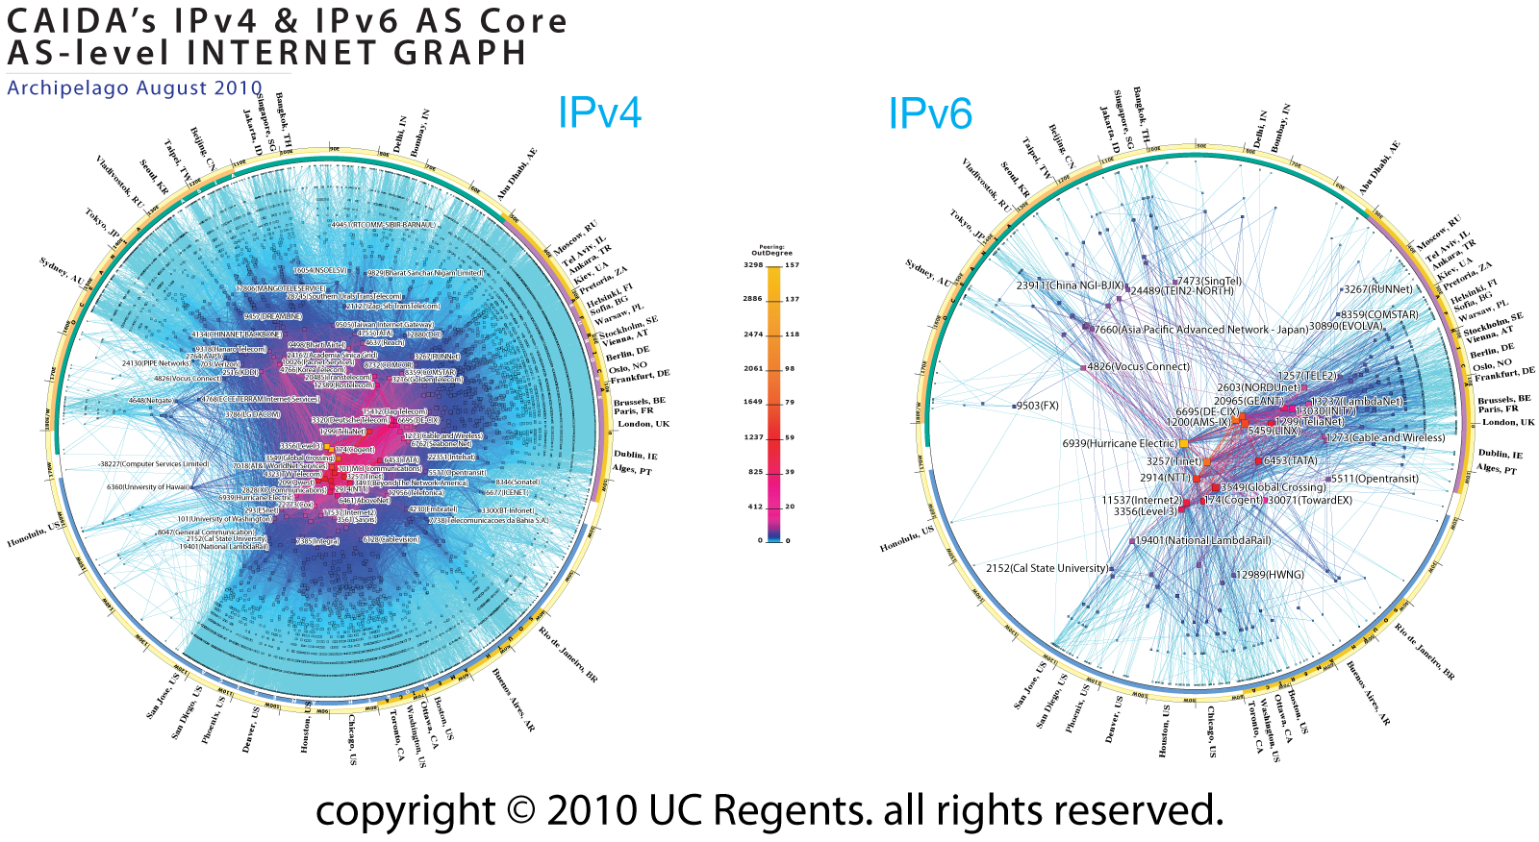
Pretty Pictures of the Internet

Slide 44
IPv4 markets
Organizations with excess IPv4 space can transfer their allocations to others that need address space
Organizations can solve their short-term needs by buying addresses on the market
  Will this inhibit the adoption of IPv6?
We need some solid quantitative modeling of this transition

