Slide 1
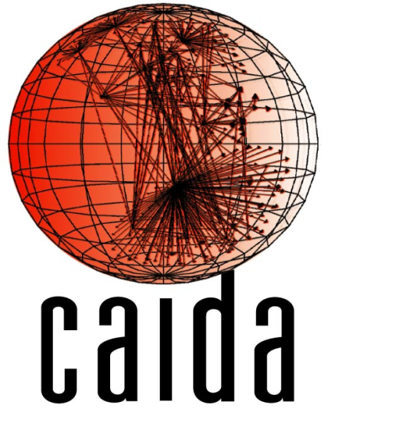
CAIDA’s AS-rank: measuring the influence of ASes on Internet Routing
Matthew Luckie
Bradley Huffaker
Amogh Dhamdhere
k claffy
http://as-rank.caida.org/

Slide 2
Overview
Inferring AS relationships using publicly available BGP paths
  views of ~400 ASes at Route Views and RIPE RIS
Inferring the influence of ASes based on their “customer cone”
  Traffic in your customer cone stays on-net and is the most profitable (when it reaches you)
http://as-rank.caida.org/

Slide 3
AS Relationships - Ground Truth Summary
CAIDA: 2,370
  2010 – 2012 83% p2p
  Most submitted via web form, some via email
RPSL: 6,065
  April 2012 100% p2c
  RIPE whois database, two-way handshake
BGP Communities: 39,838
  April 2012 59% p2c
  Dictionary of operator-published community meanings assembled by Vasileios Giotsas (UCL)
Overall: 47,881 GT relationships, 63% p2c, 37% p2p
  ~38% of the publicly available graph.

Slide 4
AS Relationships - Validation
 | p2c | p2p
CAIDA | 99.6% | 98.4%
UCLA | 99.0% | 90.9%
Isolario | 90.3% | 96.0%
Gao | 84.7% | 99.5%
SARK
CSP
ND-ToR
Percentages are Positive Predictive Value (PPV).
Take home: difficult to be accurate at
inferring both types of relationships

Slide 5
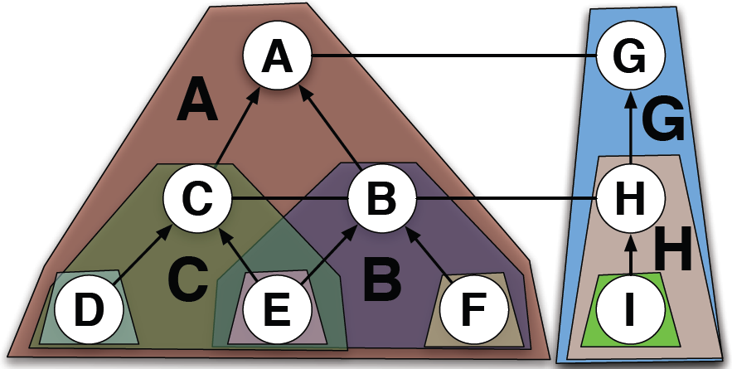
Definition – Customer Cones
A’s customer cone: A, B, C, D, E, F
B’s customer cone: B, E, F
C’s customer cone: C, D, E

Slide 6
Customer Cone Computation
AS relationships are complex: two ASes may have a c2p relationship in one location, but p2p elsewhere
Define customer cone based on provider/peer observed view of an AS
  A sees D and E as indirect customers via B, so B’s customer cone only includes D, E from C.
  Might suffer from limited visibility
A
Region Y: “Europe”
B
Region X: USA
B
C
NOT inferred to
be part of B’s.
C
F G H
D
E

Slide 7
Caveats
AS Relationship ecosystem is complex
  Different relationships in different regions
  Can’t differentiate between paid-peers and settlement-free peers (financial difference, not routing)
Don’t know about traffic
Don’t have much visibility into peering
BGP paths are messy (poisoning, leaking)
NOT a clear metric of market power

Slide 8
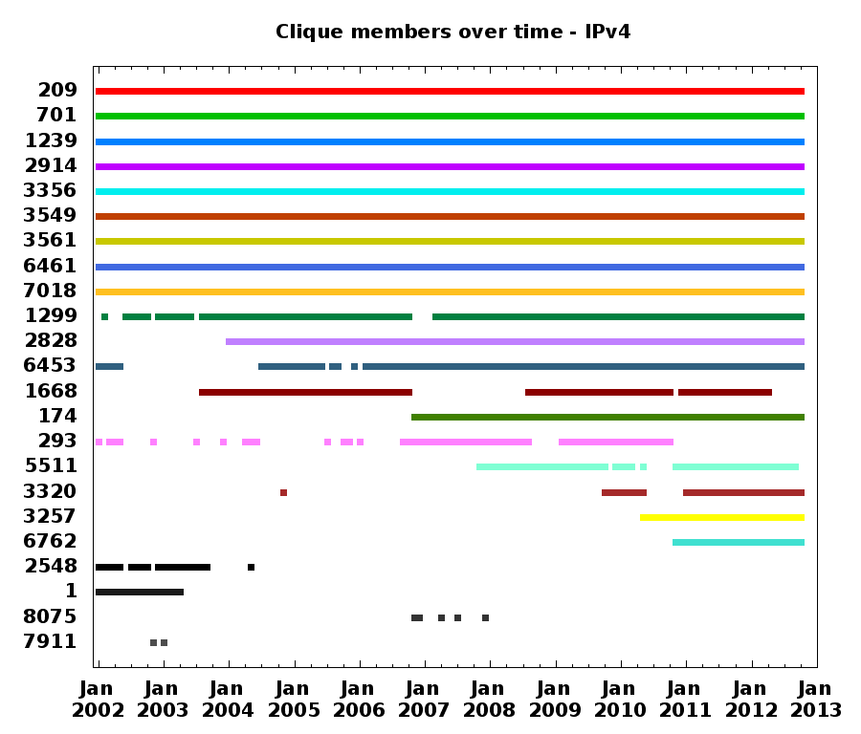
CL – Qwest
Verizon
Sprint
NTT
Level3
Level3 - GBLX
CL – Savvis
AboveNet
AT&T
TeliaSonera
XO
TATA
AOL
Cogent
ESNet
France Tel.
Deutsche Tel.
Inteliquent
Tel. Italia
WorldCom
BBN/Genuity
Microsoft
Will. Comms.

Slide 9
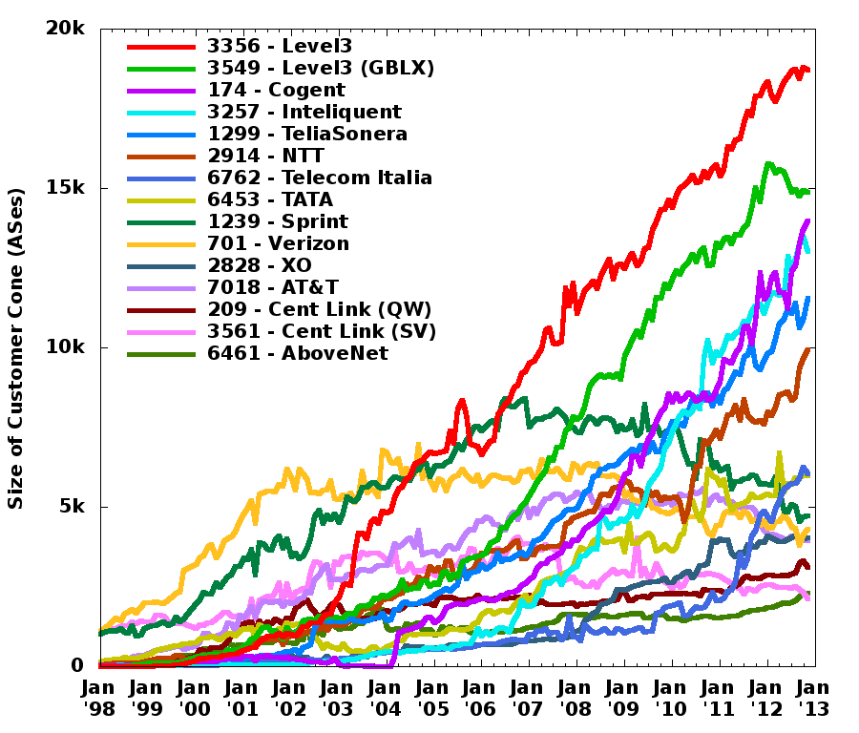
Level3
44%
Level3 + GBLX
Level3
(GBLX)
Cogent
Inteliquent
TeliaSon.
NTT
Level3 + Genuity
Tel. Italia
TATA
Sprint
Verizon
XO
AT&T
CL (QW)
AboveNet
CL (SV)
Verizon
Sprint
MCI

Slide 10
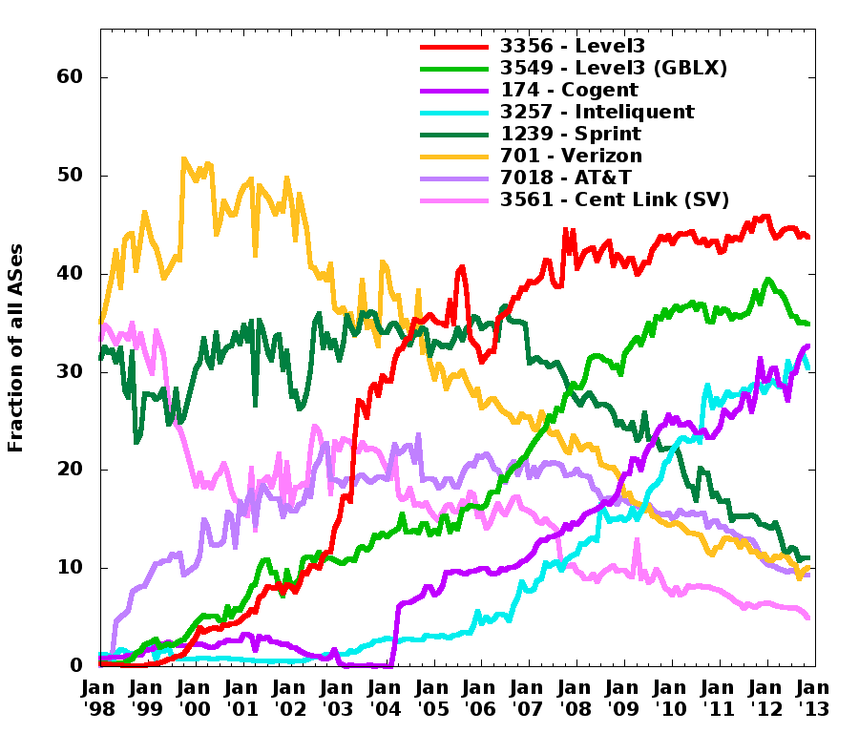
Level3
Level3
(GBLX)
Cogent
Inteliquent
Sprint
Verizon
AT&T
(MCI/CL)

Slide 11
Customer cone as a metric
Fraction: 0.75
TP
Fraction: 0.25
P₁
P₂
VP
A
B
C
D
What fraction of ASes in a customer cone are reached via the top provider?

Slide 12
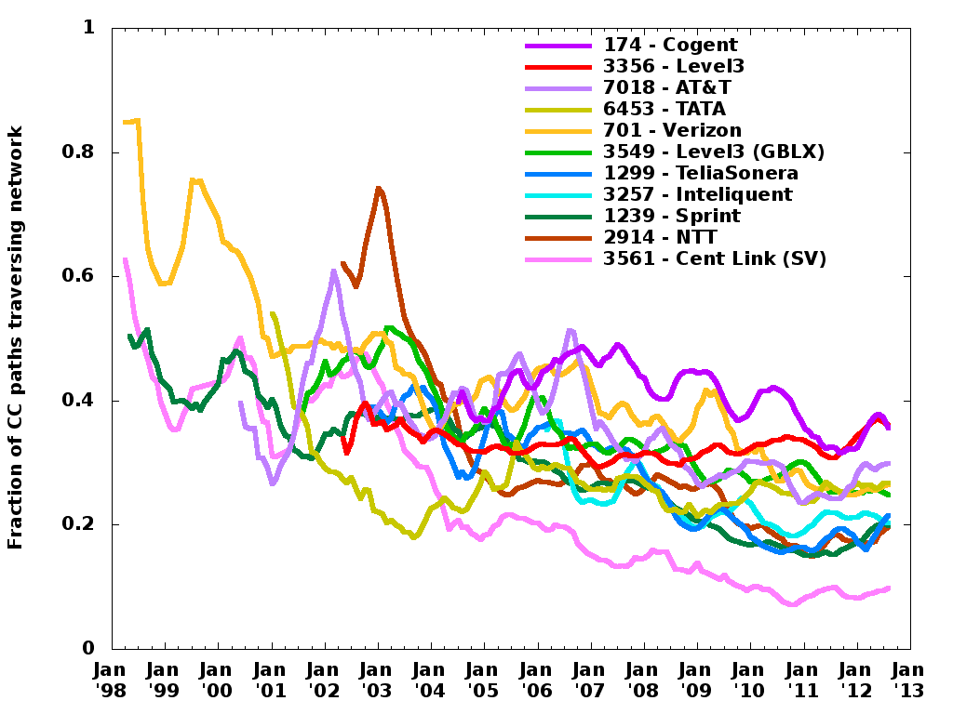

Slide 13
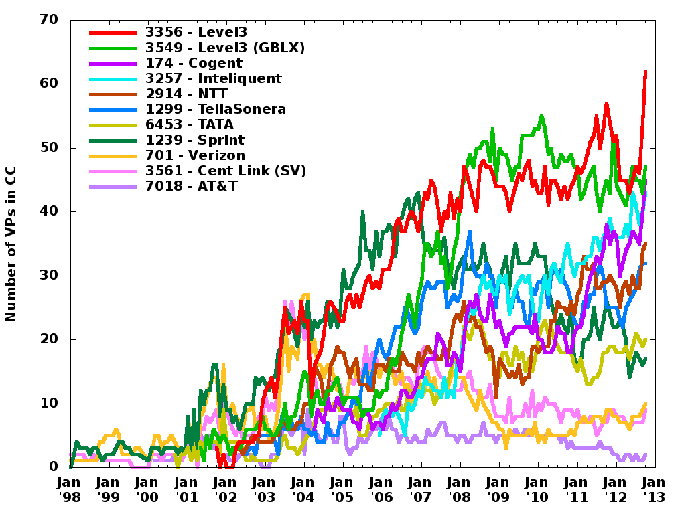

Slide 14
Help Wanted from WIE
What have we not thought of?
Does the customer cone correlate with economic measures?
How prevalent is paid-peering?
  Can you describe any routing differences between a paid peer and a settlement-free peer?
  Related: in what situations might a customer not be announced to its provider’s providers?
How prevalent are complex relationships?
  What granularity is used for routing policies?
    Region?
    Prefix?
Additional ground truth -- ideally submitted through http://as-rank.caida.org/

