Slide 1
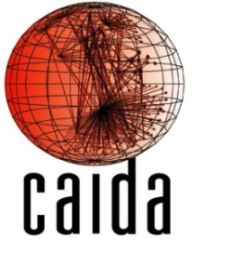


Measured Impact of Crooked Traceroute
Matthew Luckie, David Murrell (Univ. of Waikato)
Amogh Dhamdhere, kc Claffy (CAIDA/UCSD)

Slide 2
The Problem
Traceroute-based algorithms are critical to macroscopic topology collection efforts
Until recently, such algorithms ignored the effects of per-flow load balancing
Classic traceroute + per-flow load balancing:
  Inference of false loops -- Augustin et al. IMC ’06
  Lower destination reachability -- Luckie et al. IMC ’08
  Inference of false links

Slide 3
The Problem
1
0
Classic traceroute: probes toward a destination can take different paths
  Augustin et al. IMC’07: 39% of paths have at least one per-flow load-balancer
We try to quantify false link inference rate
Can’t go back and fix pre-2006 data
A
C
0
1
1
0
0
X
Y
2
2
1
B
D
1
0
1
0
X₀
A₀
D₀
Y₀
X₀
B₀
C₀
Y₀

Slide 4
Terminology
Artifact links: links that are inferred by classic traceroute but not actually traversed by packets in ﬂows
Artifact links would not be inferred with a traceroute algorithm that enumerates per-ﬂow load-balanced paths toward the destination, e.g., MDA traceroute
An artifact link is not necessarily false!
False links: Artifact links which we believe to not exist in the topology

Slide 5
X
Interface graph
With load balancing at X, A, and B, MDA traceroute would see this graph
A
B
C
D
E
F
Y

Slide 6
X
Interface graph
Inferred using
classic traceroute
A
B
C
D
E
F
A-E is an
artifact of classic
traceroute
Y

Slide 7
X
X
A
B
A,B
C
D
E
F
C
D
E
F
Y
Y
A-E does not
introduce a false link
if A+B are aliases in
the router topology
Interface graph
revealed using
classic traceroute

Slide 8
X
X
A
B
A
B
C
D
E
F
C,E
D,F
Y
Y
A-E does not
introduce a false link
if C+E are aliases in
the router topology
Interface graph
revealed using
classic traceroute

Slide 9
X
X
A
B
A
B
C
D
E
F
C,D
E,F
Y
Y
Interface graph
revealed using
classic traceroute
A-E could introduce
a false link in this
router topology

Slide 10
Not all load balancing could produce an artifact
☹
X
X
A
A
B
☺
C
X
B
Y
A
B
Y
D
C
D
E
F
☹
Y

Slide 11
Methodology
22 ark monitors, each probing a list of 16189 addresses
  Derived from BGP data from Routeviews in Sept 2010
Identify artifact links in classic traceroute data
  MDA to infer all possible links towards a destination to 99% confidence
  Artifact links appear in the output of classic traceroute but not in MDA traceroute
Determine if the artifact could introduce a false router link

Slide 12
Identifying False Links
Use Ally and Mercator to check for aliases
If (A,B) or (E,C) or (E,D) are aliases, then the artifact link is not false (classification: valid)
If (A, B, C, D, E) all exhibit incrementing IPID but no alias is found, the artifact could be a false link
Otherwise artifact is unclassified.
Assumption (validated) is that IPID-based alias resolution can determine whether or not two IP addresses are aliases if incrementing IPID values are observed.
A
B
C
D
E
F

Slide 13
Routing Changes
To guard against false positives as a result of path changes, we use the following procedure
  Initial Paris traceroute
  Classic traceroute
  MDA traceroute to 99% confidence
  Final Paris traceroute
Infer stable routing if neither Paris trace infers a link not also seen with MDA

Slide 14
Summary of Results
Total IP-level links | ICMP | UDP
Classic | 427,211 | 413,040
Paris | 422,130 | 398,179
MDA | 455,965 | 462,762
Artifact links | 13,313 | 32,233
Fraction of classic links | 3.12% | 7.8%
Inferred valid | 45.9% | 38.6%
Inferred false | 24.3% | 34.7%
Unclassified | 29.9% | 26.7%
False Links | 3,230 | 11,179
Fraction of classic links | 0.76% | 2.71%

Slide 15
False AS links
Traceroute is often used to infer AS-level connectivity
  Using prefix-AS mapping on each interface
False router links in classic traceroute can cause false AS links
26733 AS links in UDP-based graph, 28591 in ICMP graph
58 false AS links in UDP, 23 in ICMP
3 AS links (UDP) and 2 AS links (ICMP) were found in UCLA’s BGP AS topology

Slide 16
ISP-level Impact of False Links
We found small impact of false links on macroscopic topology
But what about mapping specific ISPs?
Obtained ground truth from tier-1 ISP: 1986 routers, and set of interfaces on each router
Probed prefixes in ISP’s customer cone from 265 Planetlab sites
Observed interfaces from ~45% of ISP’s routers, ~1400 links with Paris traceroute, ~4000 with Classic

Slide 17
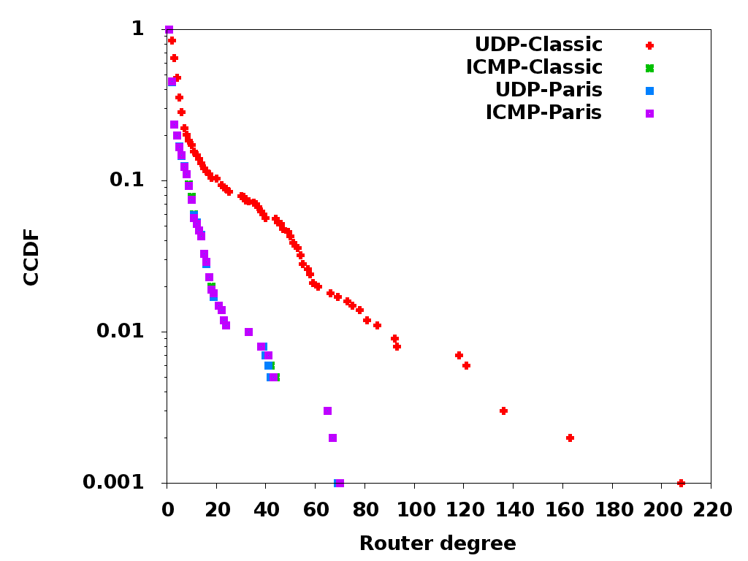
ISP Router Degree Distribution
UDP-Classic makes the ISP appear to have much richer connectivity
Router degrees inflated by a median factor of 2.9 in UDP-Classic vs UDP-Paris

Slide 18
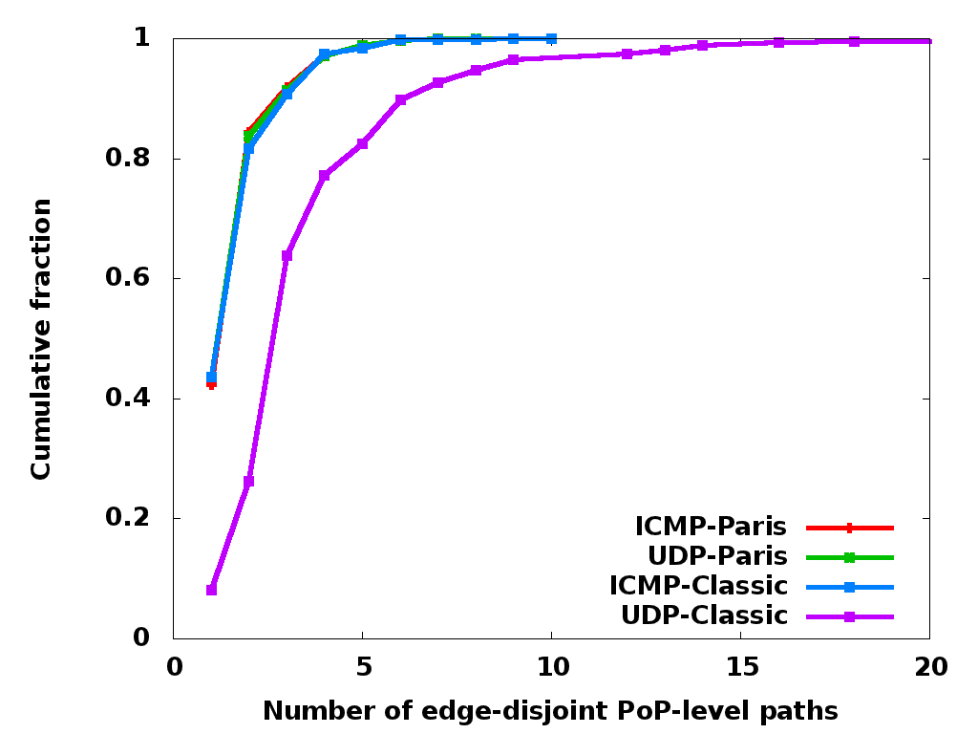
ISP PoP-level Path Diversity
We map routers to PoPs using geographic information
We compute the number of edge and node-disjoint paths between each pair of PoPs
UDP-Classic overestimates path diversity

Slide 19
Summary
Quantified the impact of classic traceroute + per-flow load balancing
Macroscopic topology: small impact
  0.76% of links in classic ICMP traceroute are invalid
  2.71% of links in classic UDP traceroute are invalid
Classic ICMP-echo approach not as affected by per-flow load balancers as UDP
ISP mapping: larger impact
  Classic traceroute overestimates router degrees (median factor 2.9), PoP level path diversity

Slide 20
Thanks!
Questions?
www.caida.org/~amogh/crooked-CCR10.pdf

Slide 21
Artifact link impact: analytical alias resolution
Analytical alias resolution rule: two addresses in a traceroute path can’t be aliases if there are no loops.
0
X
0
X
C
Y
Y
D
0
0
1
0
0
A
0
C
0
B
0
1
10-15% of false links are of this form
Y
0
D

Slide 22
Validating use of Ally technique to classify artifact links
Use ping –R and ICMP-Paris traceroute towards destination
  RR IP address usually from egress interface
  ICMP time-exceeded IP address usually from ingress interface
Infer addresses used in a sequence of /30 subnets
Identify ICMP/TCP/UDP IP-ID behaviour for each
Resolve for aliases using Ally for pairs of addresses with incrementing IPID values.
RR
a.b.c.5
d.e.f.86
g.h.i.194
traceroute
a.b.c.6
d.e.f.85
g.h.i.193

Slide 23
Validating use of Ally technique: results
22 ark monitors, 26,510 pairs of likely /30 aliases tested
Classification obtained for 20,762 (78%)
  Others did not have an incrementing IP-ID
  Some were incrementing but unresponsive to Ally.
93.8% inferred as aliases
  Of not aliases, 6 IPs are involved in 88% of pairs
  Suggests 6 outliers rather than a systematic erro

