Slide 1
Geometry of large networks (computer science perspective)
Dmitri Krioukov (CAIDA/UCSD) AIM, November 2011

Slide 2
Geometry in computer science
Machine learning and data mining
Bioinformatics
Computer graphics
Distributed systems
Networking

Slide 3
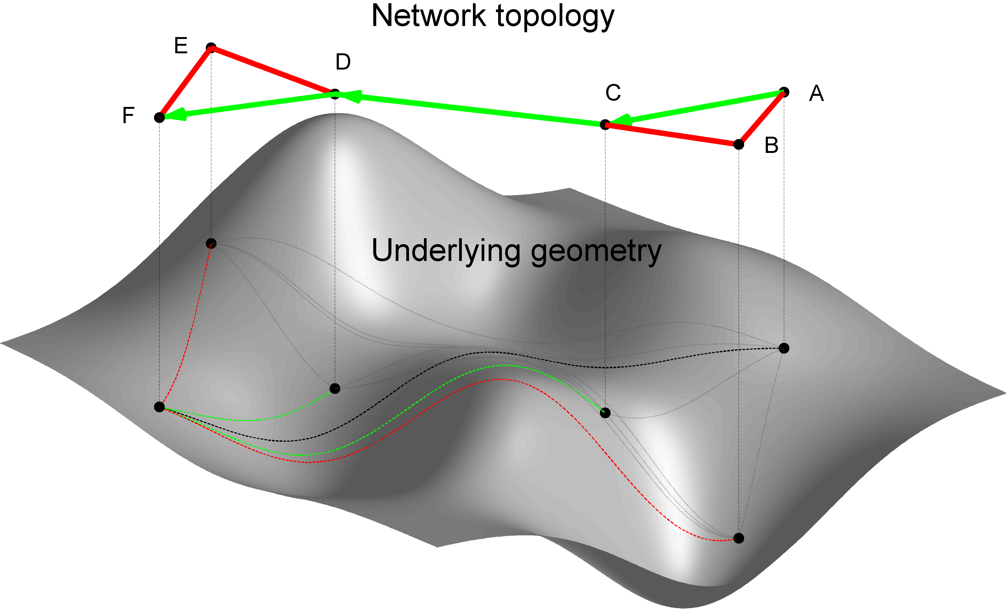
Geometry of what?
Of the network graph
Of an auxiliary space underlying the graph

Slide 4
Geometry of what?
Of the network graph
Applications:
…
Of an auxiliary space underlying the graph
Applications:
Delay estimation
Overlay networks
Routing

Slide 5
What is the space?
Real
Geography
Physical space
Applications
Geographic routing
Wireless routing
Hidden / virtual / latent
Can be virtually anything!
Applications
Delay estimation
Overlay routing
Geometric routing

Slide 6
Notes:
No node has any global knowledge
Congruency is needed (for efficiency, optimality, and robustness)
If congruency is there, shortest paths in network are discrete reflections of smooth shortest (geodesic) paths in the space

Slide 7
Why routing?
The Internet was designed for and exists to transfer information packets from A to B, where A and B are any two Internet-Protocol- (IP-)talking devices

Slide 8
IP packet format

Slide 9
IP addresses
A = 193.137.168.155
B = 192.172.226.78

Slide 10
IP routes
traceroute 192.172.226.78
1 <1 ms 2 ms 2 ms 193.137.81.254
2 <1 ms <1 ms <1 ms 192.168.255.253
3 1 ms 1 ms 1 ms 193.137.173.254
4 1 ms 1 ms 1 ms 193.136.4.26
5 5 ms 5 ms 5 ms 193.136.1.221
6 5 ms 6 ms 6 ms 193.137.0.30
7 6 ms 6 ms 6 ms 62.40.124.185
8 32 ms 33 ms 32 ms 62.40.112.146
9 41 ms 40 ms 40 ms 62.40.112.137
10 123 ms 124 ms 124 ms 62.40.112.134
11 130 ms 130 ms 129 ms 216.24.184.85
12 134 ms 131 ms 130 ms 216.24.186.23
13 143 ms 144 ms 143 ms 216.24.186.20
14 167 ms 167 ms 167 ms 216.24.186.8
15 199 ms 199 ms 198 ms 216.24.186.30
16 197 ms 197 ms 197 ms 137.164.26.130
17 203 ms 203 ms 203 ms 137.164.25.5
18 204 ms 203 ms 203 ms 137.164.27.50
19 204 ms 205 ms 204 ms 198.17.46.56
20 203 ms 204 ms 204 ms 192.172.226.78

Slide 11
IP routes
R₂
R₃
R₁
R₄
A
B

Slide 12
Autonomous Systems
A
X
Y
Z

Slide 13
AS topology
A
X
Y
Z

Slide 14
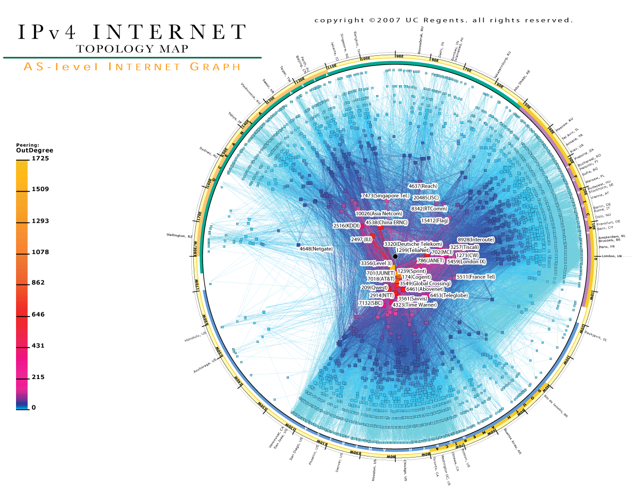

Slide 15
Internet AS topology
Cumulative result of local, decentralized, and rather complex interactions between AS pairs
Surprisingly, in 1999, it was found to look completely differently than computer scientists had thought: it shares the two main common features of topologies of other complex networks
scale-free degree distributions
strong clustering
Routing protocols have to find and update paths to destinations through it

Slide 16
IP routing
Intradomain (Interior Gateway Protocols (IGPs))
routing within an Autonomous System (AS)
protocols:
Open Shortest Path First (OSPF)
Intermediate System to Intermediate System (ISIS)
Links State (LS) routing protocols
Interdomain (Exterior Gateway Protocols (EGPs))
routing between Autonomous Systems (ASs)
protocols:
Border Gateway Protocol (BGP)
Path Vector (PV) routing protocol (~Bellman-Ford)

Slide 17
BGP
Each AS X advertises IP addresses A_{X} that it has
All neighboring ASs receiving this advertisement re-advertise them to their neighbors after pre-pending their AS numbers
The result is that each AS Y has a routing entry for A_{X} which looks like: A_{X} : Y₁, Y₂, …, X, where Y₁ is a neighbor of Y, Y₂ is a neighbor of Y₁, and so on.

Slide 18
Simple routing event
A
s
X
Y
Z
t

Slide 19
BGP dynamics
BGP updates
2 per second on average
7000 per second peak rate
Convergence after a single event can take up to tens of minutes

Slide 20
Compact routing
Memory per node
Size of the routing tables
Stretch
How close routing paths are to shortest paths in the network
Communication overhead
Number of messages the protocol generates per topology change, etc.

Slide 21
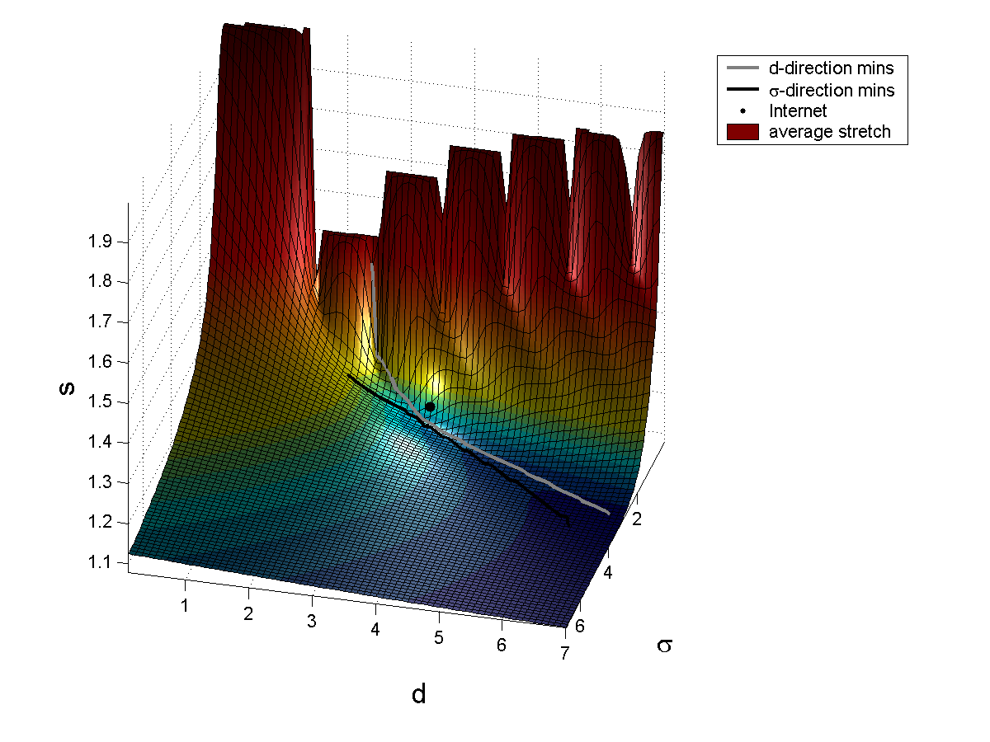

Slide 22
Compact routing overhead
There can be no routing algorithm with the number of messages per topology change scaling better than linearly with the network size in the worst case
Internet-like networks are this worst case
Oops, too bad. Is there anything we can do?

Slide 23
Notes:
In maze without the MAP
Learning its MAP
Dynamic
More complex

Slide 24
Notes:
Direction would be good
Efficiency
Optimality
Robustness
Geometry!!! (no geometry on the previous slide!)
BEST POSSIBLE if all these conditions satisfied

Slide 25
Notes:
No node has any global knowledge
Congruency is needed (for efficiency, optimality, and robustness)
If congruency is there, shortest paths in network are discrete reflections of smooth shortest (geodesic) paths in the space

Slide 27
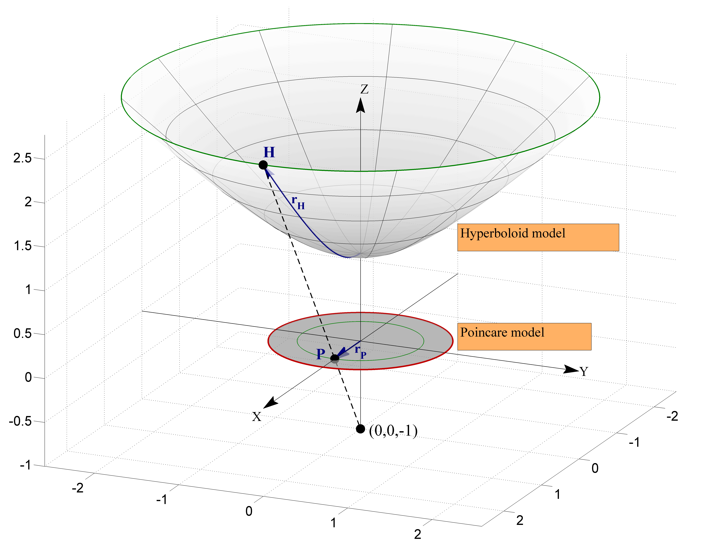
$${ds}^{2}={dx}^{2}+{dy}^{2}−{dz}^{2}$$
$$r_{P}=\tanh{\frac{r_{H}}{2}}$$
$${ds}^{2}={dx}^{2}+{dy}^{2}+{dz}^{2}$$
$$r_{E}=−iE\left(ir_{H},2\right)$$

Slide 30
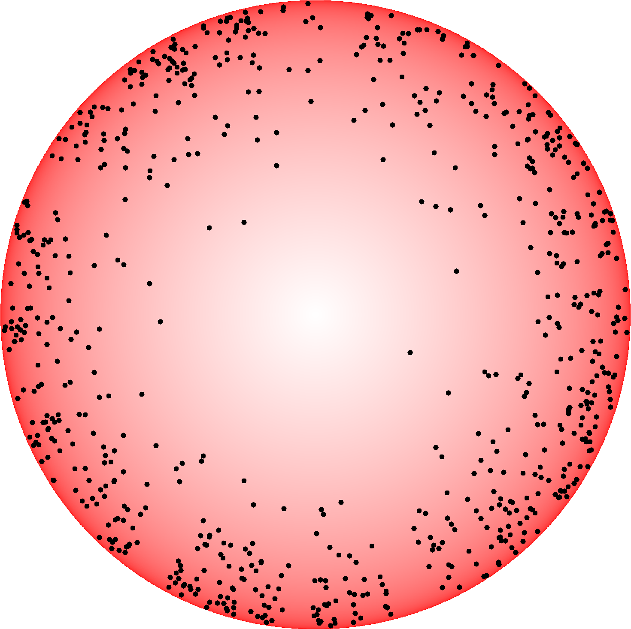

Slide 32
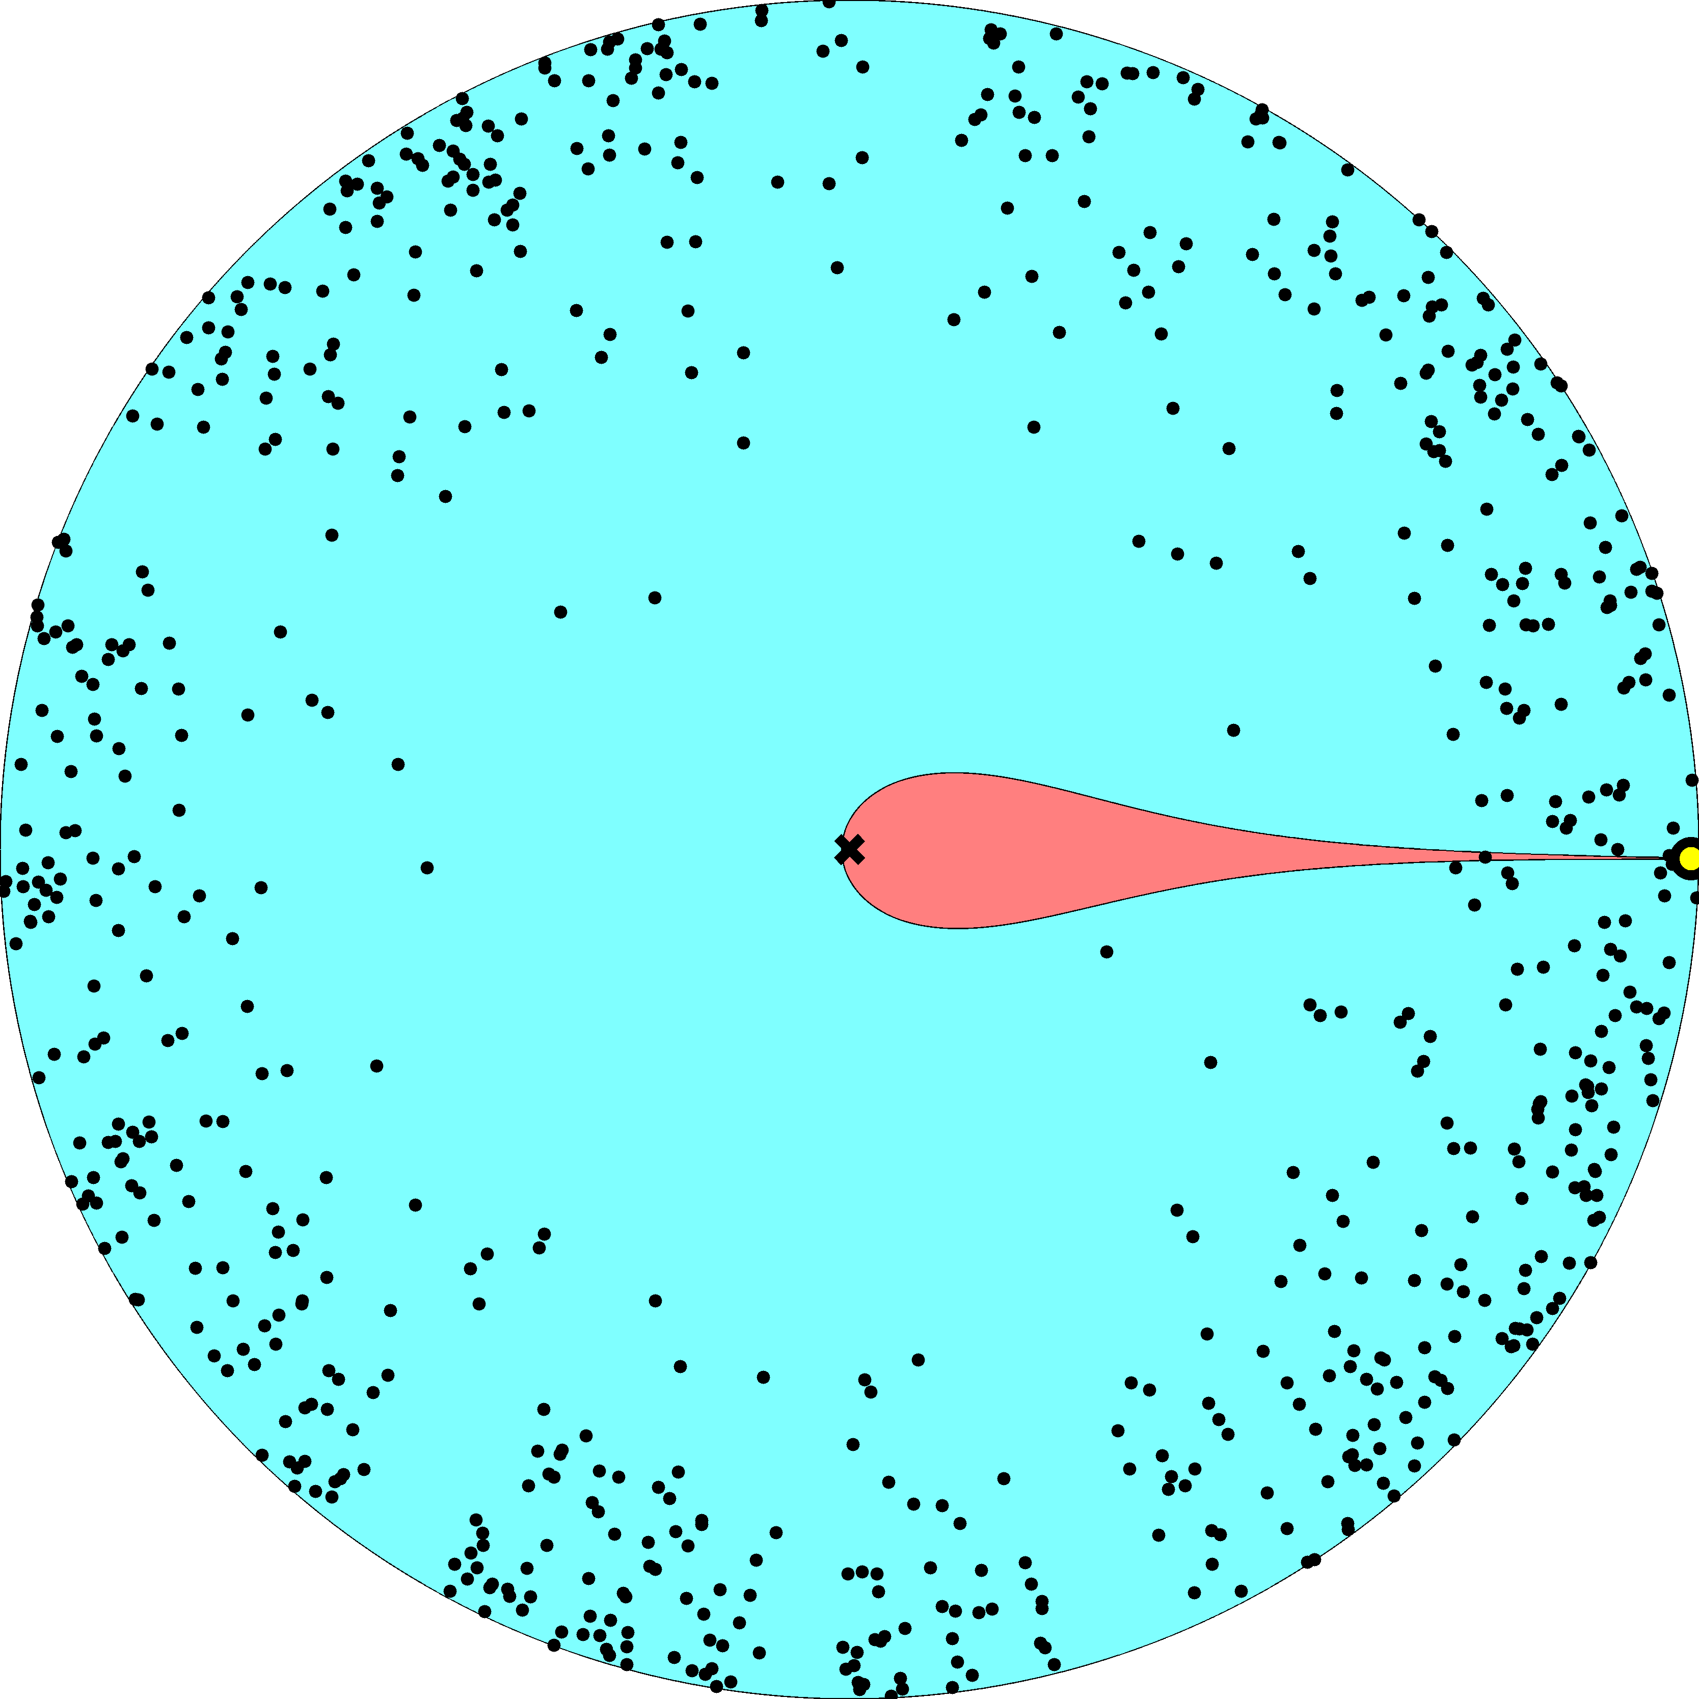

Slide 33
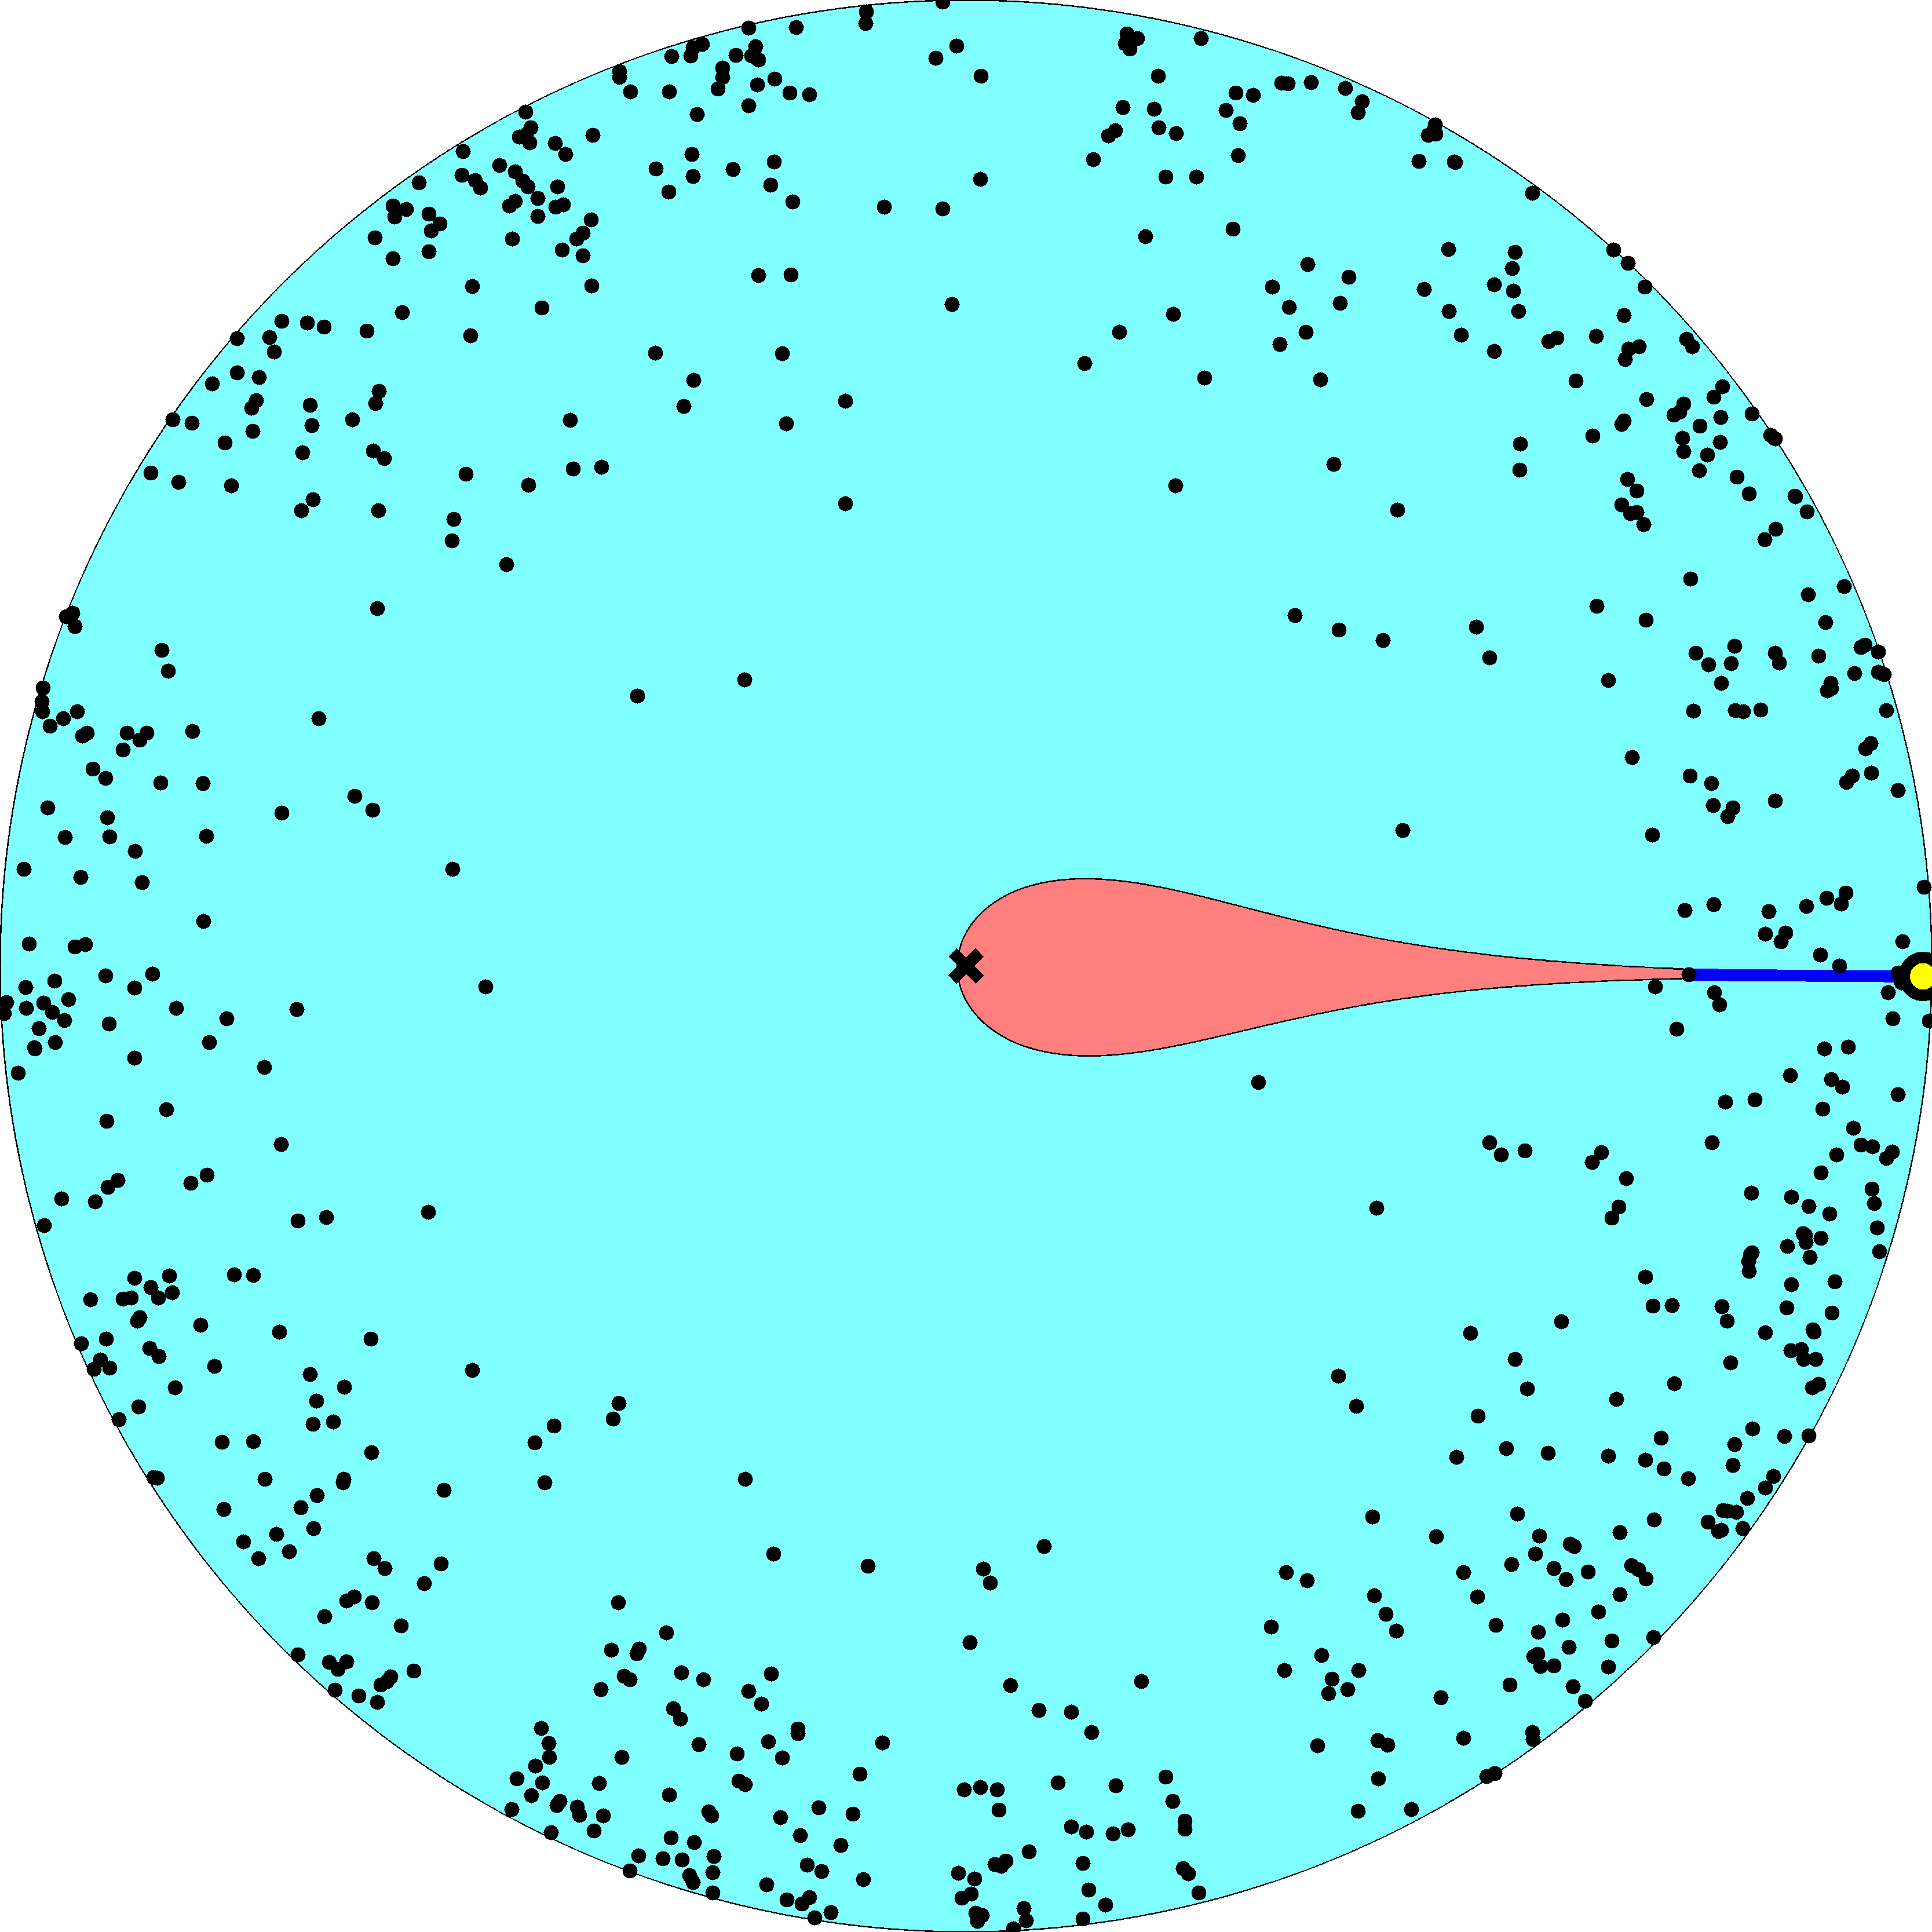

Slide 34
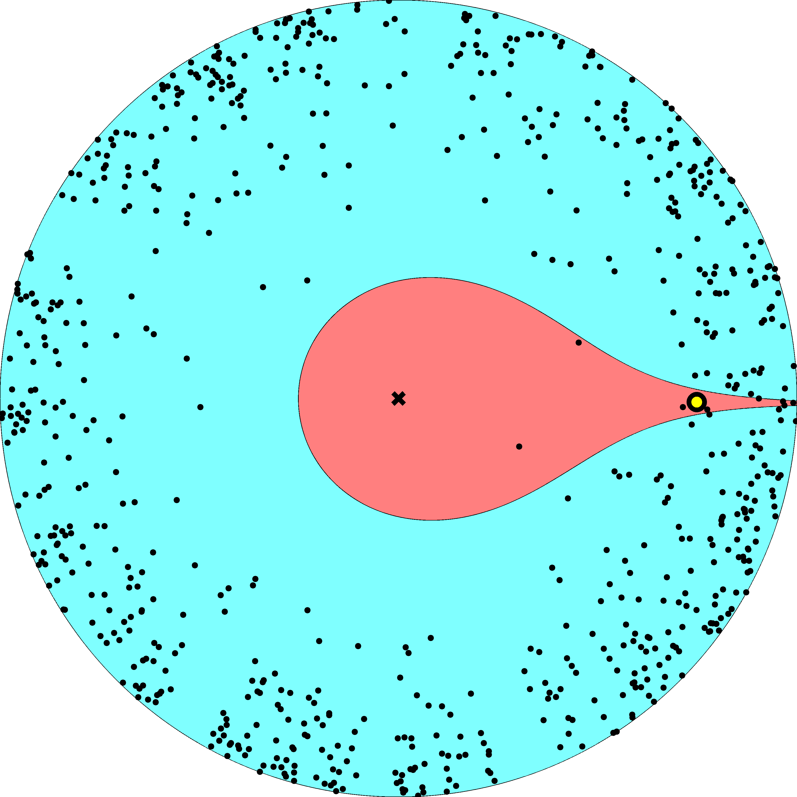

Slide 35
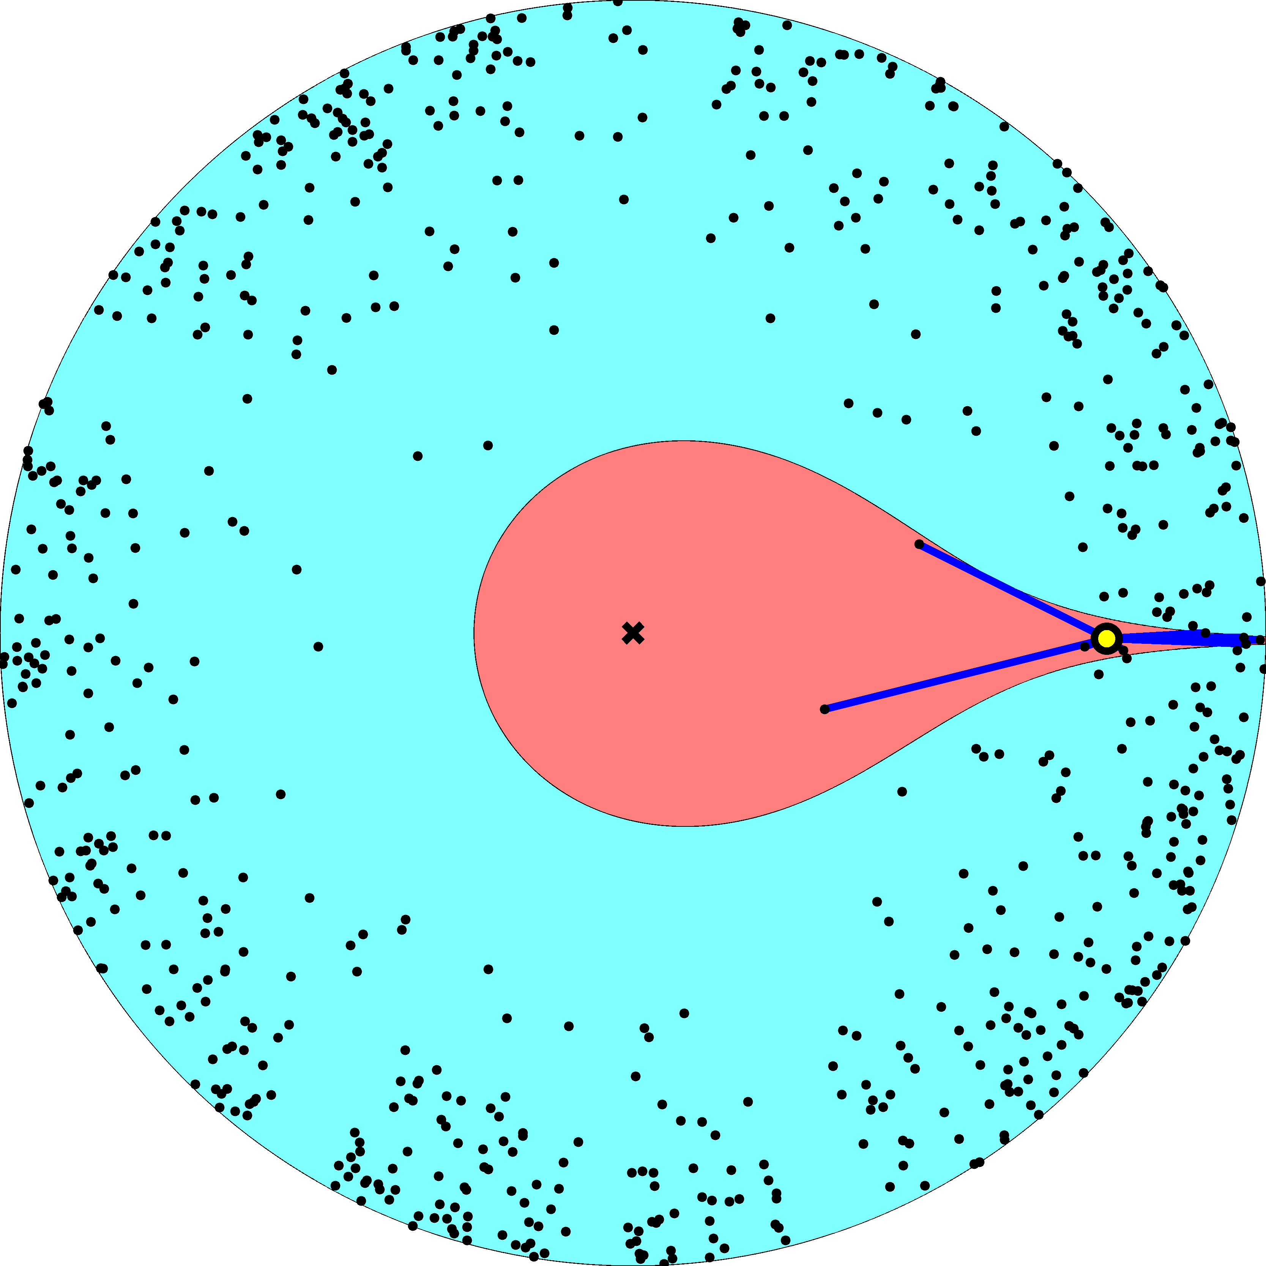

Slide 36
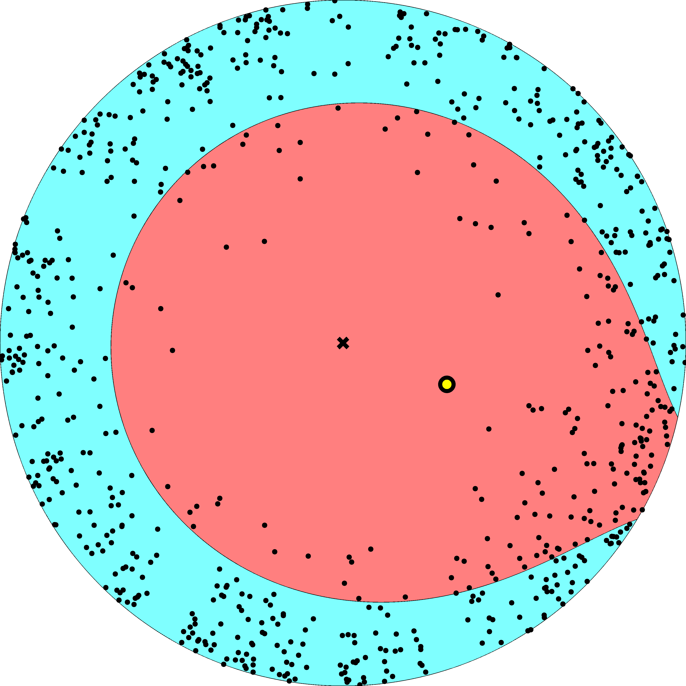

Slide 37
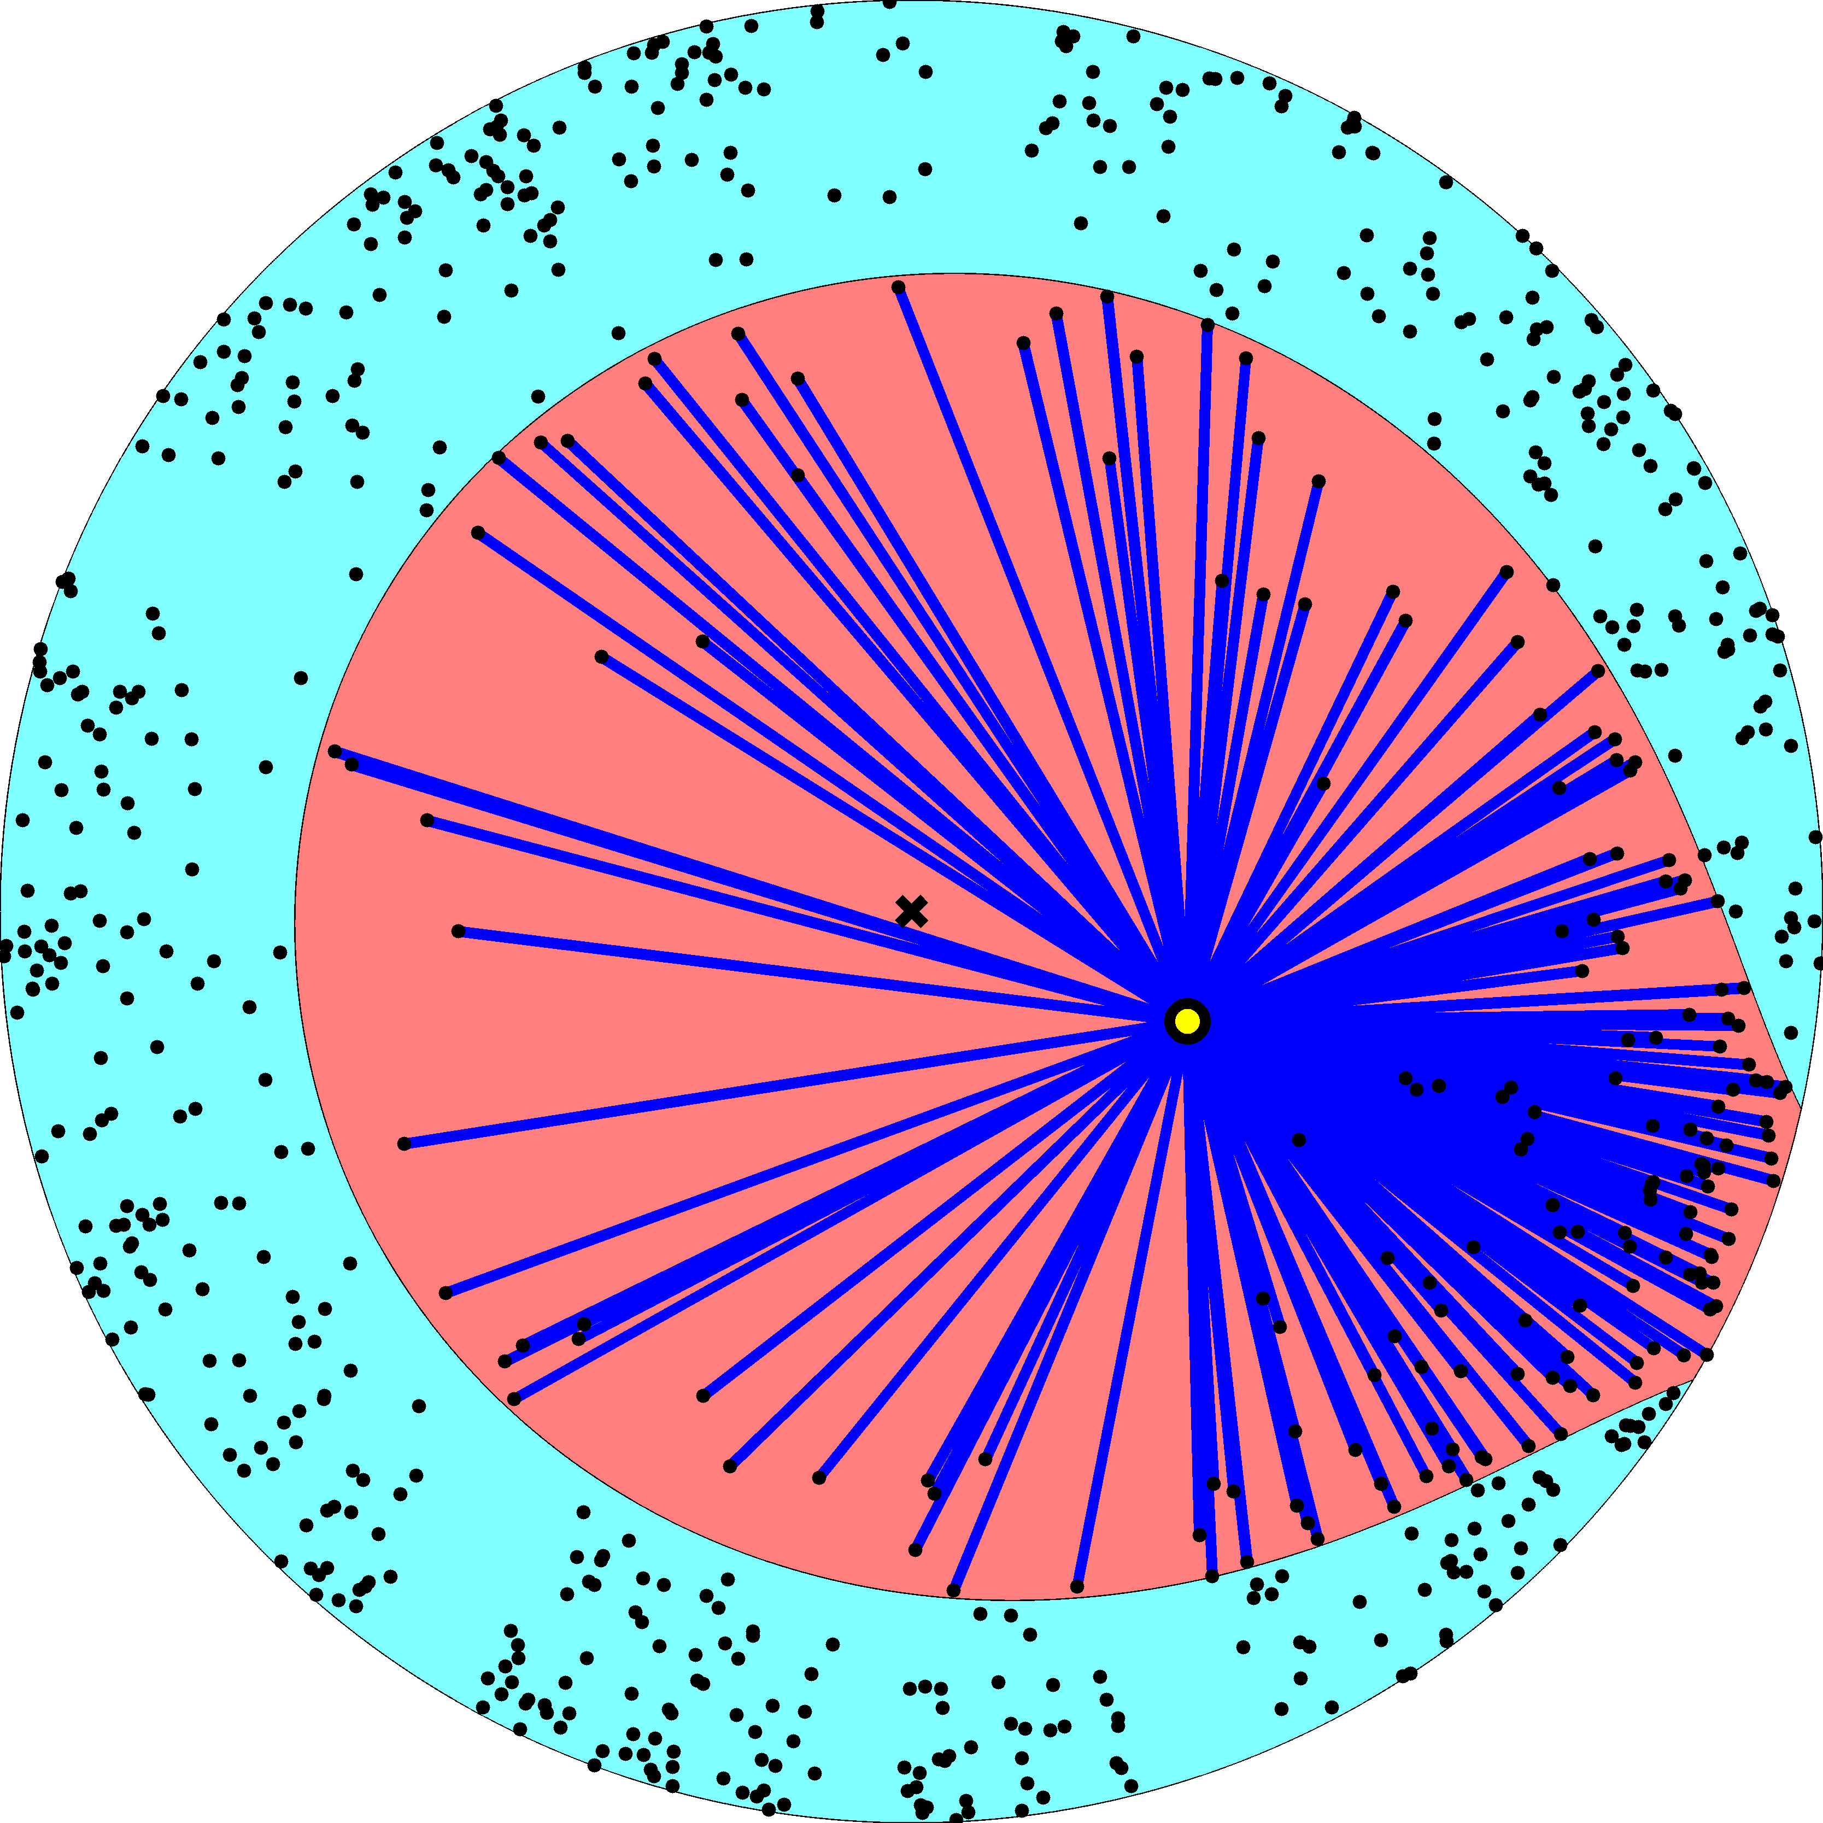

Slide 38
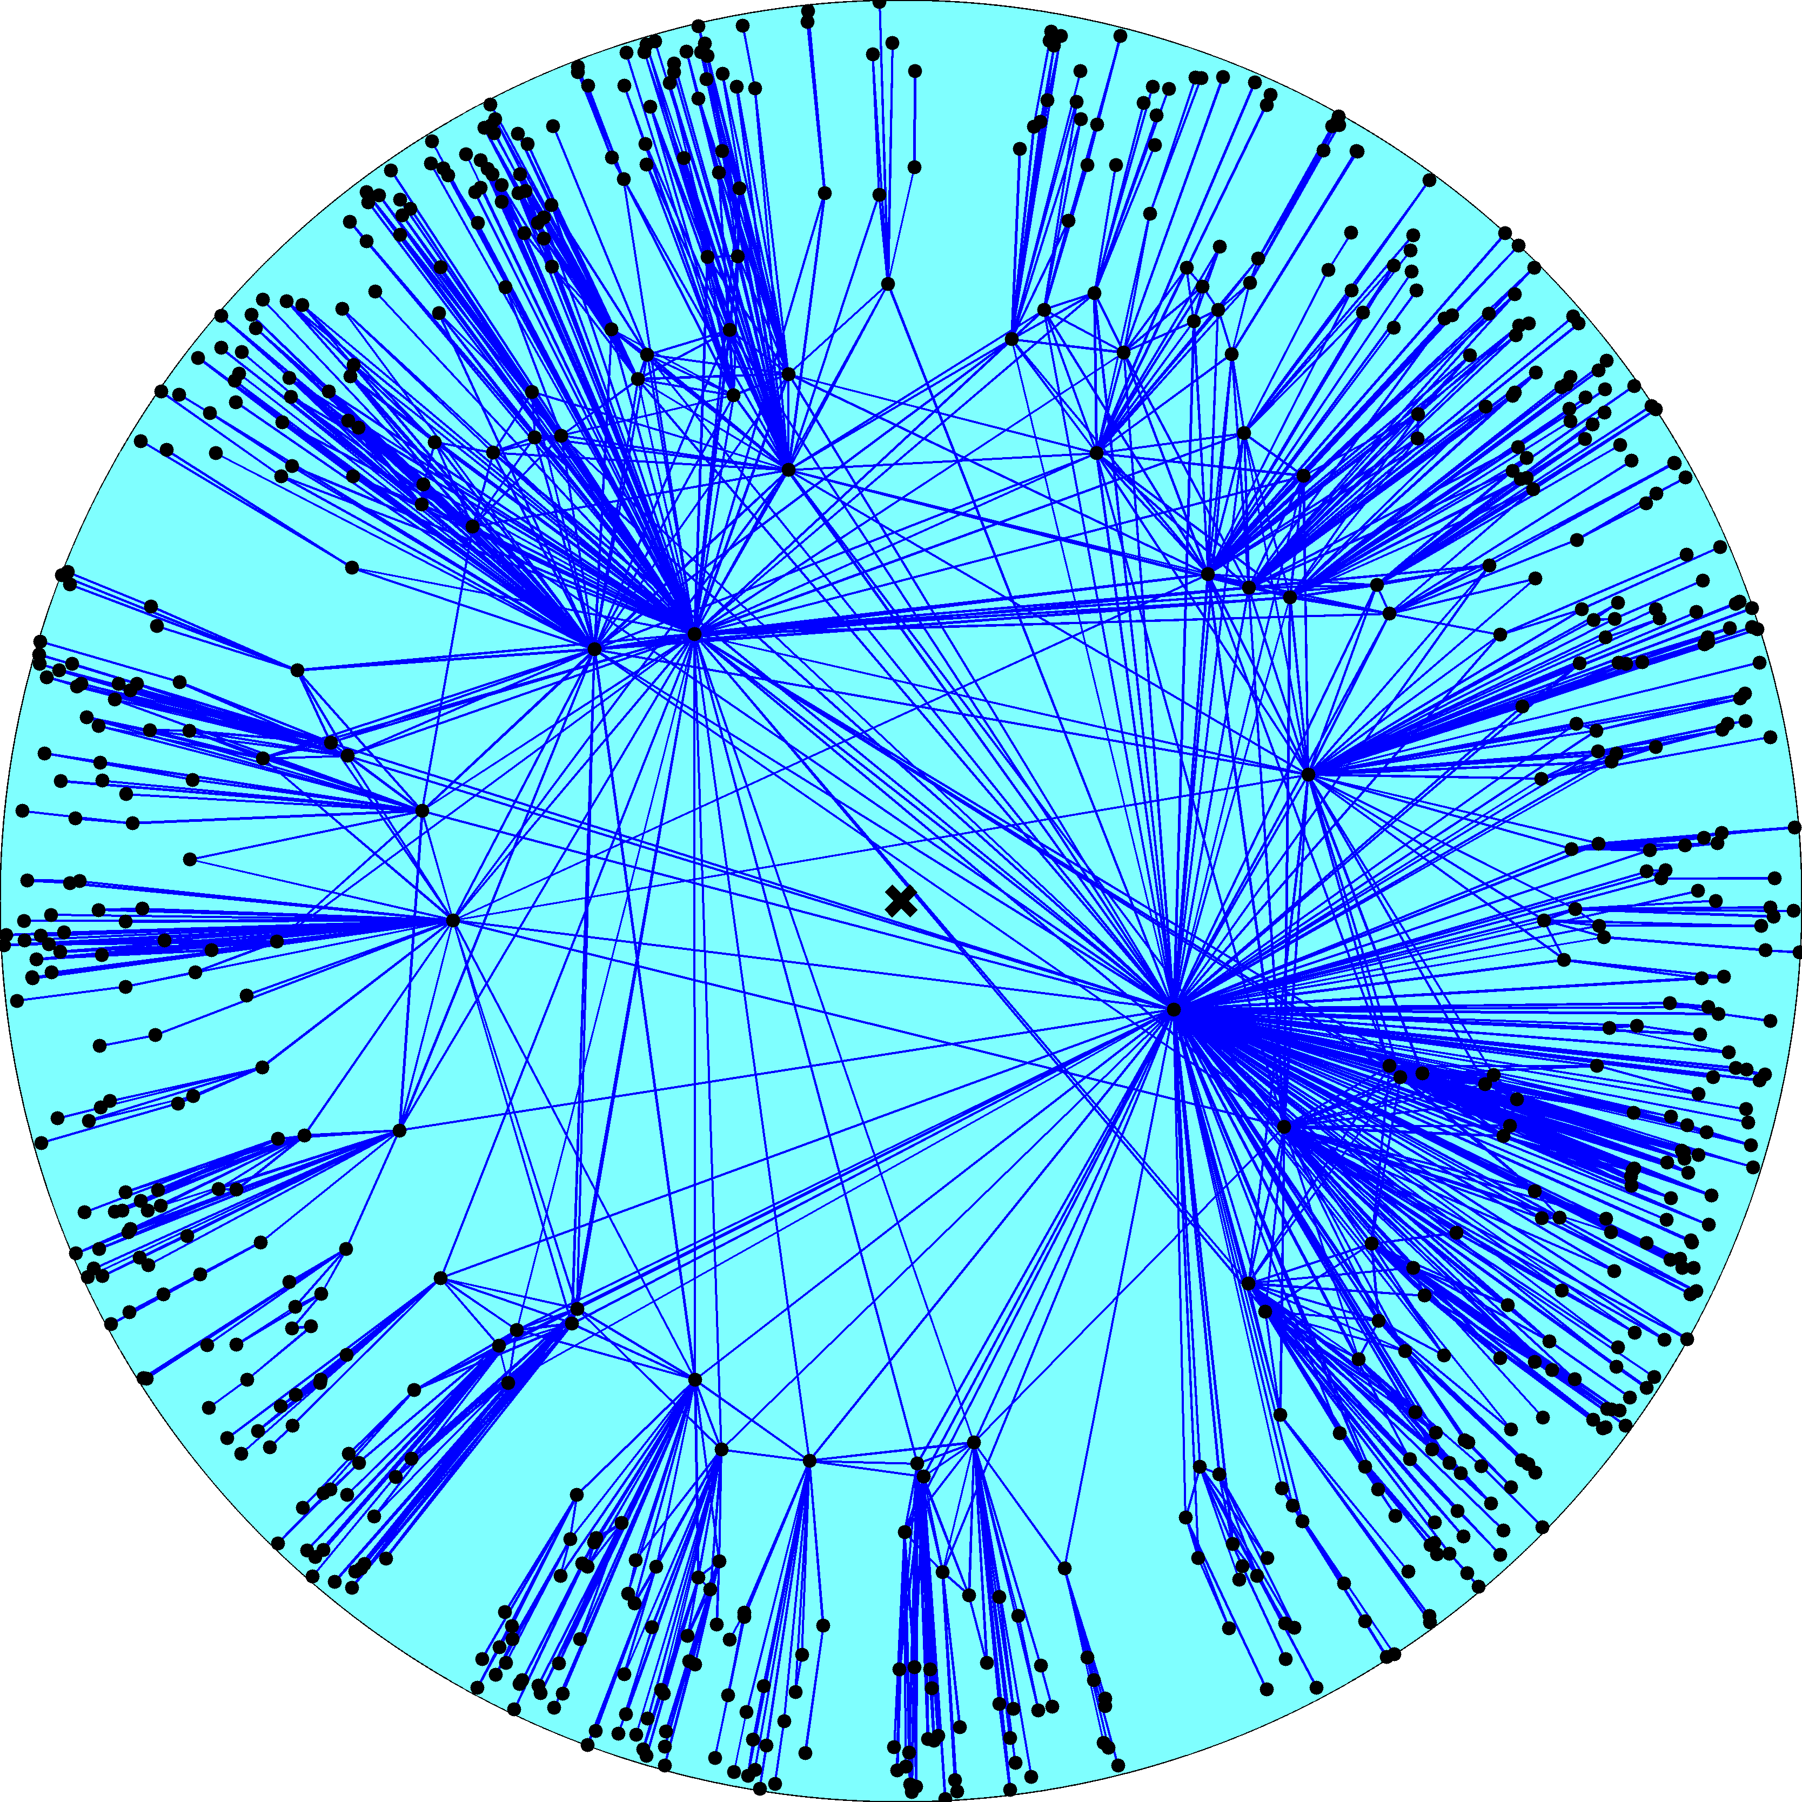
Node density
Node degree
R – disk radius
K – disk curvature
maximized
Degree distribution
Clustering

Slide 39
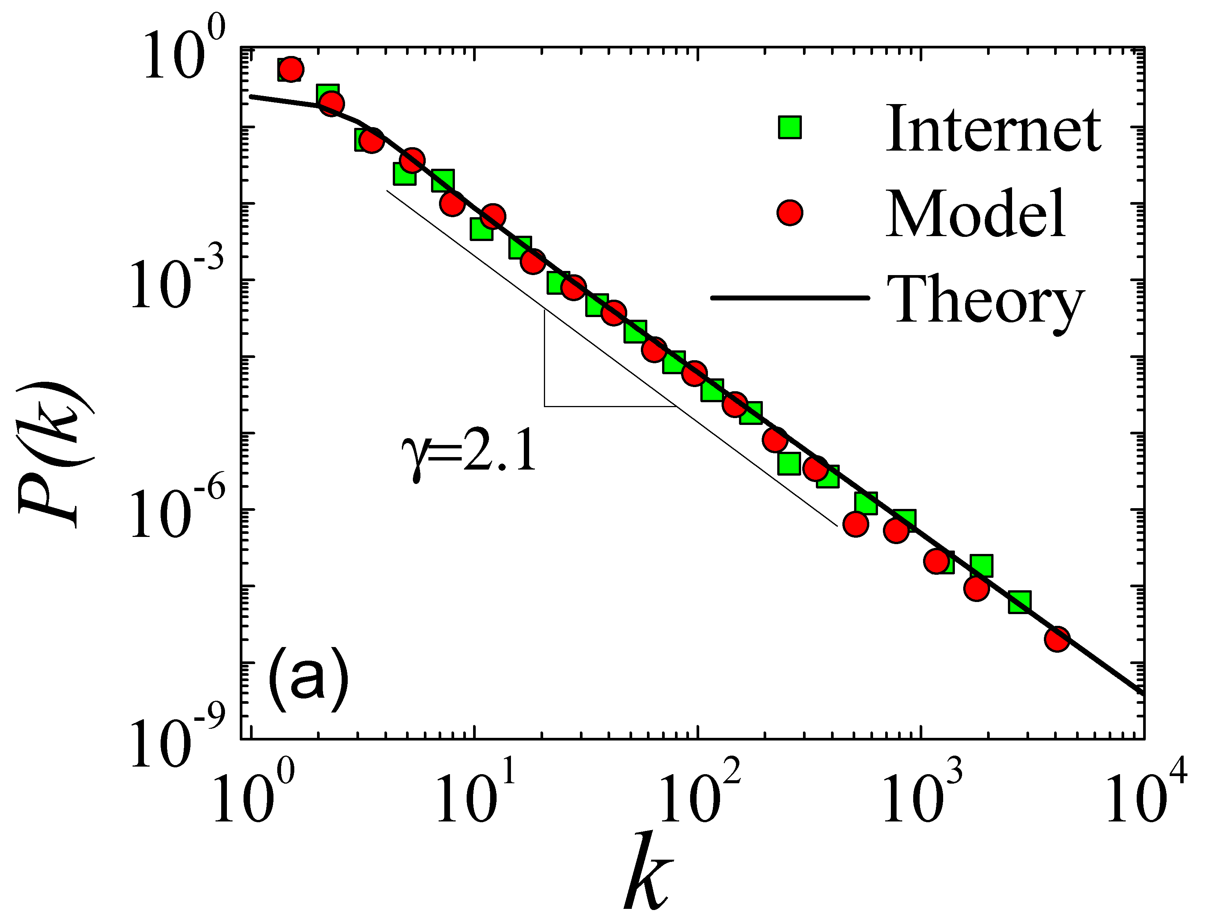

Slide 40
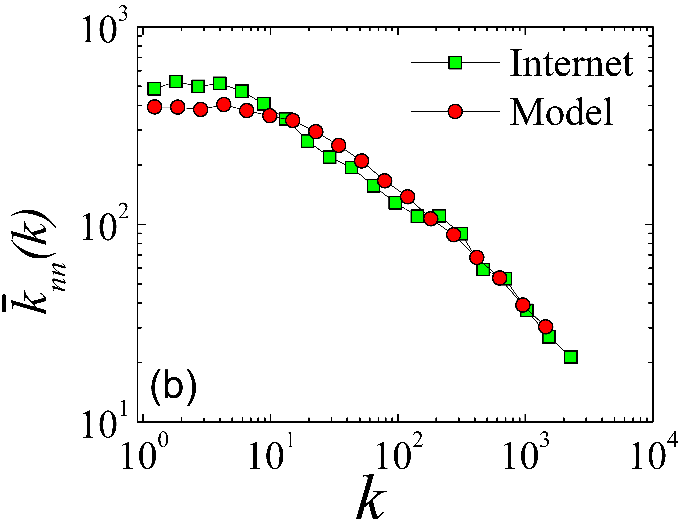

Slide 41
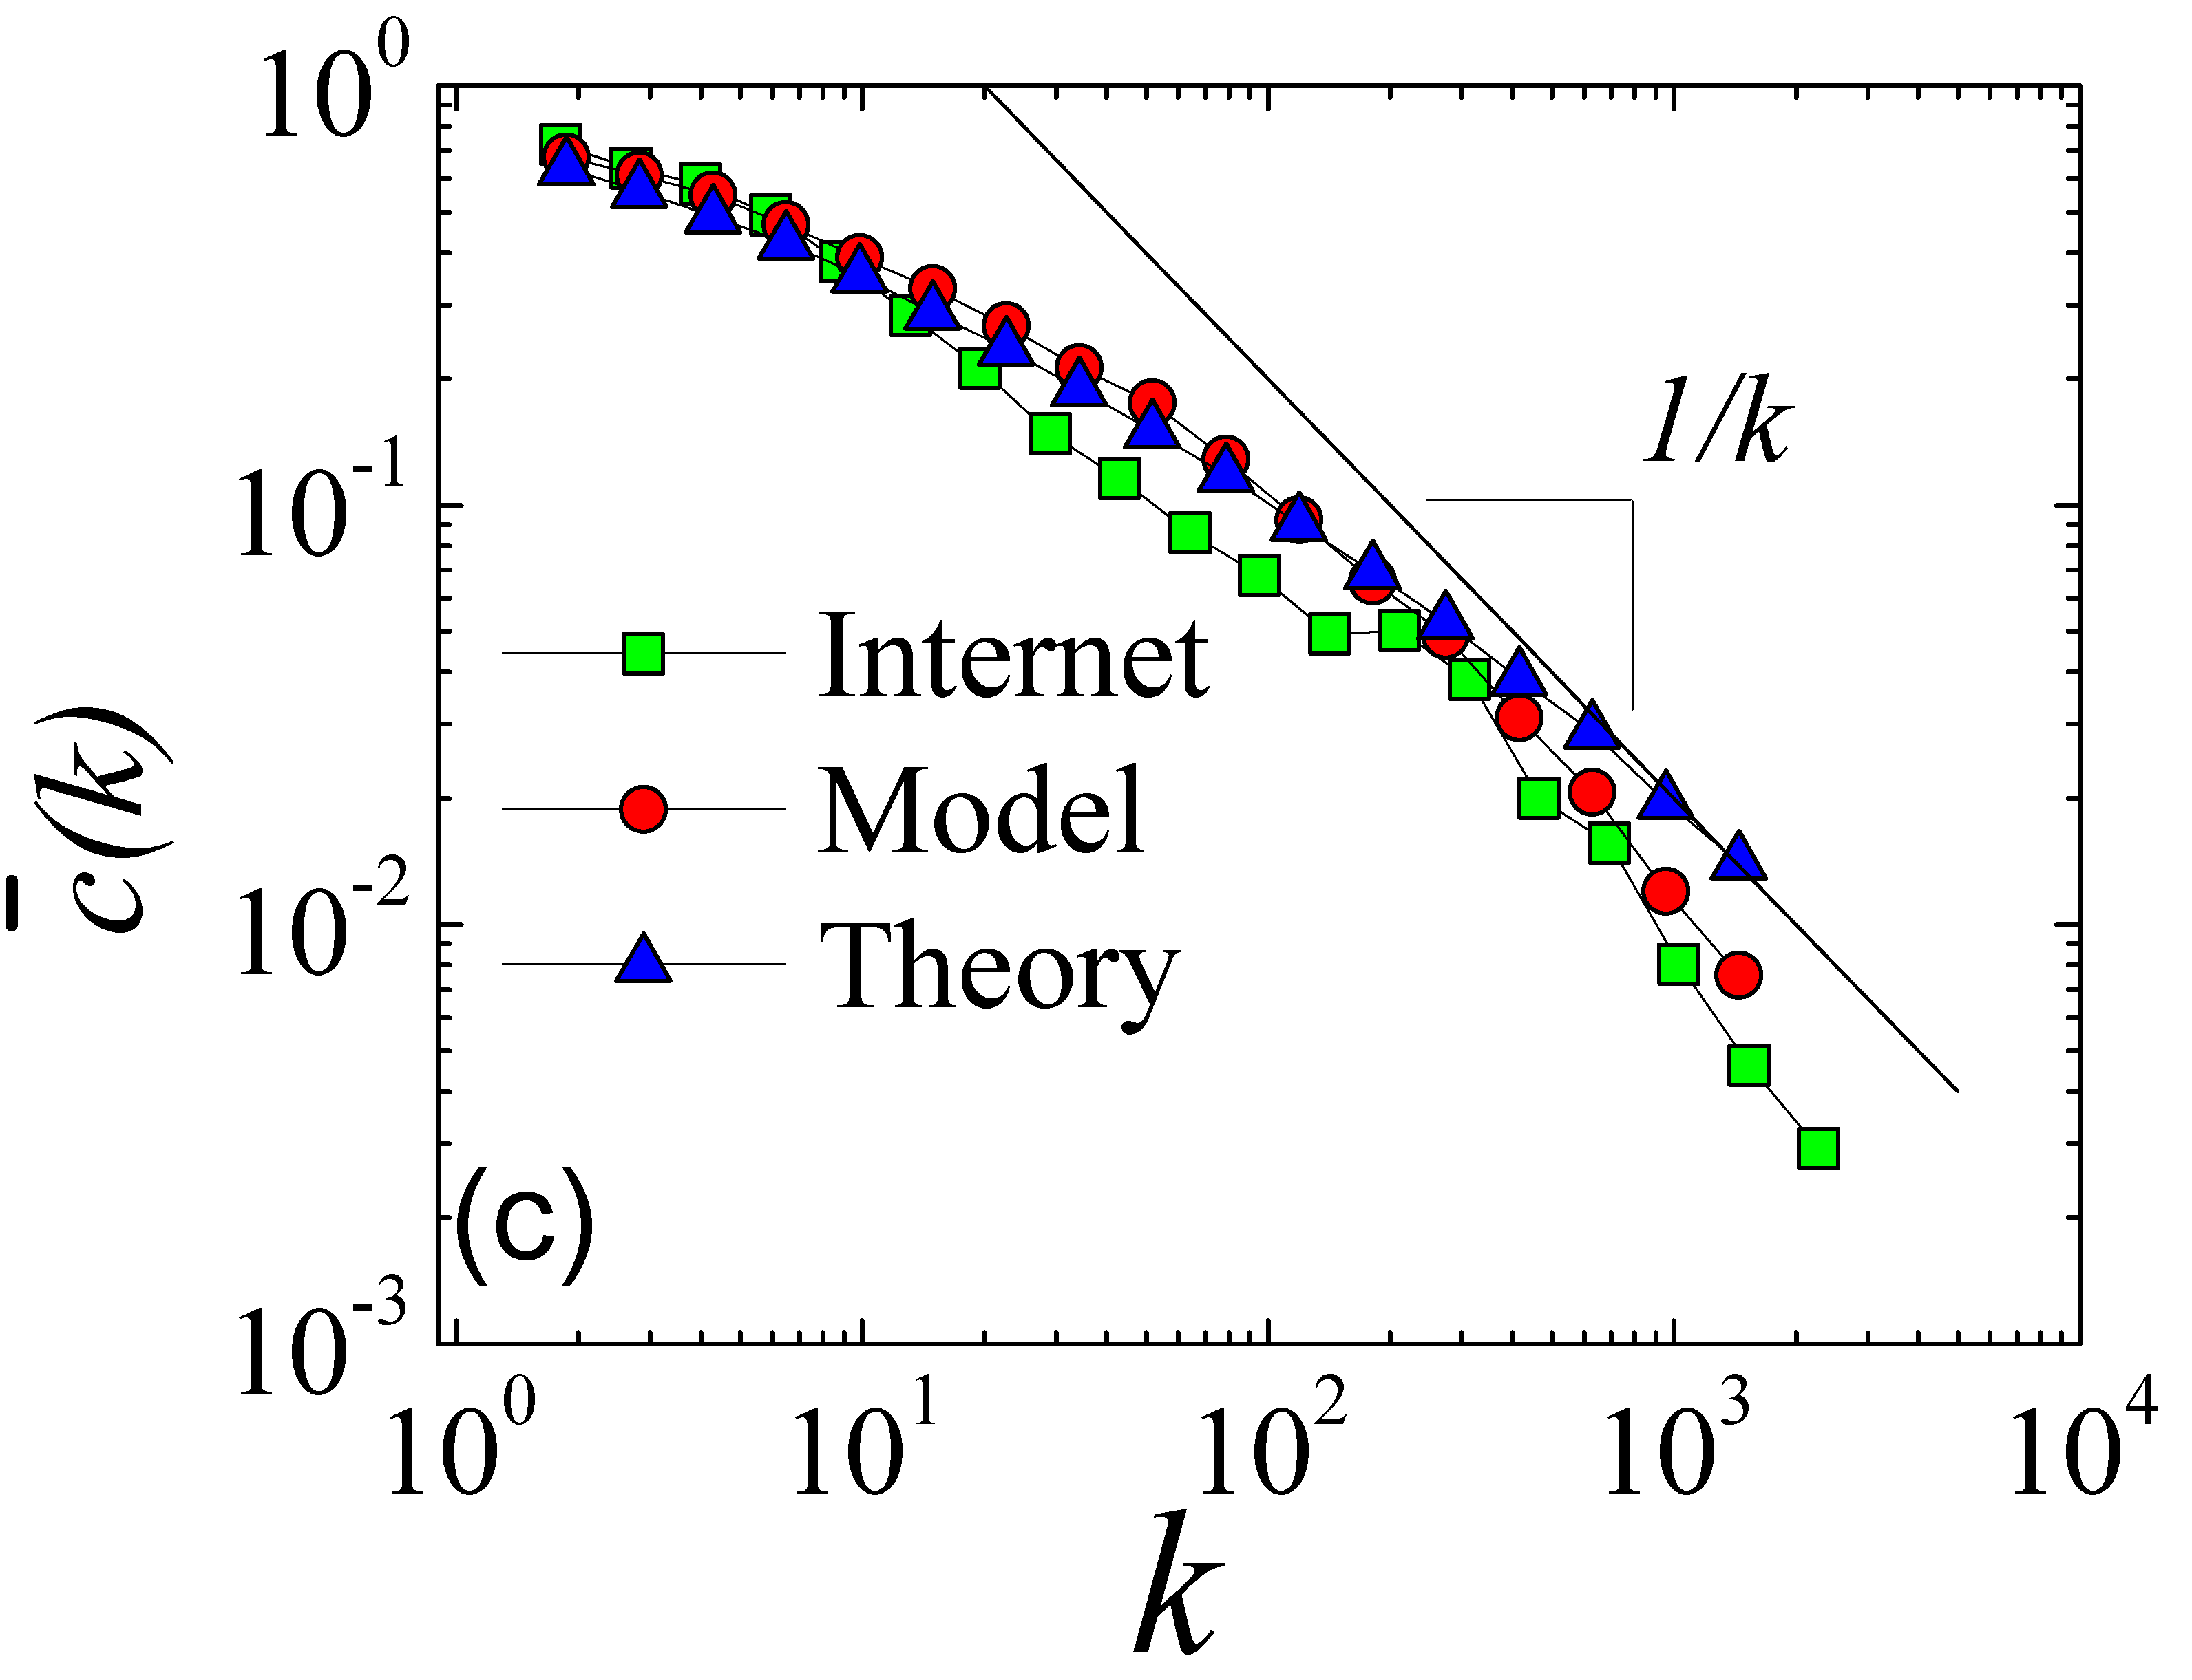

Slide 42
GR in hyperbolic Internet
Memory per node
Proportional to its degree
Stretch
Close to 1 (1.1)
Success ratio
Close to 1 (0.97)
Communication overhead
0

Slide 43
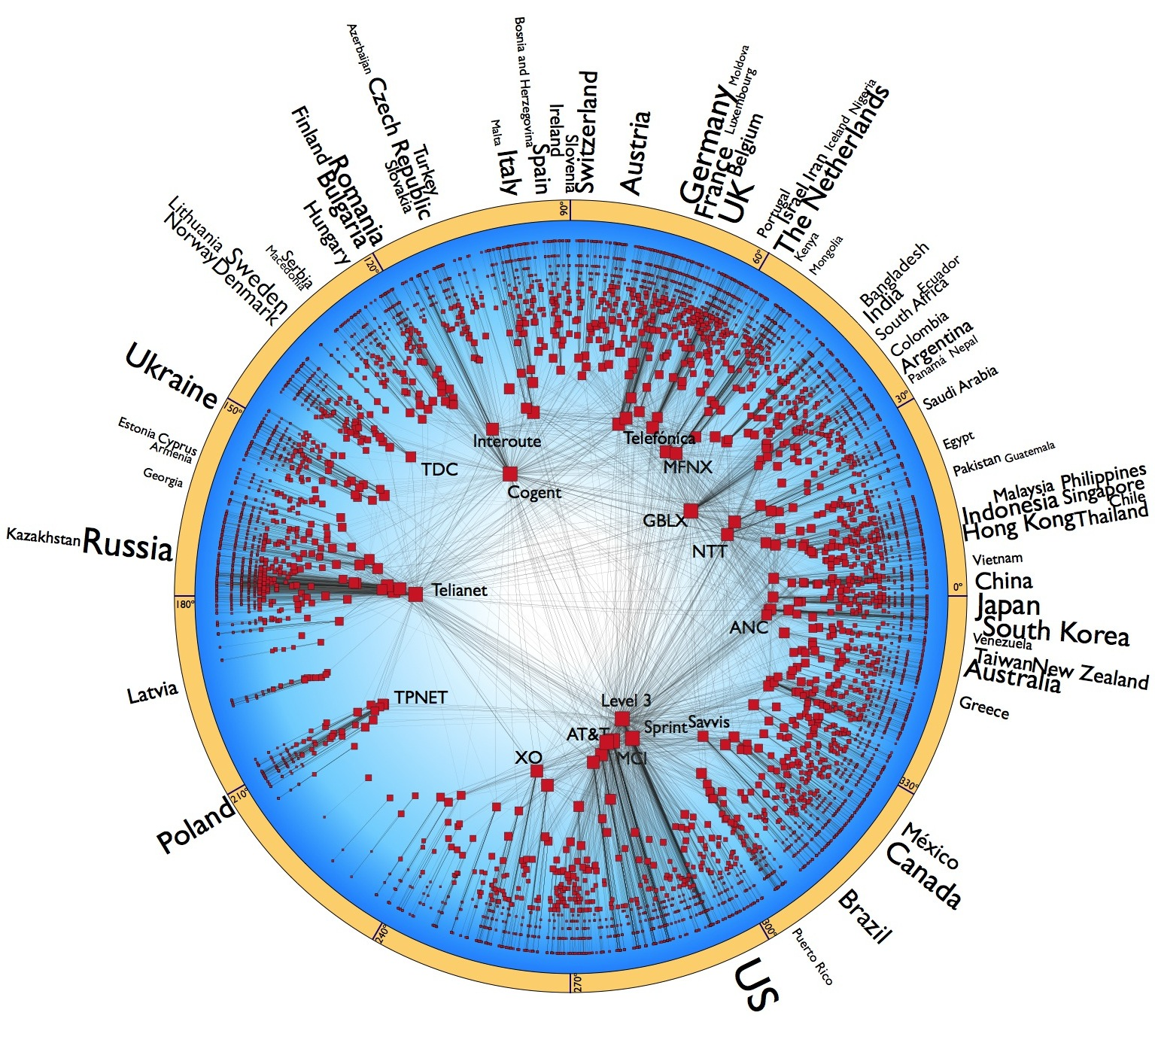
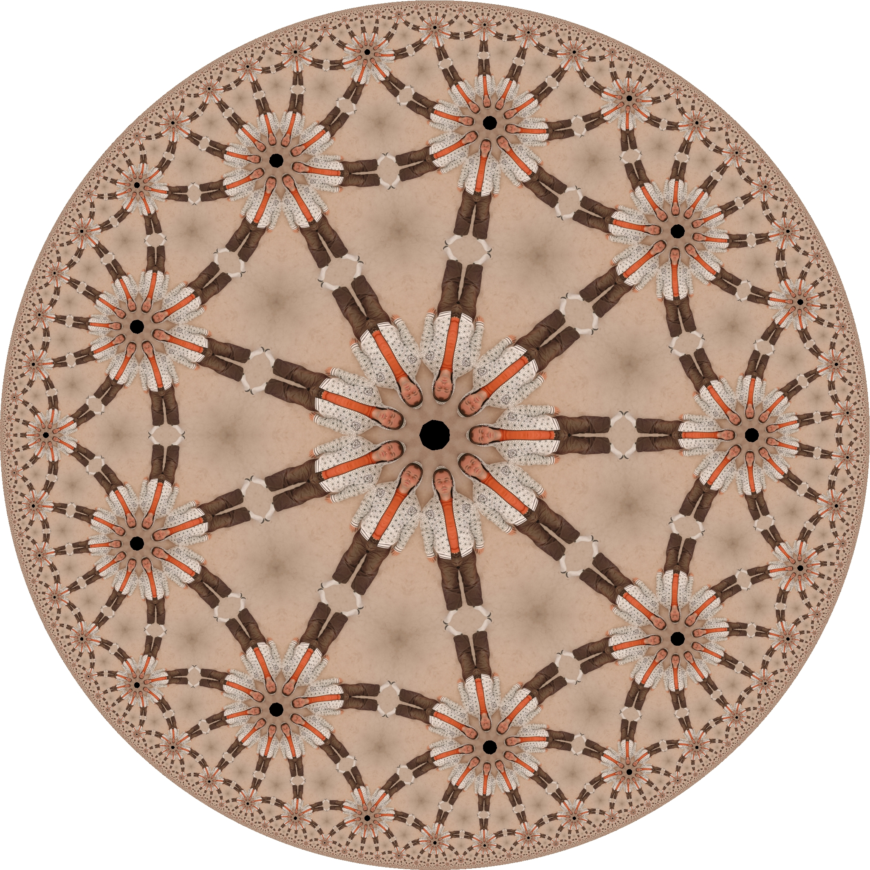
Take-home message

?
←

Slide 44
Conclusion
Latent geometry of large complex networks is useful for many applications
For routing, it yields theoretically best possible results (optimal routing), which could not be obtained by any methods for decades
Yet, this research area is
Quite involved
Poorly understood
Only recently attracted some focused attention

Slide 45
M. Boguñá, F. Papadopoulos, and D. Krioukov, Sustaining the Internet with Hyperbolic Mapping, Nature Communications, v.1, 62, 2010
D. Krioukov, F. Papadopoulos, A. Vahdat, and M. Boguñá, Hyperbolic Geometry of Complex Networks, Physical Review E, v.82, 036106, 2010, Physical Review E, v.80, 035101(R), 2009
F. Papadopoulos, D. Krioukov, M. Boguñá, and A. Vahdat, Greedy Forwarding in (Dynamic) Scale-Free Networks Embedded in Hyperbolic Metric Spaces, INFOCOM 2010, SIGMETRICS MAMA 2009
M. Boguñá, D. Krioukov, and kc claffy, Navigability of Complex Networks, Nature Physics, v.5, p.74-80, 2009

