Slide 1
PalmTree
M. Engin Tozal Kamil Sarac
The University of Texas at Dallas

Slide 2
PalmTree
IP Alias Resolution problem could be defined in two different forms:
  Given two IP addresses identifying whether they are hosted by the same router or not
  Given a set of IP addresses grouping all IP addresses belonging to the same router
  A solution to one of the definitions could be employed in the other
Palm Tree, given a set of IP addresses, attempts to group IP addresses accommodated by the same router

Slide 3



PalmTree
Related Work
  Mercator (probe based source IP address IP alias resolver)
  Ally (probe based IP Identifier IP alias resolver)
  Radargun (velocity modeling based ally improvement)
V

Slide 4





PalmTree
Related Work
  APAR/KAPAR (inference based IP alias resolver)
  Discarte (hybrid record-route option leveraging IP alias resolver)
V₂
R₄
R₃
R₂
R₁
V₁

Slide 5

PalmTree
R₁
V
hop h
R₂
AQ TTL=h
DQ TTL=255
R₃
R₁
V
S
RPY TTL=…
RPY TTL=…
Assume a set of IP addresses are fed to palm tree and at the moment is the one being processed
Assume R1 reports the probed interface if it hosts probe destination
Assume R1 returns the incoming interface if it does not host the probe destination

Slide 6






PalmTree
Definitions
  Routers and subnets are represented as sets of interfaces e.g.
  An interface has an associated IP address denoted by this value is set to in case is anonymous
  An interface is obtained by direct or indirect probing from a particular vantage point
  denotes the hop distance to from
  and denote mate 31 and mate 30 of respectively
  Let be alias relationship, implies and are hosted by the same router
  is a symmetric and transitive relation

Slide 7
PalmTree
Definitions
  Direct Probing
  Indirect Probing
  Router Response Configuration (RRC)
    Nil Interface Router
    Probed Interface Router
    Incoming Interface Router
    Shortest Path Interface Router
    Default Interface Router
    Usually responsive routers are configured as “probed interface routers” for direct probes
    Routers cannot be configured as “probed interface router” for indirect probes
    RRC may vary with respect to the probing protocol

Slide 8

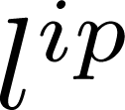


PalmTree
Observations
  Hierarchical Addressing (RFC 4632) states that any two IP addresses on the same subnet shares a common bits prefix
  Fixed Ingress Router states that as long as there is no path fluctuations, packets destined to different interfaces of a subnet are delivered through the same ingress router
  Unit Subnet Diameter implies
  Mate-31 Adjacency implies given that and are in use and mate-31 of each other than

Slide 9
PalmTree
R₄
R₃
R₆
R₅
R₂
R₁
V₁

Slide 10
PalmTree
We have two issues to address
  A concept called frontier interface resolution
  Path fluctuations

Slide 11
PalmTree
Path Fluctuations
  Routing updates, load balancing enabled routers
  Distance and Alias probes use different ingress router
  Asymmetric diamonds
  Increasing confidence level by repeating alias query

Slide 12
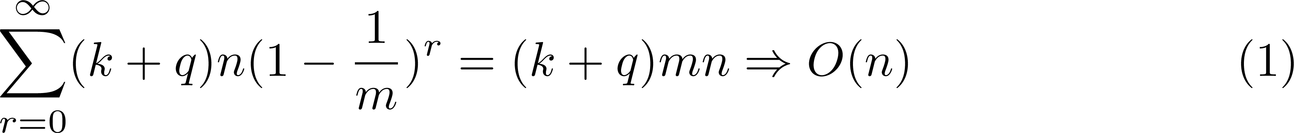
PalmTree
Variations in Implementation
  ICMP based distance querying
  Source based alias resolution
  Embedding into traceroute/traceNET
Probing Complexity
  Distance Query, on the average q
  Alias Query, single probe
  Confidence level k
  Frontier Interface Resolution 1/m of whole at each vantage point

Slide 13
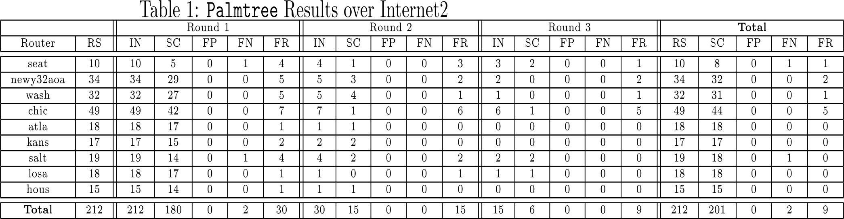
PalmTree
PalmTree over Internet2 from three vantage points

Slide 14
PalmTree
Palm Tree Validation with Mercator from Single Vantage Point
  Mercator is a 100% correct IP alias resolver
  We built a target IP address set T consisting of 92354 distinct IP addresses distributed over four commercial ISPs
  We collected a set M IP alias pairs over four different commercial ISPs with mercator
  We ran Palmtree with disabling source based alias resolution feature on the same target set T and built set P of alias pairs.
  Distance Query method of PalmTree was UDP for this experiment
    |M|=13188
    |P|=16958
    |PՈM|=12110 which is 92%
    |P\M|=4848
    |M\P|=1078 (frontier interfaces for PalmTree)

Slide 15
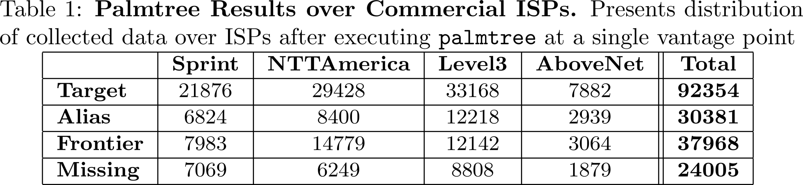
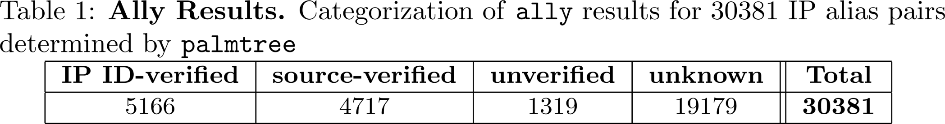
PalmTree
PalmTree Validation with Ally
  Ally response categorization
    Unknown; Source Verified; IP-ID Verified; Unverified

Slide 16
PalmTree
PalmTree with UDP Distance Probing
PalmTree with ICMP Distance Probing

Slide 17
PalmTree
Conclusions
  PalmTree is a novel probe based IP alias resolver
  PalmTree complements existing approaches
  PlamTree has linear probing complexity
  PlamTree does not require pre-collected traceroute paths

Slide 18
PalmTree
Questions

Slide 19
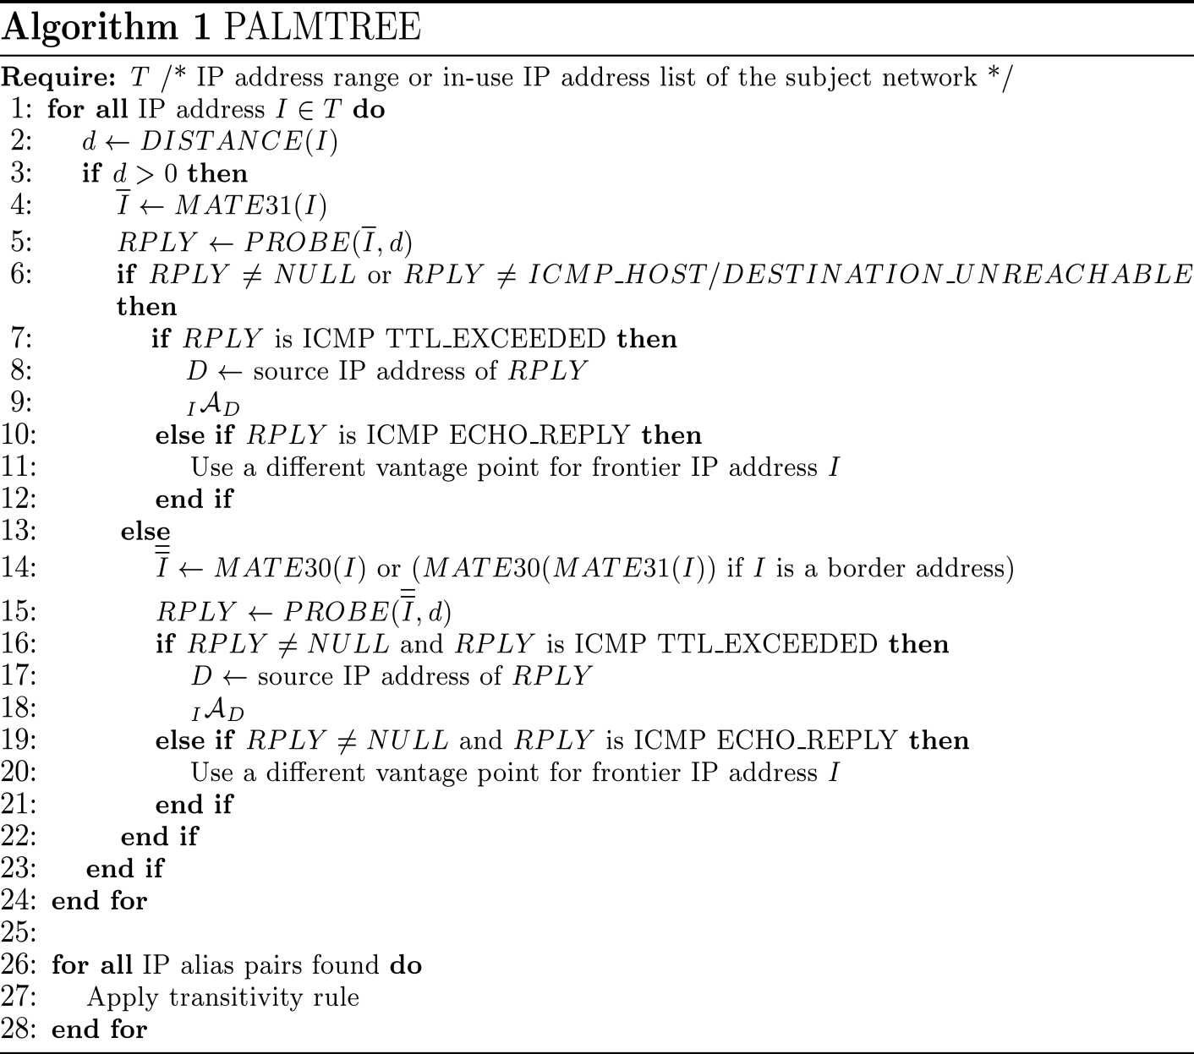
PalmTree

