Slide 1
TraceNET
M.Engin Tozal Kamil Sarac
The University of Texas at Dallas

Slide 2

TraceNET
Destination
Traceroute Path
Source
Source
Destination
TraceNET Path

Slide 3
TraceNET
Destination
Traceroute Path
Source
Source
Destination
TraceNET Path

Slide 4
TraceNET
TraceNET is an online, probe-based network layer topology collection tool
TraceNET employs a set of rules based on inclusion-exclusion principle
A traceNET session collects a topology map on a path between two end systems
TraceNET
  Groups those IP addresses accommodated by the same subnet
  Annotates the subnets with their observed subnet masks
  Discovers more IP addresses than traceroute in a systematic way.
TraceNET could be used as an
  Topology Collection Tool
  Network Debugging/Analysis Tool

Slide 5
TraceNET
TraceNET as a Topology Collection Tool
  Network topologies are collected at AS-level, router-level, and IP-level
  Current router-level topology mapping tools collect IP addresses and groups the ones hosted by the same router (IP Alias Resolution)
  Two successive IP addresses in a trace path does not necessarily point the existence of a LAN between them
  We believe that layer-3 subnets should be an important part of network topology maps

Slide 6
TraceNET
TraceNET as a Network Debugging/Analysis Tool
  Similar to traceroute, traceNET collects a routing path between two end hosts
  However, traceNET reveals much more network information than traceroute
  This could help for example, to detect server replicas located on the same subnet
  We are still looking for new ways of using TraceNET for network debugging/analysis (any suggestion is welcomed)

Slide 7
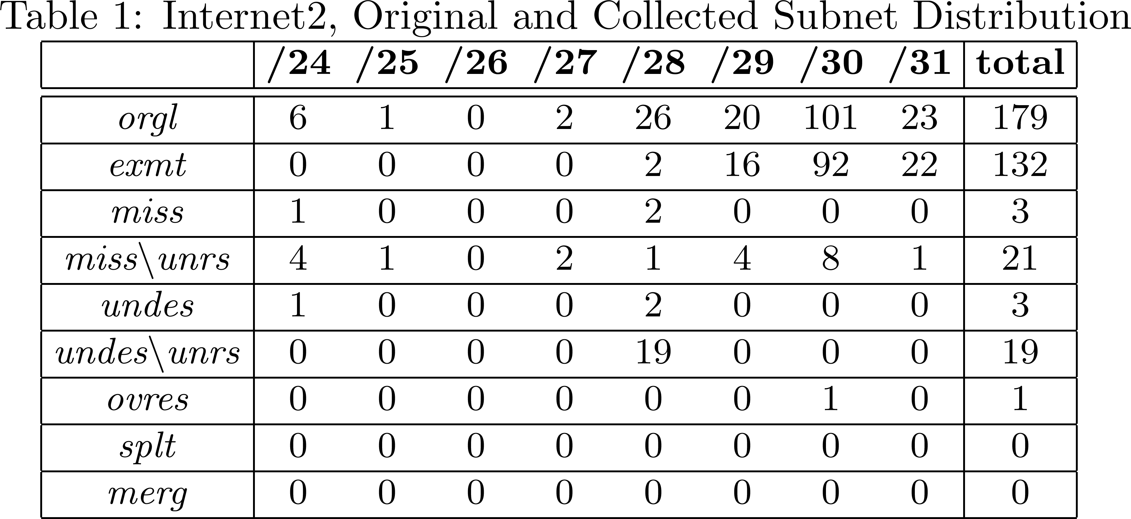
TraceNET

Slide 8
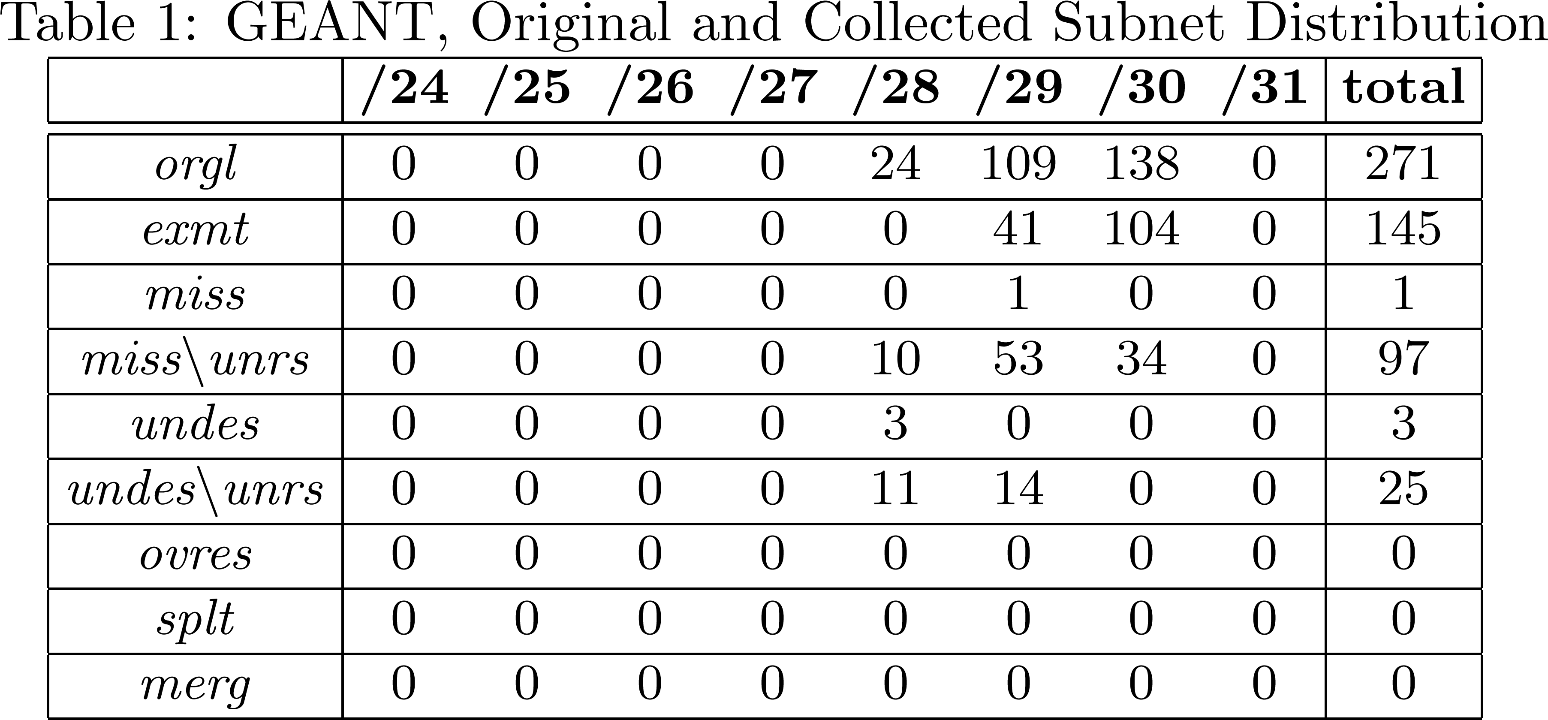
TraceNET

Slide 9
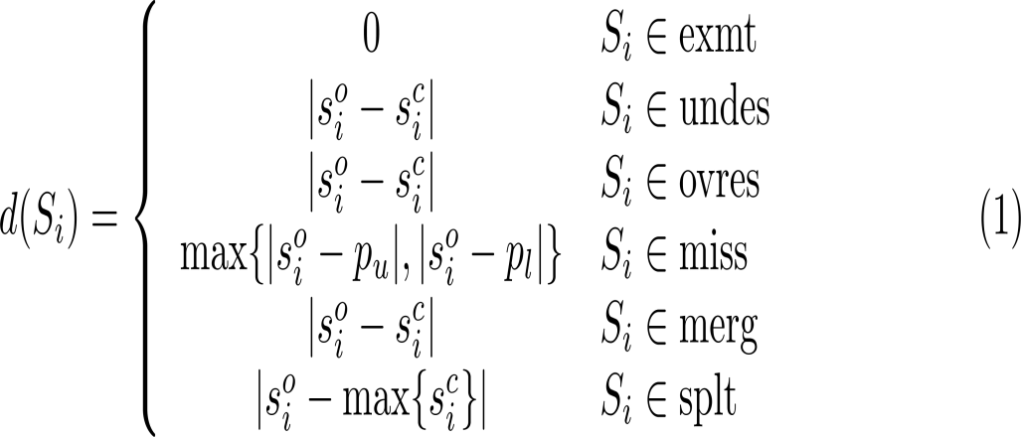
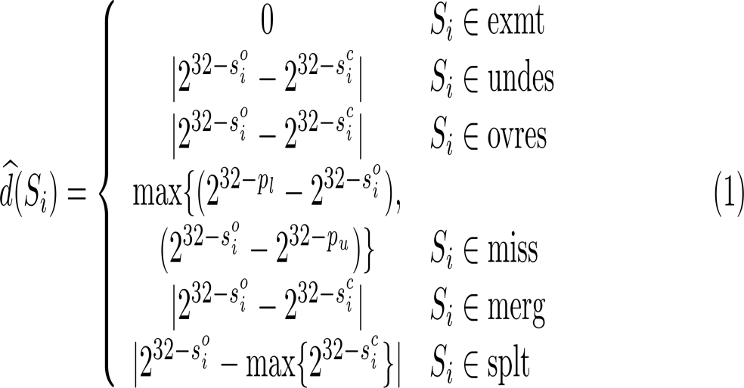
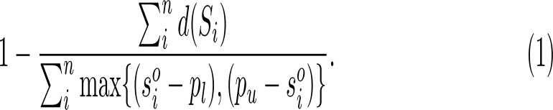
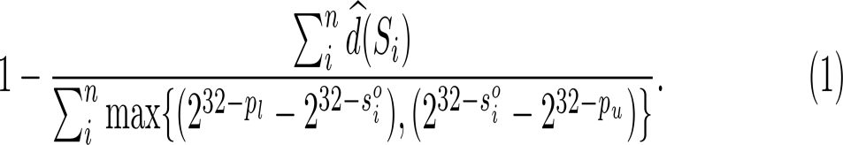
TraceNET
Exact Match Rate
Including Unresponsive Subnets : 73.7%
Excluding Unresponsive Subnets : 94.9%
Exact Match Rate
Including Unresponsive Subnets : 83.0%
Excluding Unresponsive Subnets : 86.0%

Slide 10
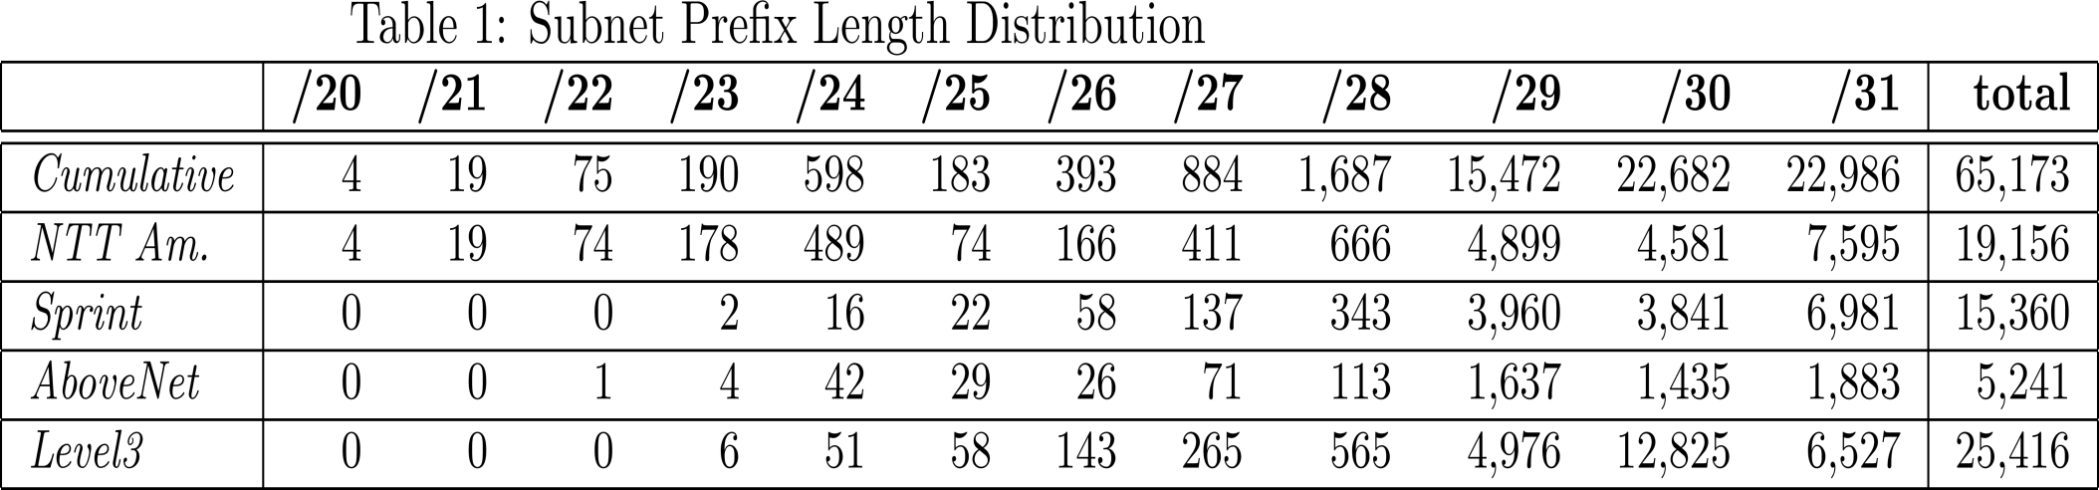
TraceNET

Slide 11
TraceNET

Slide 12
TraceNET
Conclusions
  TraceNET is a traceroute-like online, probe based tool that collects subnets between two end hosts.
  TraceNET could be used in network topology mapping studies to get a more complete map
  TraceNET could be employed as network debugging/analysis tool
  In this study we devised a set of generic heuristics for inferring subnets
  (Future Work) The set of heuristics devised in this study could also be used as an offline algorithm to derive subnets from a bulk of trace paths obtained by traceroute

Slide 13
TraceNET
Questions

