Slide 1
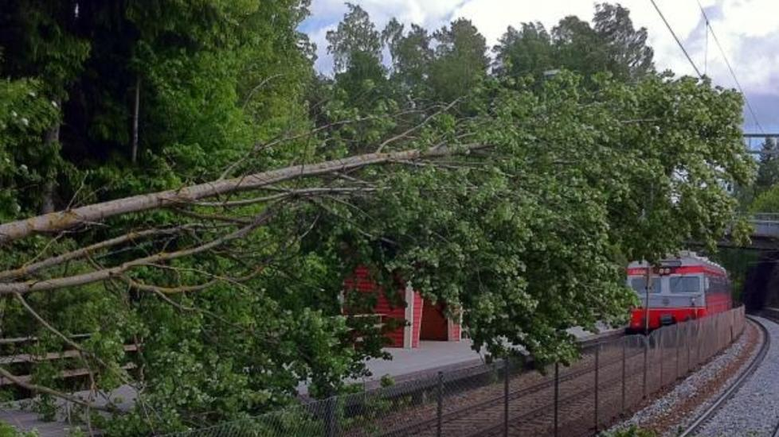
Measuring Mobile Broadband Availability in Norway
Ahmed Elmokashfi and Amund Kvalbein

Slide 2
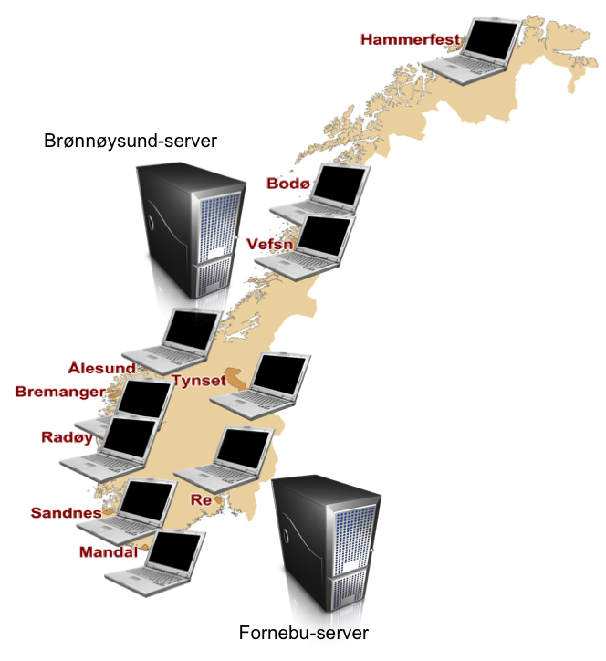
Over 100 measurement points in
10 municipalities
Measure the availability
and quality of multiple
operators

Slide 3





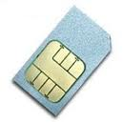
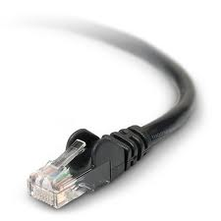
Each measurement node is multihomed to four ISPs
ICE
Brønnøysund
NetCom
Internet
Telenor
Simula
  Fixed
For more information: http://nevada.simula.no/

Slide 4
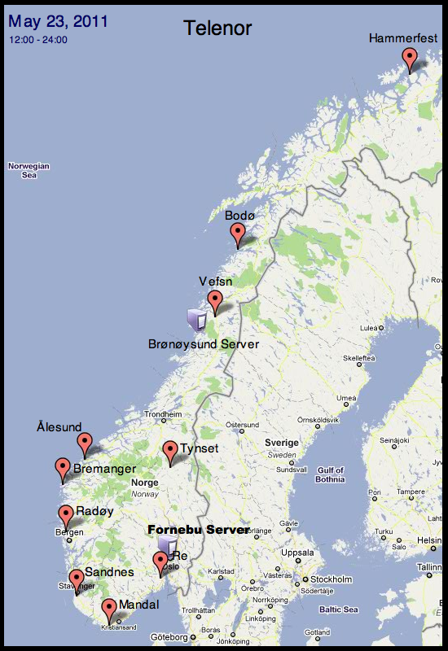


Slide 5
We measure the gaps in monitors ping time series
203 interfaces
- 64 fixed, 56 ICE, 54 Telenor, 29 Netcom
Three months duration (May ‘11-July ‘11)
Downtime
g
Is a downtime if g>=15 seconds

Slide 6
There are large differences in stability between operators and between monitors in the same operator
10 minutes per day

Slide 7
Major failure events have only a slight impact on the measured downtime

Slide 8
Most outages are short-lived lasting less than 3 minutes
CCDF
Failure Duration(Seconds)

Slide 9
Failures tend to be clustered. About 70% of all failures are spaced by less than 100 seconds
CCDF
Up time (Seconds)

Slide 10
Monitors do not fail independently
Telenor
ICE

Slide 11
Failures affecting multiple monitors simultaneously contribute significantly to the overall downtime

Slide 12
In ICE, geographically close monitors are more likely to fail simultaneously
Telenor
ICE
An ICE base station covers a larger geographical area

Slide 13
Combining all three MBB operators increases the overall availability to 99.98%
2 minutes
18 seconds
Telenor | Netcom | ICE
99.51% | 99.83% | 99.73%

Slide 14
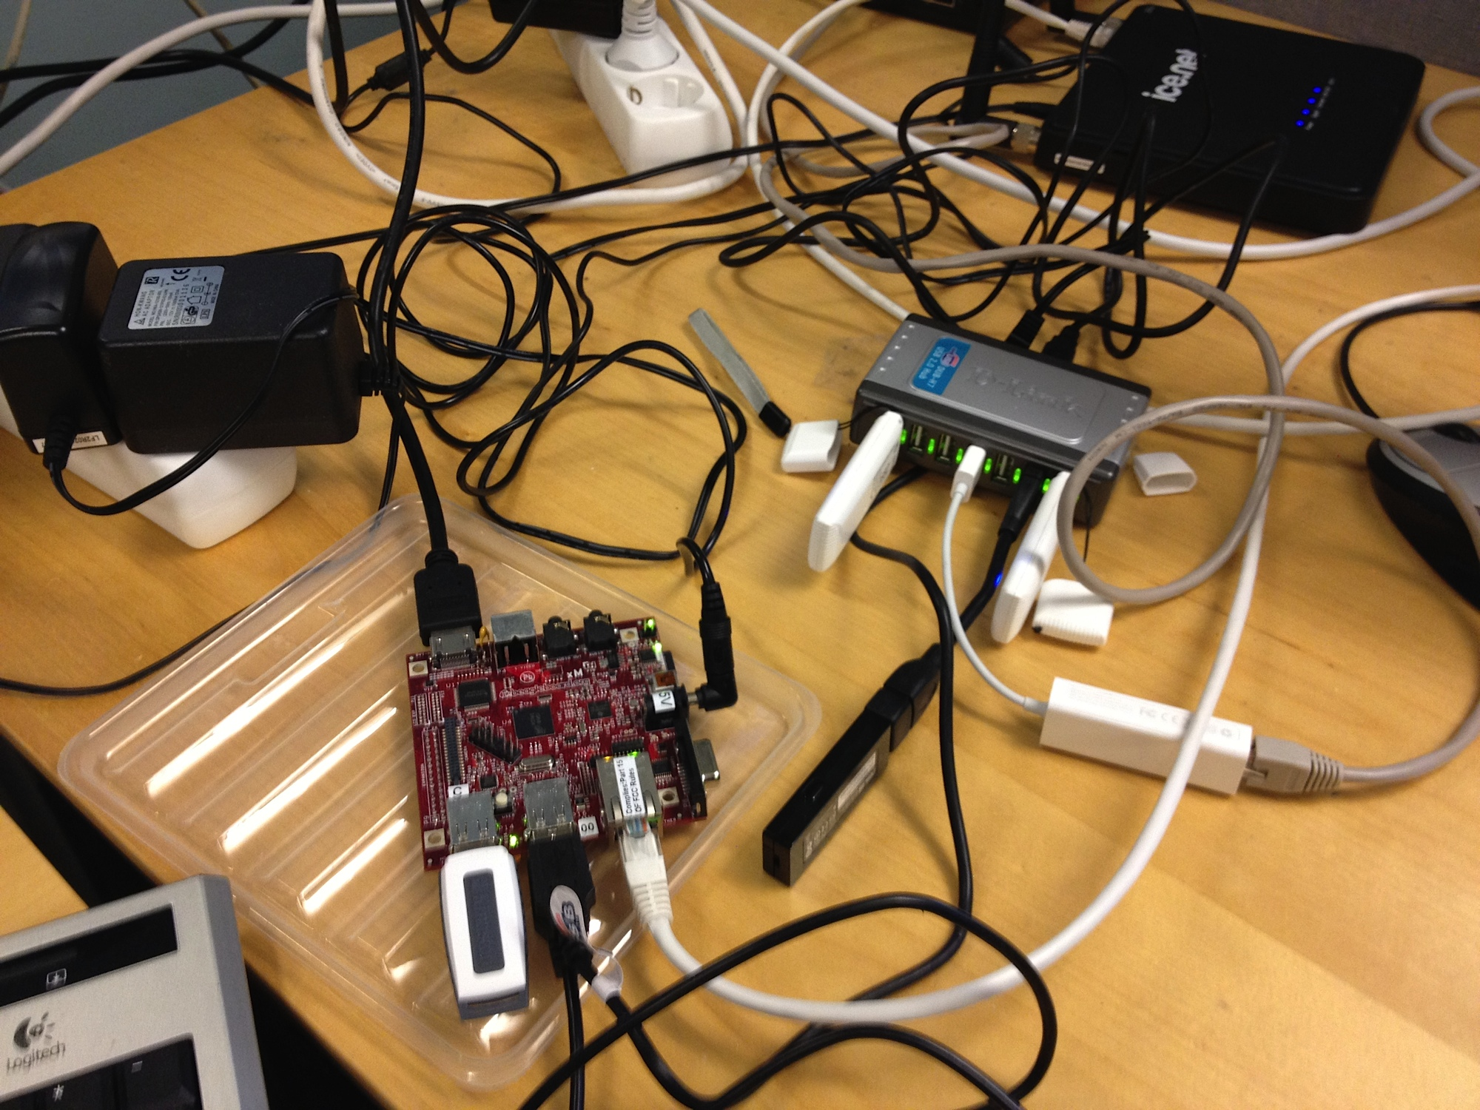


What’s next?
New measurement nodes
External data sources
Mobile Apps

