Slide 1

On the Evolution of ndnSIM: an Open-Source Ecosystem for NDN Experimentation
NDNcomm 2017
Macrh 23 – 24
Memphis
Spyridon (Spyros) Mastorakis
University of California, Los Angeles

Slide 2
Presentation Overview
Design of ndnSIM simulation ecosystem
Design trade-offs
NDN research areas enabled by ndnSIM
Community adoption & growth
Major lessons learned during the development process
ndnSIM running code

Slide 3
ndnSIM Simulation Ecosystem
ndnSIM: Open-source NDN simulator based on NS-3
Fully integrated with NDN prototype implementations: NFD & ndn-cxx
Effort started in 2011
6 years since then, several lessons learned
Goals:
Create a common NDN evaluation platform
Keep up with the latest advancements of NDN research
Provide interoperability between simulation and prototyping
Enable a two-way of experimentation and evaluation
Enable high-fidelity NDN simulations
Notes:
1) Keep up with the latest advancements of NDN research → Parts of NDN forwarding (strategies, congestion control mechanisms), packet format, security, applications
2) Provide interoperability between simulation and prototyping
Enable a two-way of experimentation
In the sense that code developed in ndnSIM can be moved directly to the real NFD and ndn-cxx prototypes and vice versa

Slide 4
ndnSIM Ecosystem Design
Notes:
a) On the bottom, we have NS-3. ndnSIM uses NS-3 in the following ways:
Define simulation topologies and set node and link parameters (delay, bandwidth, queue size, etc.)
Simulate available NS-3 models (energy, mobility, LoWPAN) and modules (WiFi, LTE)
Simulate the exchange of NDN traffic among simulated nodes
Simulation execution visualization using the NS-3 visualization module
b) Above that, we have the NDN Prototypes; NFD (Face, PIT, FIB, CS, strategy) and ndn-cxx (packet encoding/decoding, signing, security, Face used by real-world apps)
c) Above that, we have an NDN Simulation Layer including:
ndnSIM core: 1) NDN protocol stack
2) LinkService for ndnSIM specific apps to talk to the local forwarder
3) Network Device Transport to talk to lower layer NS-3 components (NetDevice) and encap/decap NDN packets to/from NS-3 packets
4) helpers (to set NFD’s strategy, routes in FIB, cache replacement policy) and utilities (packet tracers, tool to create topologies defined in external txt files)
d) Applications: 1) ndnSIM-specific apps: consumer and producer applications developed to work in ndnSIM
2) Real-world apps: applications that use the Face abstraction provided by ndn-cxx and were ported to ndnSIM
e) Plug-N-Play simulation scenarios: collection of simulation scenarios of various network enviroments that users can run as soon as they compile ndnSIM

Slide 5
Prototype Integration Trade-offs
On the one hand:
1) Lost backward compatibility (with ndnSIM 1.0)
2) Lost ability to use NS-3 virtual payload
3) Increased memory requirements
On the other hand:
A two-way of experimentation and evaluation
High-fidelity simulation of NDN networks

Slide 6
ndnSIM: NDN Research Enabler
Design and experimentation with NDN Forwarding (forwarding strategies, congestion control, etc.)
Experimentation with a variety of Network Environments (mobile, IoT, vehicular, wireless ad hoc, etc.)
Design and debugging of real-world applications (ChronoSync, nTorrent, etc.)
Design of link-layer protocols
Design and evaluation of routing protocols
Design and evaluation of in-network caching schemes (we believe there are more interesting research areas to work on…)

Slide 7
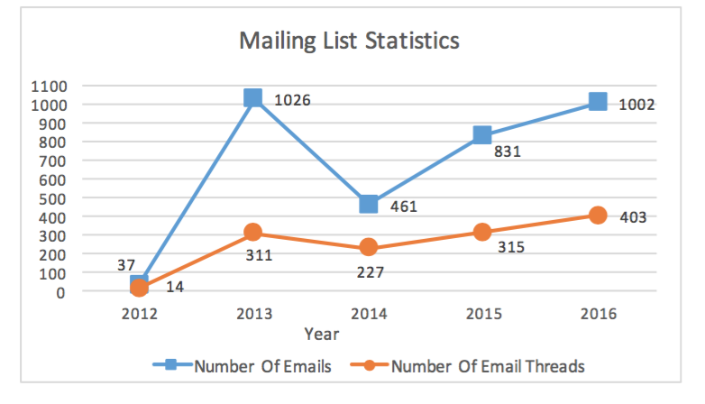
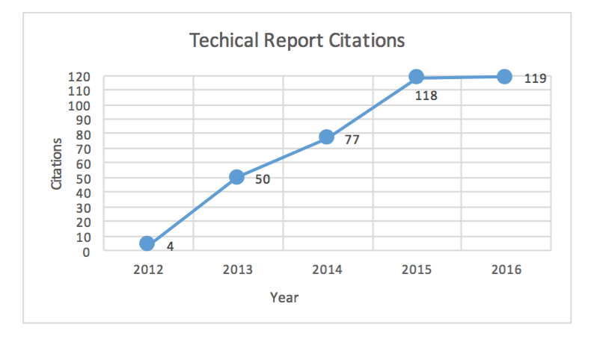
Community Adoption & Growth
Started with a mailing list with a few dozen of subscribers
Now: ~500 subscribers, 380 Technical Report citations

Slide 8
Lessons Learned
A well-designed simulation platform facilitates the protocol design effort
The simulator and the prototypes facilitate and influence each other’s development
Developing an open-source software project is an iterative process
Researchers should be able to reproduce each other’s experiments
An open communication channel with the user community is crucial for an open-source project
Notes:
some design deficiencies come up only after intensive experimentation. A recent example is ChronoSync [40], a distributed protocol for dataset synchronization in NDN; a design bug that could lead to large delays in the case of multiple simultaneous data generations was discovered and fixed after large scale simulations.
ndnSIM changes over time, since NDN itself is evolving, thus researchers should record the ndnSIM version that was used, so that others can reproduce their results (especially those used in published work)
Users help each other on the mailing list and implement new features or submit bug fixes. We have tried to establish this channel through: a) extensive documentation publicly available on our website, so that users can become familiar with the development process and ramp up with the simulator codebase, b) mailing list to encourage direct communication with/among the users and respond to questions not covered in the documentation (the mailing list requires commitment and daily effort to answer all the questions)
Feature development -> user feedback -> re-design, refactor or extend
a) When NFD and ndn-cxx development process started, code from ndnSIM was used to facilitate it. Eventually, NFD and ndn-cxx were integrated with ndnSIM.
b) we work closely with the NFD team to make sure that the features developed for NFD and ndn-cxx are compatible with ndnSIM and NS-3

Slide 9
ndnSIM Running Code
Latest version: ndnSIM v2.3: https://github.com/named-data-ndnSIM/ndnSIM
Integrated NFD v0.5: https://github.com/named-data-ndnSIM/NFD/tree/38111cde9bab698f6eaf1a9d430130c2cbb3eca4
Integrated ndn-cxx v0.5: https://github.com/named-data-ndnSIM/ndn-cxx/tree/4692ba80cf1dcf07acbbaba8a134ea22481dd457
Real-world application examples:
  ChronoSync: https://github.com/named-data-ndnSIM/scenario-ChronoSync
  NDN Ping: https://github.com/named-data-ndnSIM/scenario-ndn-ping
NLSR in ndnSIM: https://github.com/3rd-ndn-hackathon/nlsrSIM

Slide 10
ndnSIM: Universal Evaluation Platform for NDN Experimentation
Modular design
High-fidelity NDN simulations
Integration with NFD & ndn-cxx
Support for real-world applications
Continuous development & support
Extensive documentation available on our website: http://ndnsim.net
Growing community
Active mailing list: ndnsim@lists.cs.ucla.edu

Slide 11
We invite you to use ndnSIM and explore NDN research

