Slide 1
Analysis of peering strategy adoption by transit providers in the Internet
Aemen Lodhi (Georgia Tech)
Amogh Dhamdhere (CAIDA)
Constantine Dovrolis (Georgia Tech)
2nd Workshop on Internet Economics (WIE’11)

Slide 2
Outline
Motivation
Objective
The model: GENESIS
Results
  Adoption of peering strategies
  Impact on economic fitness
  Who loses? Who gains?
Alternatives
Conclusion

Slide 3
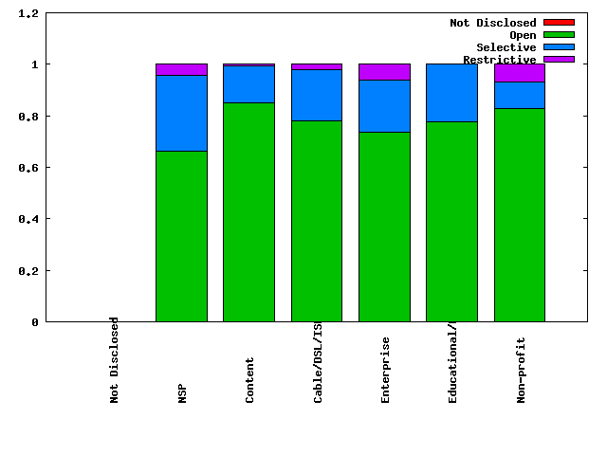
Motivation
Peering strategies of ASes in the Internet
(source: PeeringDB www.peeringdb.com)

Slide 4
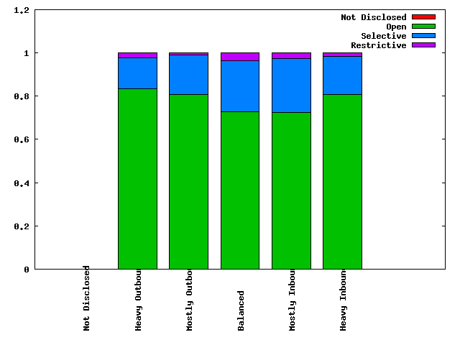
Motivation
Peering policies for networks classified by traffic ratio (source: PeeringDB www.peeringdb.com)

Slide 5

Objective
Why do transit providers peer Openly?
Impact on their economic fitness?
Which transit providers lose/gain?
Are their any alternative peering strategies?
Internet
Transit Provider
Transit Provider
Enterprise customer
Content Provider
Content Provider
Enterprise customer

Slide 6
Approach
Agent based computational modeling
Scenarios
Conservative
Selective
Restrictive
vs.
Non-conservative
Selective
Restrictive
Open

Slide 7
The model: GENESIS*
Agent based interdomain network formation model
Incorporates
  Co-location constraints in provider/peer selection
  Traffic matrix
  Public & Private peering
  Set of peering strategies
  Peering costs, Transit costs, Transit revenue

Slide 8
The model: GENESIS*
  Fitness = Transit Revenue – Transit Cost – Peering cost
Objective: Maximize economic fitness
Optimize connectivity through peer and transit provider selection
Choose the peering strategy that maximizes fitness

Slide 9
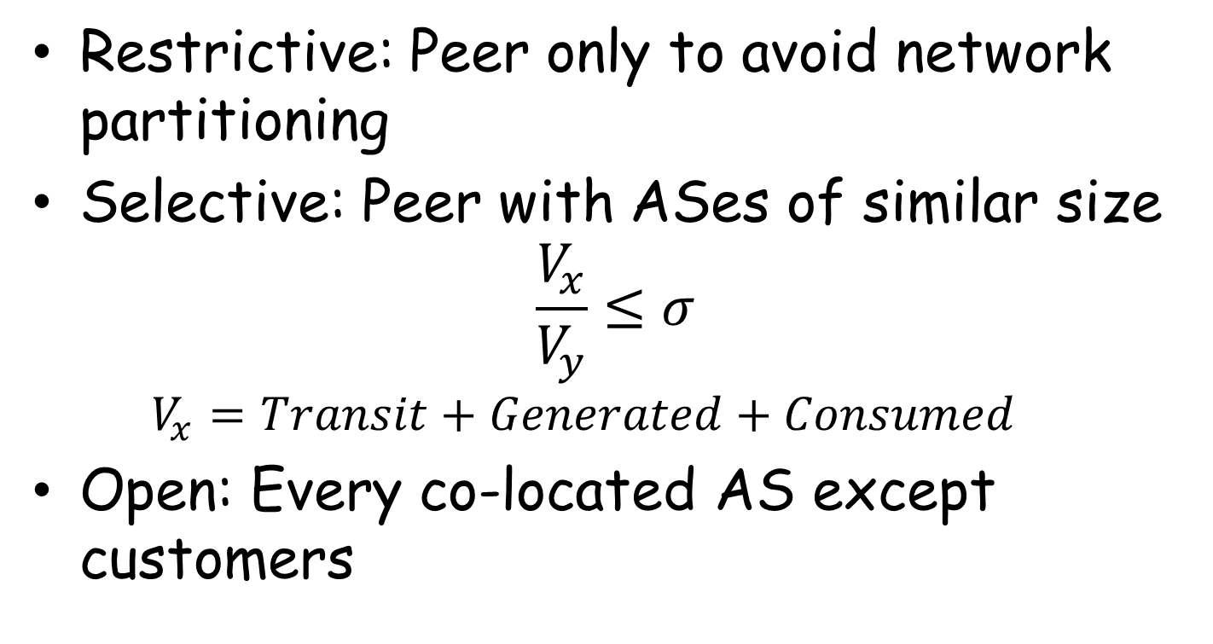
Peering strategies
Restrictive: Peer only to avoid network partitioning
Selective: Peer with ASes of similar size
$$\frac{V_{x}}{V_{y}}≤σ$$
  $$V_{x}=Transit+Generated+Consumed$$
Open: Every co-located AS except customers

Slide 10
results

Slide 11
Strategy adoption by transit providers

Slide 12
Why do transit providers adopt Open peering?
Affects:
Transit Cost
Transit Revenue
Peering Cost
v
Save transit costs
x
y
But your customers are doing the same!
z
w

Slide 13
Why gravitate towards Open peering?
x adopts Open peering
x regains lost transit revenue partially
x lost transit revenue
Options for x?
x
y
Not isolated decisions
Network effects !!
Y peering openly
z w,
traffic passes through x
z
z w,
z y,
traffic bypasses x
w

Slide 14
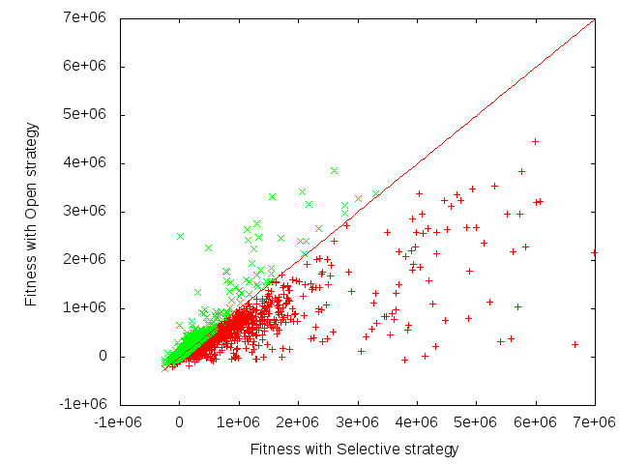
Impact on fitness of transit providers switching from Selective to Open
70% providers have their fitness reduced

Slide 15
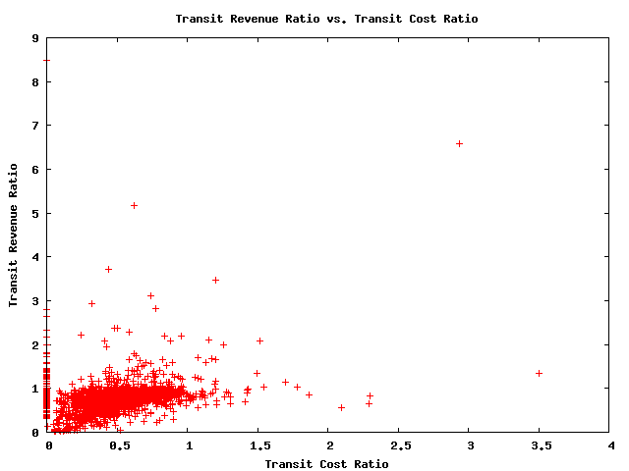

Fitness components: transit cost, transit revenue, peering cost?
Reduction in transit cost accompanied by loss of transit revenue
$Transit cost ratio= \frac{Transit cost with Open}{Transit cost with Selective}$

Slide 16
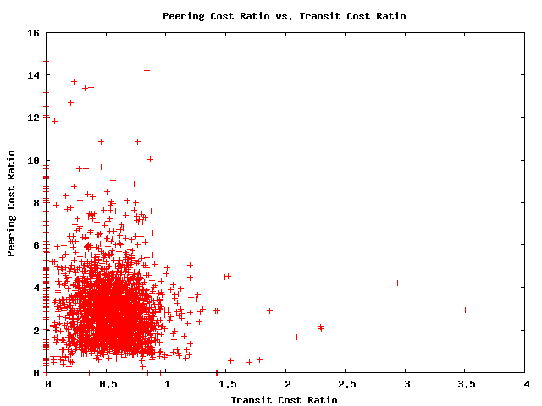
Fitness components: transit cost, transit revenue, peering cost?
Significant increase in peering costs
Interplay between transit & peering cost, transit revenue

Slide 17
Avoid fitness loss?
Lack of coordination
No incentive to unilaterally withdraw from peering with peer’s customer
Sub-optimal equilibrium
x
y
vs.
x
y
z
w
z
w

Slide 18
Which transit providers gain through Open peering? Which lose?
Classification of transit providers
  Traffic volume
  Customer cone size

Slide 19
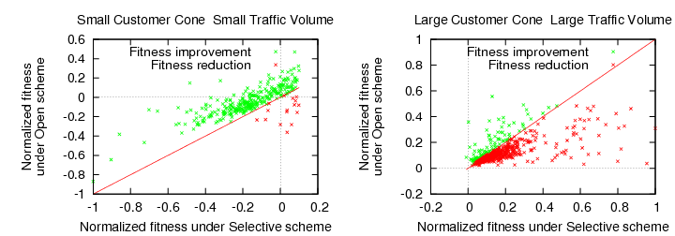
Who loses? Who gains?
Who gains: Small customer cone small traffic volume
  Cannot peer with large providers using Selective
  Little transit revenue loss
Who loses: Large customer cone large traffic volume
  Can peer with large transit providers with Selective
  Customers peer extensively

Slide 20
Alternatives: Open peering variants
Do not peer with immediate customers of peer (NPIC)
Do not peer with any AS in the customer tree of peer (NPCT)
x
y
x
y
w
z
w
z
v
NPIC
NPCT

Slide 21
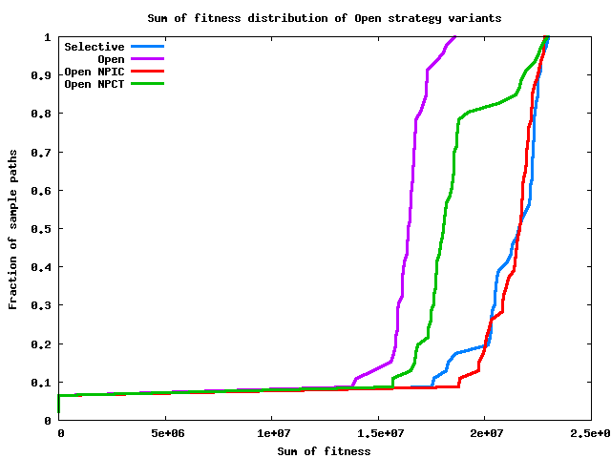
Fitness analysis Open peering variants
Collective fitness with NPIC approaches Selective

Slide 22
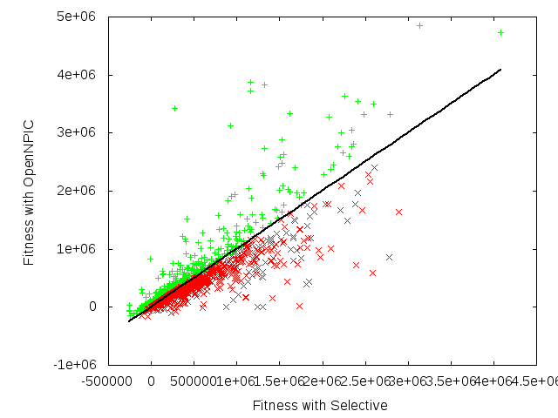
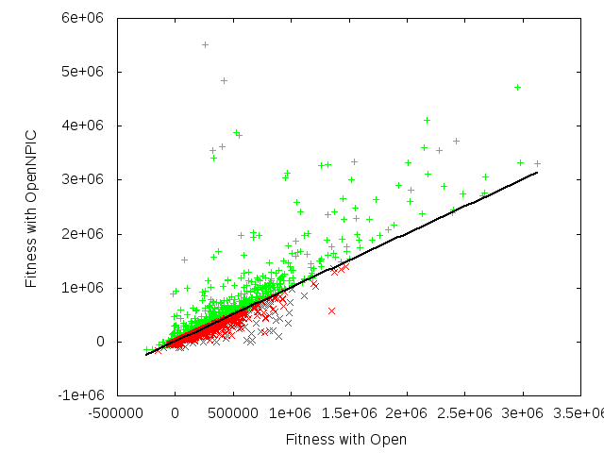
Fitness analysis Open peering variants
47% transit providers loose fitness compared to Conservative scheme with Selective strategy
OpenNPIC vs. Selective
OpenNPIC vs. Open

Slide 23
Fitness analysis Open peering variants
Why the improvement?
  No traffic “stealing” by peers
  Aggregation of peering traffic over fewer links (economies of scale !!)
  Less pressure to adopt Open peering
Why did collective fitness not increase?
  Non-peer transit providers peer openly with stub customers

Slide 24
Fitness analysis Open peering variants
Why NPIC gives better results than NPCT?
  Valley-free routing
  x has to rely on
  provider to reach v
x
y
w
z
v
NPCT
24

Slide 25
Conclusion
Gravitation towards Open peering is a network effect for transit providers
Extensive Open peering by transit providers in the network results in collective loss
Coordination required to mitigate
No-peer-immediate-customer can yield results closer to Selective strategy

Slide 26
Thank you

Slide 27
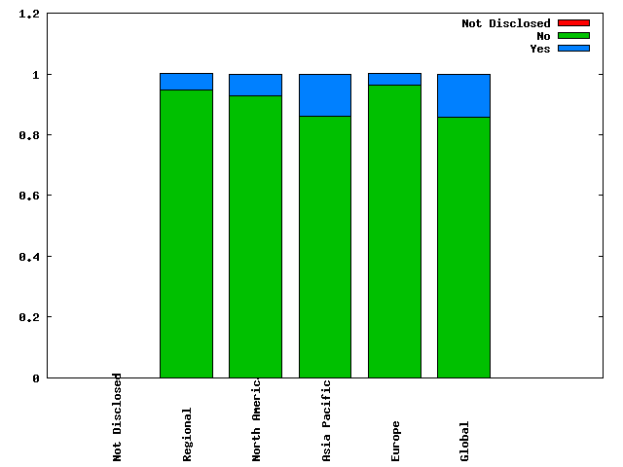
Motivation
Traffic ratio requirement for peering?
(source: PeeringDB www.peeringdb.com)

Slide 28
Introduction
Internet
Transit Provider
Transit Provider
Enterprise customer
Content Provider
Content Provider
Enterprise customer

Slide 29
Traffic components
Inbound traffic
Traffic consumed in the AS
Traffic generated within the AS
Traffic transiting through the AS
Autonomous system
Outbound traffic
Transit traffic = Inbound traffic – Consumed traffic
same as
Transit traffic = Outbound traffic – Generated traffic

Slide 30
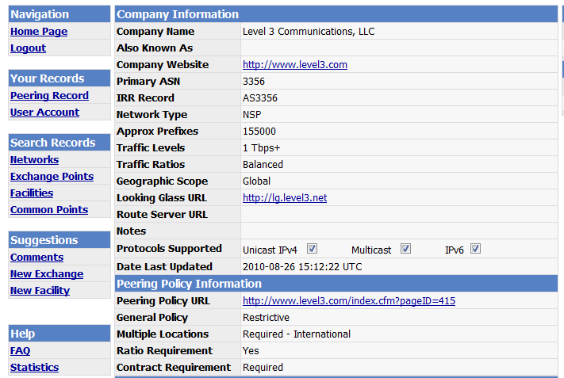
Customer-Provider traffic comparison – PeeringDB.com
Traffic carried by the AS

Slide 31
Customer-Provider traffic comparison
2500 customer-provider pairs
90% pairs: Customer traffic significantly less than provider traffic
9.5% pairs: Customer traffic larger than provider traffic (difference less than 20%)
0.05% pairs: Customer traffic significantly larger than provider traffic

Slide 32
Geographic presence & constraints
Peering link at top tier possible across regions
Geographic overlap
Link formation across geography not possible
Regions corresponding to unique IXPs

Slide 33
Logical Connectivity

Slide 34
Traffic
Traffic for ‘N’’ size network represented through an N * N matrix
Illustration of traffic matrix for a 4 AS network
Intra-domain traffic not captured in the model
Traffic sent by AS 0 to other ASes in the network
Generated traffic
Traffic received by AS 0 from other ASes in the network
Consumed traffic

Slide 35
Peering strategy adoption
Strategy update in each round
Enumerate over all available strategies
Use netflow to “compute” the fitness with each strategy
Choose the one which gives maximum fitness

Slide 36
Peering strategy adoption
Open
Selective
Open
No coordination
Limited foresight
Eventual fitness can be different
Stubs always use Open peering strategy
1
2
3
Time
Restrictive
Selective
Open
Restrictive
Selective
Open
Restrictive
Selective
Open

